Slide 1

16.03 JDBC Practice: Part 2
Peter H. Chen

Slide 2
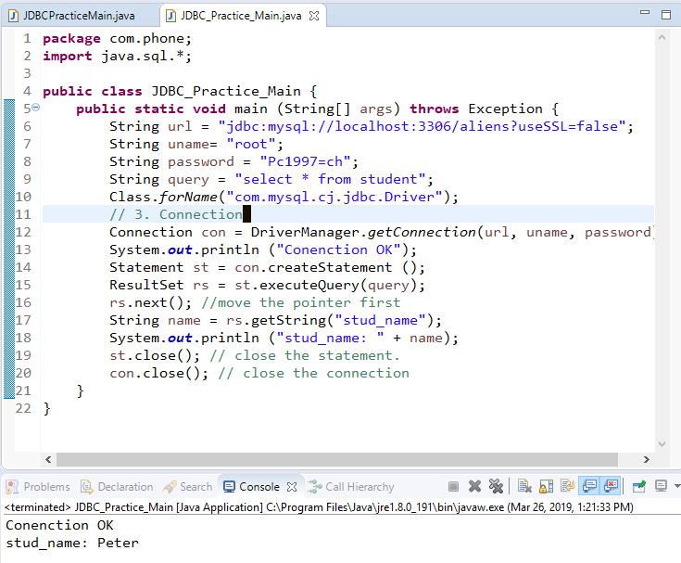
16.03 JDBC Practice: Part 2
https://www.youtube.com/watch?v=5vzCjvUwMXg&list=PLGwb7xZHg-oMv1pOlTHAqAEjw0EPALzlL&index=159
Last section, we have JDBC connect to MySQL Database and retrieve and print the one value.

Slide 3
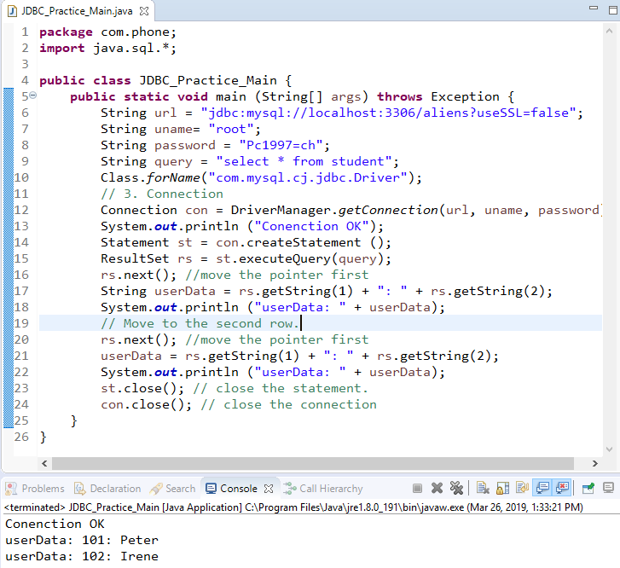
16.03 JDBC Practice: Part 2
https://www.youtube.com/watch?v=5vzCjvUwMXg&list=PLGwb7xZHg-oMv1pOlTHAqAEjw0EPALzlL&index=159
Use rs.next() two times to move to the next row and get the data.

Slide 4
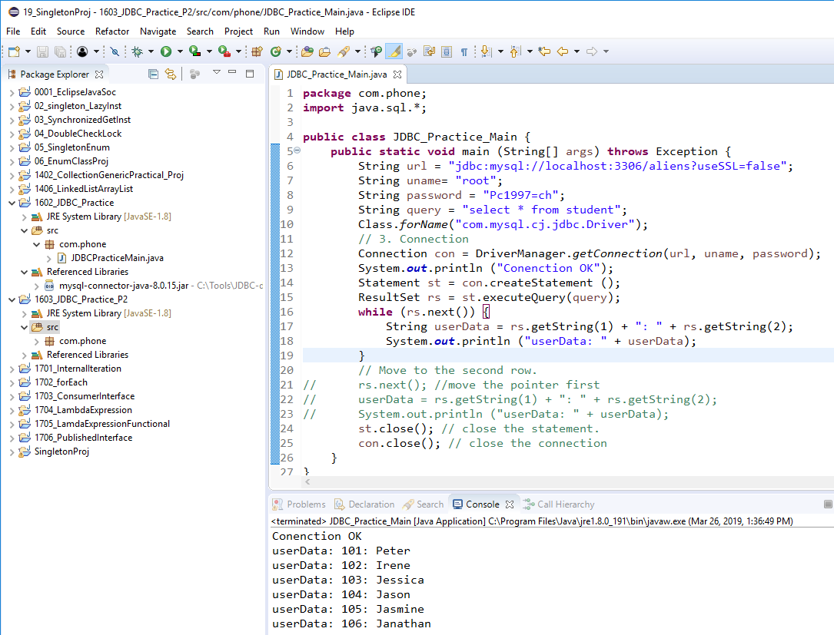
16.03 JDBC Practice: Part 2
https://www.youtube.com/watch?v=5vzCjvUwMXg&list=PLGwb7xZHg-oMv1pOlTHAqAEjw0EPALzlL&index=159
We can use while loop for rs.next()

Slide 5
End of Chapter

