Slide 1

17.05 Lambda Expression Functional
Peter H. Chen

Slide 2
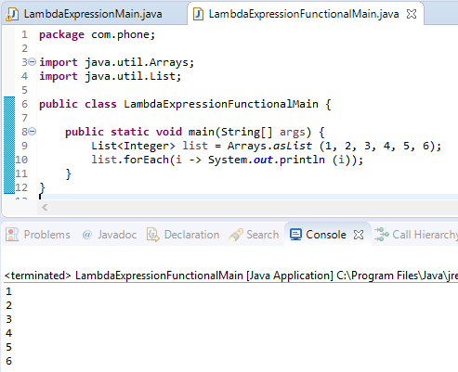
17.05 Lambda Expression Functional
https://www.youtube.com/watch?v=mY1IquoLFhg&list=PLsyeobzWxl7oZ-fxDYkOToURHhMuWD1BK&index=168
What have we done so far?
We have created a list of values in which we have assigned 6 values.
Once we have object with 6 elements.
We can use external iteration or internal iterations with forEach.
We use Lambda expression to take the one object value one at time out of array of objects.

Slide 3
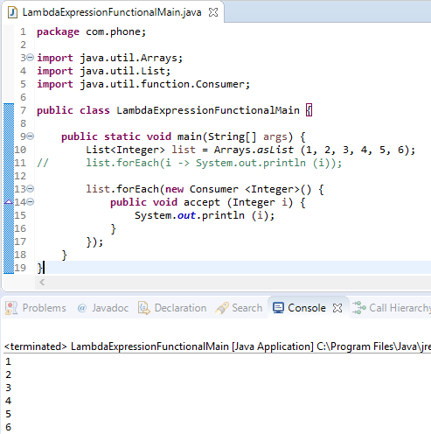
17.05 Lambda Expression Functional
https://www.youtube.com/watch?v=mY1IquoLFhg&list=PLsyeobzWxl7oZ-fxDYkOToURHhMuWD1BK&index=168
In this section, we are going to use Single Abstract Method (SAM) to implement forEach().
We will use SAM (Single Abstract Method) instead of Lambda function.
The SAM interface is also called Functional Interface with only one method accept () inside.

Slide 4
17.05 Lambda Expression Functional
https://www.youtube.com/watch?v=mY1IquoLFhg&list=PLsyeobzWxl7oZ-fxDYkOToURHhMuWD1BK&index=168
This forEach only take the Consumer interface.
Inside the Consumer Interface, there is only method accept ().

Slide 5
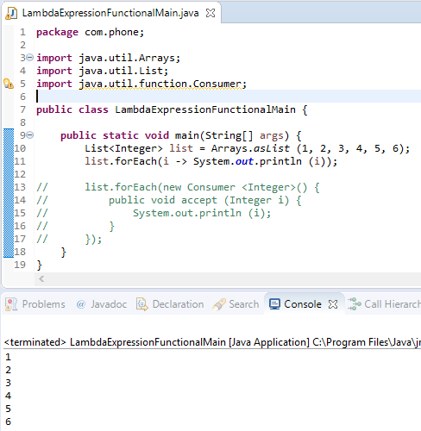
17.05 Lambda Expression Functional
https://www.youtube.com/watch?v=mY1IquoLFhg&list=PLsyeobzWxl7oZ-fxDYkOToURHhMuWD1BK&index=168
We can simplify the Consumer Functional will back to the Lambda Expression again.

Slide 6
End of Chapter

