Slide 1

4 Double Check Lock
Peter H. Chen

Slide 2
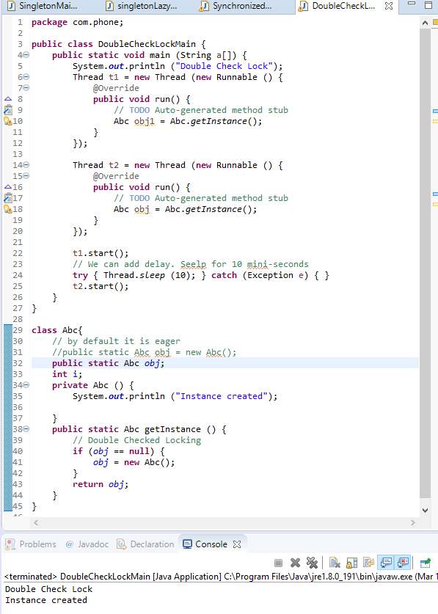
4 Double Check Lock
https://www.youtube.com/watch?v=KUTqnWswPV4&list=PLsyeobzWxl7rqhgfVySFnwhtS4QUT4805
This section discusses Double Check Lock.
The try { Thread.sleep (10) } catch ( Exception e) {} is added for delay 10 mini-second before start another thread, the singleton still work.
We remove the synchronized keyword from getInstance().

Slide 3
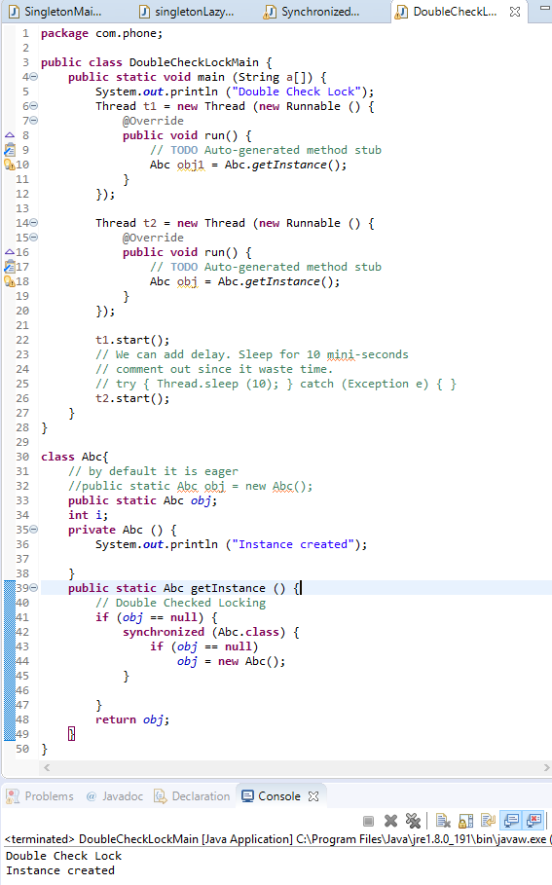
4 Double Check Lock
https://www.youtube.com/watch?v=KUTqnWswPV4&list=PLsyeobzWxl7rqhgfVySFnwhtS4QUT4805
But, waiting for 10 mini-seconds is waiting time.
Remove the wait for 10-min seconds.
We can use double check lock to save time.
How do we use the double check lock?
Double check mean we check the object two times.
The first check is simply check, the second time is inside the synchronized block.
Instead of delay 10 min-seconds. The double check lock is around 5-6 min-seconds.

Slide 4
End of Chapter

