Slide 1

16.04 JDBC Practice: Part 3
Peter H. Chen

Slide 2
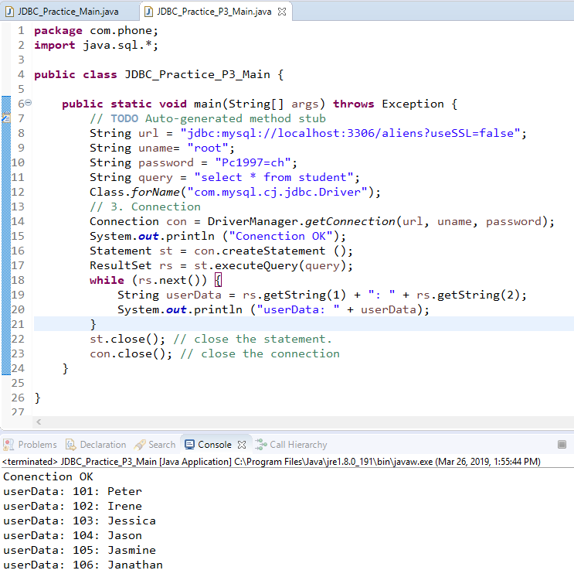
16.04 JDBC Practice: Part 3
https://www.youtube.com/watch?v=DyTEu08x3o0&list=PLsyeobzWxl7rU7Jz3zDRpqB-EODzBbHOI&index=4
Last section, we use while (rs.next()) to loop through the ResultSet data.

Slide 3
16.04 JDBC Practice: Part 3
https://www.youtube.com/watch?v=DyTEu08x3o0&list=PLsyeobzWxl7rU7Jz3zDRpqB-EODzBbHOI&index=4
In this section, we try to insert data from Java, not from the MySQL Workbench.
DDL: create table. You change the structure of database by DDL.
DML: Insert, update, and delete values.
DQL: retrieve the data.
TCL: Transaction Control Language for grant permission and rollback for revoke the permission.
When you insert the data by DML, you are not retrieve the data.
You cannot use executeQuery(), instead, you use executeUpdate().

Slide 4
16.04.01 Insert Row Data
Peter H. Chen

Slide 5
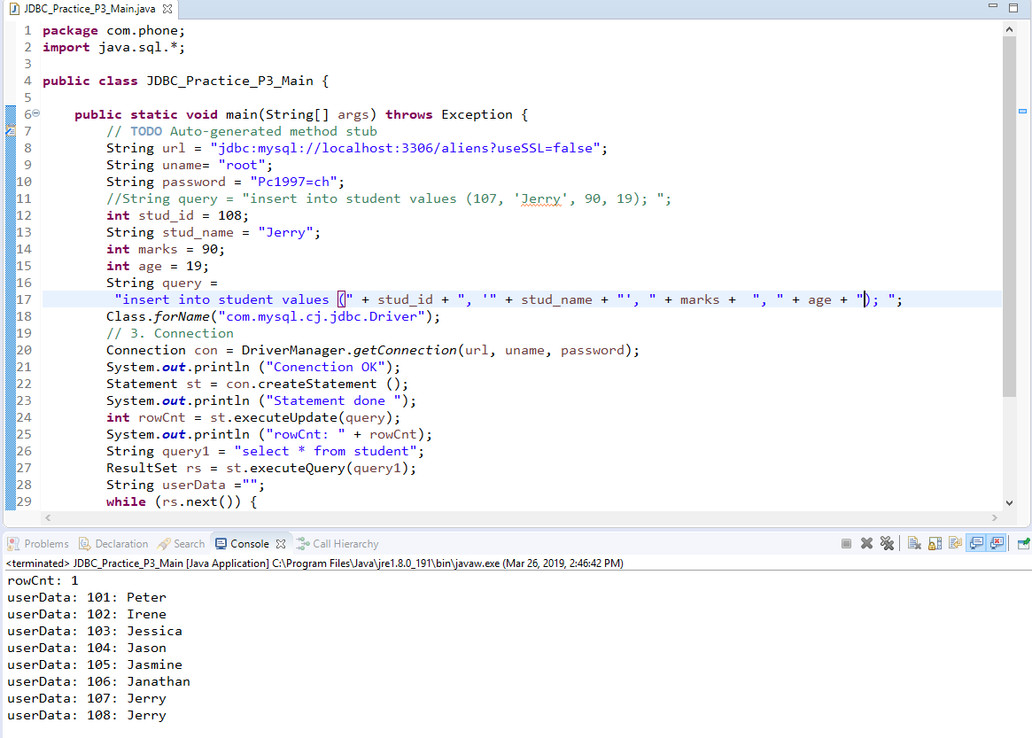
16.04.01 Insert Row Data
https://www.youtube.com/watch?v=DyTEu08x3o0&list=PLsyeobzWxl7rU7Jz3zDRpqB-EODzBbHOI&index=4
If you use int or string variables, you can use string double quote concatenation for operator.

Slide 6
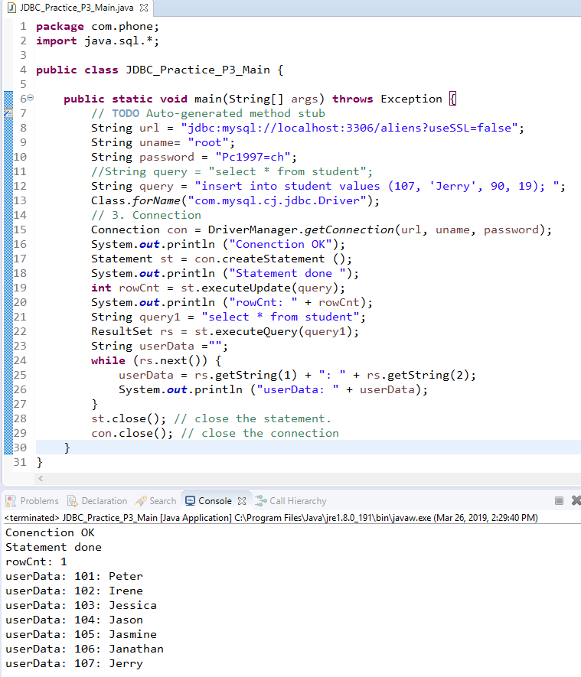
16.04.01 Insert Row Data
https://www.youtube.com/watch?v=DyTEu08x3o0&list=PLsyeobzWxl7rU7Jz3zDRpqB-EODzBbHOI&index=4
Query = “insert into student values (107, ‘jerry’, 90, 19); “;
Add “int rowCnt = executeUpdate(query)”.

Slide 7
16.04.02 PreparedStatment for Insert
Peter H. Chen

Slide 8
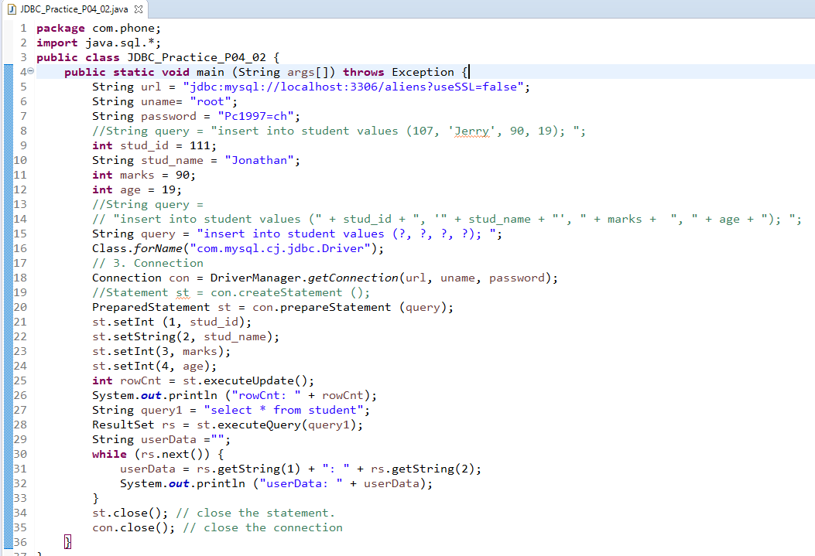
16.04.02 PreparedStatment for Insert
https://www.youtube.com/watch?v=DyTEu08x3o0&list=PLsyeobzWxl7rU7Jz3zDRpqB-EODzBbHOI&index=4
This is just 4 columns, if you have 10 columns, how you handle the double quote problem?
We can use preparedStatement with st.setInt()/st.setString() as below.

Slide 9
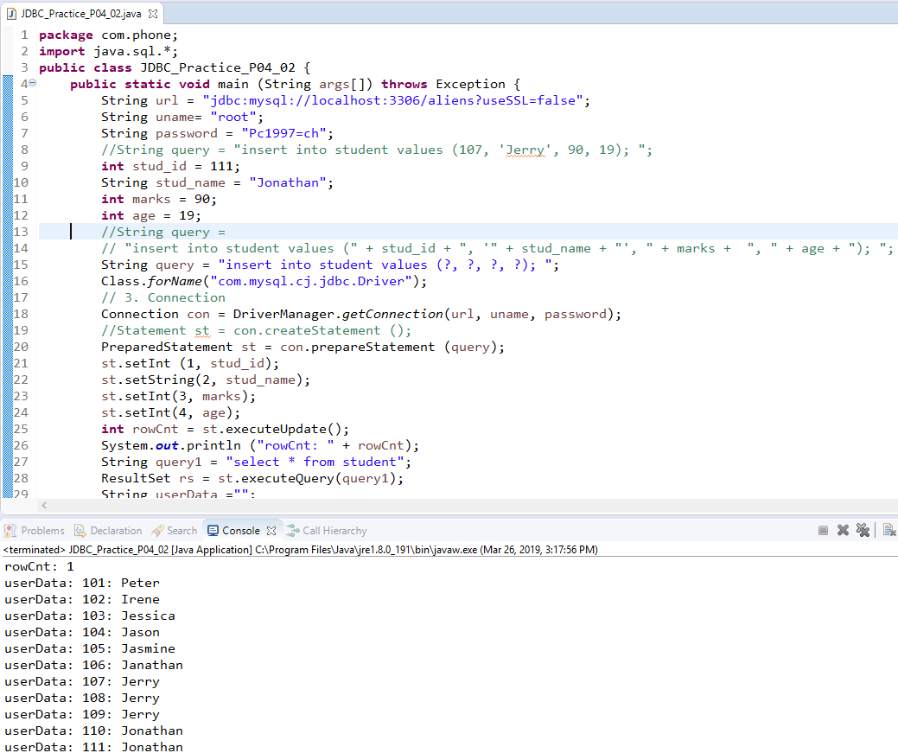
16.04.02 PreparedStatment for Insert
https://www.youtube.com/watch?v=DyTEu08x3o0&list=PLsyeobzWxl7rU7Jz3zDRpqB-EODzBbHOI&index=4
Run Java Application.

Slide 10
End of Chapter

