Slide 1

1 String
Peter H. Chen

Slide 2
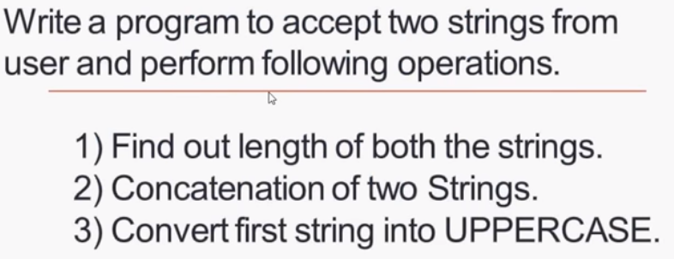
1 String
https://www.youtube.com/watch?v=5J9o2Q7MqUQ&list=PLsyeobzWxl7oZ-fxDYkOToURHhMuWD1BK&index=96
We discuss String Operation.

Slide 3
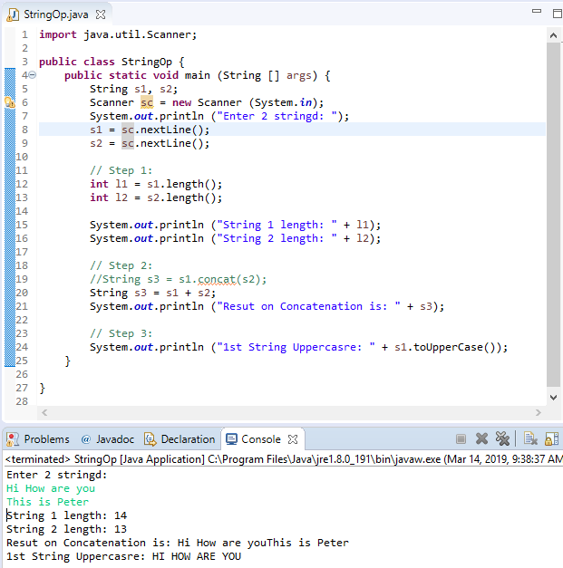
1 String
https://www.youtube.com/watch?v=5J9o2Q7MqUQ&list=PLsyeobzWxl7oZ-fxDYkOToURHhMuWD1BK&index=96
We discuss String Operation.

Slide 4
End of Chapter

