Slide 1

10 String Mutable
Peter H. Chen

Slide 2
1 String Immutable
https://www.youtube.com/watch?v=oYcb0N1YfVw
In the last section, we know the string are immutable which means once you assign the value to a string variable. If you try to change it, it will not replace the old object. It will create a new object for you.
In this section, we do not want to do that. What we want is a string variable where the value of the variable change. It will not create a new object, it update the old value.
How to do the string mutable? We will use a classes called StringBuffer or StringBuilder. The StringBuffer and StringBuilder provide the string mutability.
Class StringBuffer and StringBuilder:
StringBuffer is mutable and thread safe for multiple thread.
StringBuilder is mutable but not thread safe.
StringBuffer and StringBuilder both have the same methods.

Slide 3
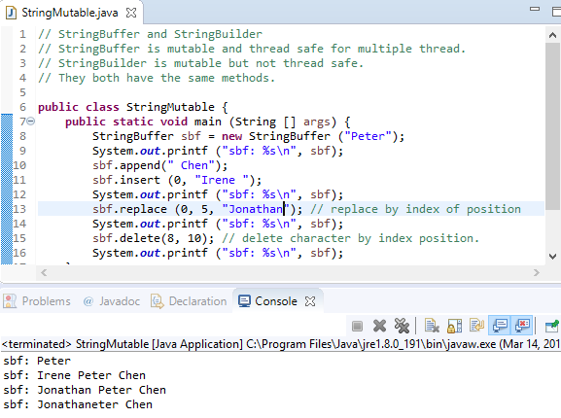
1 String Immutable
https://www.youtube.com/watch?v=oYcb0N1YfVw
Code example:

Slide 4
End of Chapter

