Slide 1

1 String
Peter H. Chen

Slide 2
1 Serialization
https://www.youtube.com/watch?v=qo9S2CeoqQE&list=PLsyeobzWxl7oZ-fxDYkOToURHhMuWD1BK&index=120
Serialization is a process of converting an Object into stream of bytes so that it can be transferred over a network or stored in a persistent storage.
Deserialzation is exact opposite - Fetch a stream of bytes from network or persistence storage and convert it back to the Object with the same state.
Only thing to understand now is how those stream of bytes are interpreted or manipulated so that we get the exact same Object/ same state. There are various ways to achieve that. Some of them are:
XML : Convert Object to XML, transfer it over a network or store it in a file/db. Retrieve it and convert it back to the object with same state. In Java we use JAXB(Java architecture for XML binding) library.(From java 6 it comes bundled with JDK).
JSON :Same can be done by converting the Object to JSON (Javascript Object notation). Again there is GSON library that can be used for this.
Or we can use the Serialization that is provided by the OOP language itself. For eg. in Java you can serialize an Object my making it implement Serializable interface and writing to Object Stream.

Slide 3
1 Serialization
https://www.youtube.com/watch?v=qo9S2CeoqQE&list=PLsyeobzWxl7oZ-fxDYkOToURHhMuWD1BK&index=120
We have one object in memory with one variable i = 4. We want to write this object to file.
Object in memory have to convert into stream format and then serially write into hard-drive.
Object name: obj
Object name: obj1
int i = 4
int i
System.printf ()
Stream Format
Stream Format
Serialization
De-Serialization

Slide 4
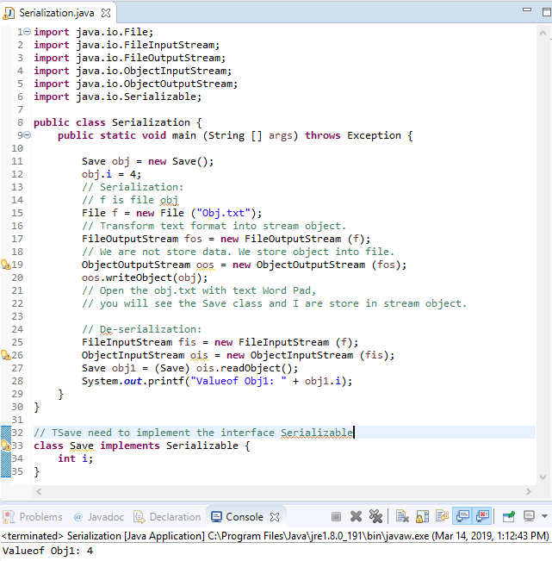
1 Serialization
https://www.youtube.com/watch?v=qo9S2CeoqQE&list=PLsyeobzWxl7oZ-fxDYkOToURHhMuWD1BK&index=120
Code example: Serialization: Transform Class Obj in memory into Stream Object. Write the stream object into file.

Slide 5
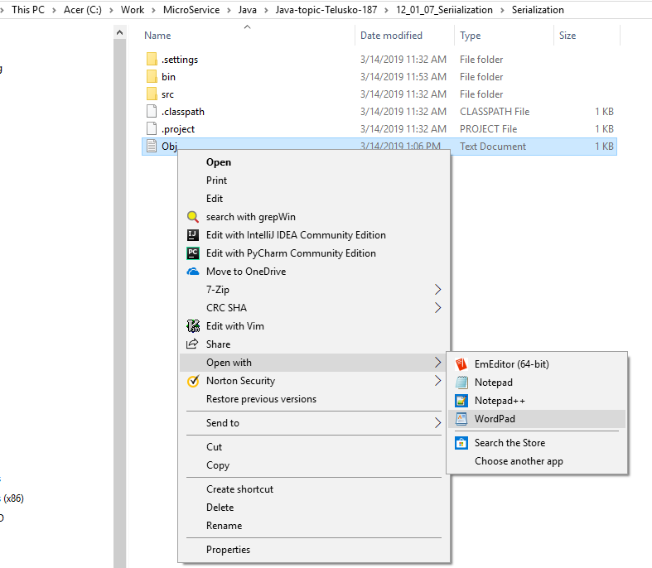
1 Serialization
https://www.youtube.com/watch?v=qo9S2CeoqQE&list=PLsyeobzWxl7oZ-fxDYkOToURHhMuWD1BK&index=120
Code example: open the Obj.txt file.

Slide 6
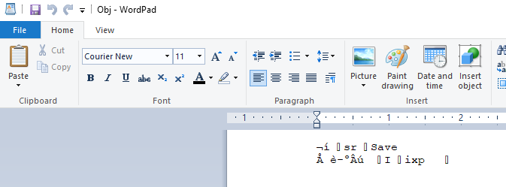
1 Serialization
https://www.youtube.com/watch?v=qo9S2CeoqQE&list=PLsyeobzWxl7oZ-fxDYkOToURHhMuWD1BK&index=120
Code example: You can see the class Save is there and the variable I is there.

Slide 7
1 Serialization
https://www.youtube.com/watch?v=qo9S2CeoqQE&list=PLsyeobzWxl7oZ-fxDYkOToURHhMuWD1BK&index=120
Code example: How do you retrieve the value? De-Serialization

Slide 8
End of Chapter

