Slide 1

Ch00 MySQL Installation
Peter H. Chen

Slide 2
Ch00 MySQL Installation
https://www.youtube.com/watch?v=WuBcTJnIuzo&t=1197s
This sections discusses how to use MySQL Workbench.
MySQL workbench is a GUI software or GUI version of MySQL console.
In order to use Workbench, first, we have to setup MySQL on our computer.
We can verify MySQL from the command line. If we don’t have the software, google search “MySQL download”
1. Install MySQL
2. Configuration: Ask for the password

Slide 3
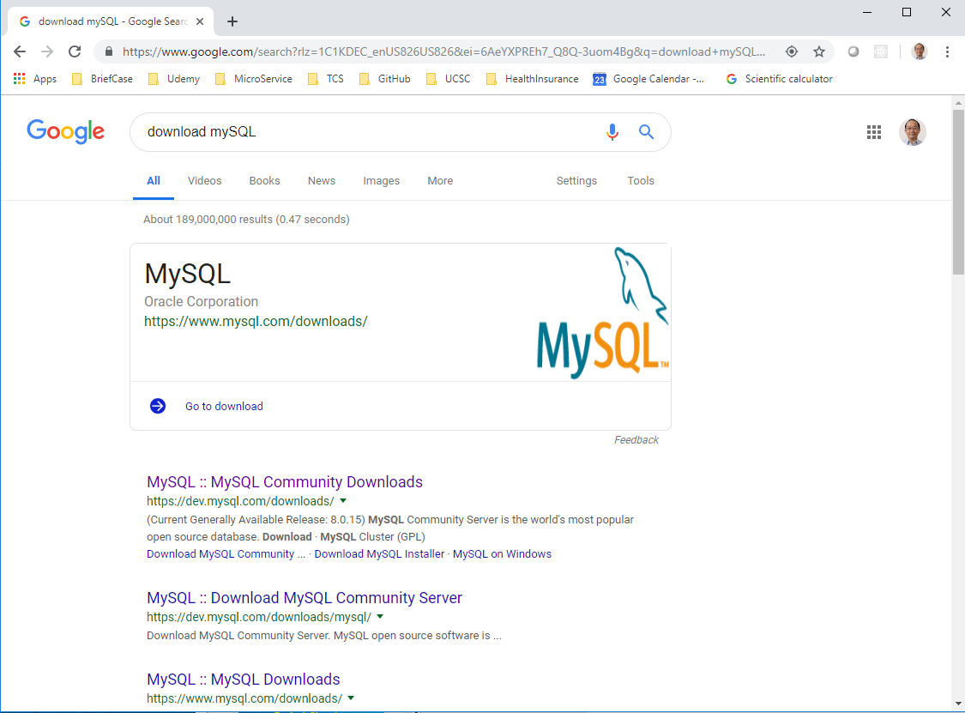
Ch00 MySQL Installation
https://www.youtube.com/watch?v=WuBcTJnIuzo&t=1197s
Search for “download MySQL” (https://dev.mysql.com/downloads/)

Slide 4
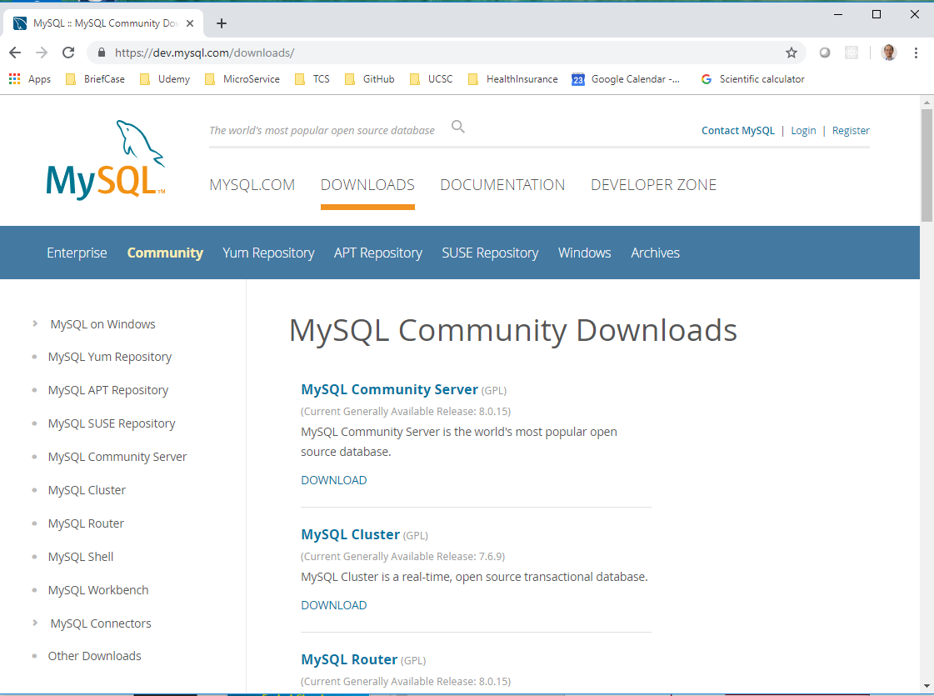
Ch00 MySQL Installation
https://www.youtube.com/watch?v=WuBcTJnIuzo&t=1197s
Open MySQL Download Page. Click “DOWNLOADS”. In here, we want to download the MySQL Server.

Slide 5
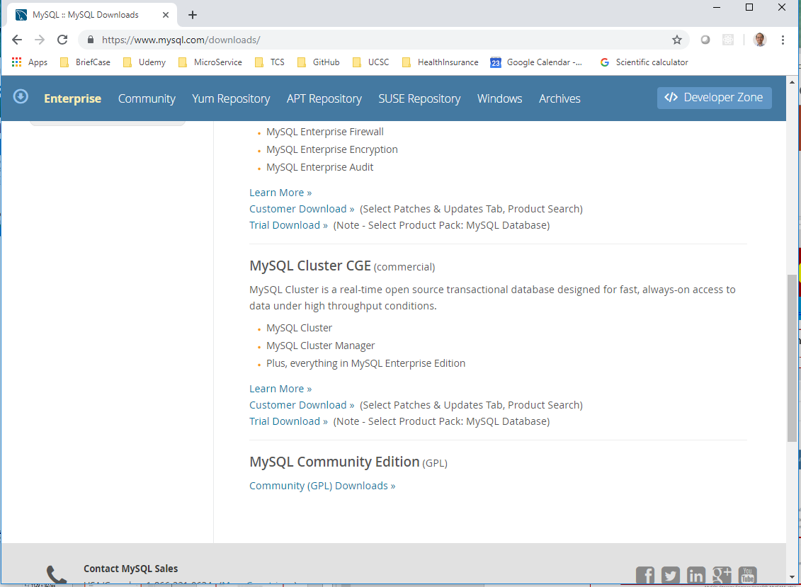
Ch00 MySQL Installation
https://www.youtube.com/watch?v=WuBcTJnIuzo&t=1197s
Scroll down to the button, you will find the “MySQL Community Edition”. Click “Community (GPL) Downloads”

Slide 6
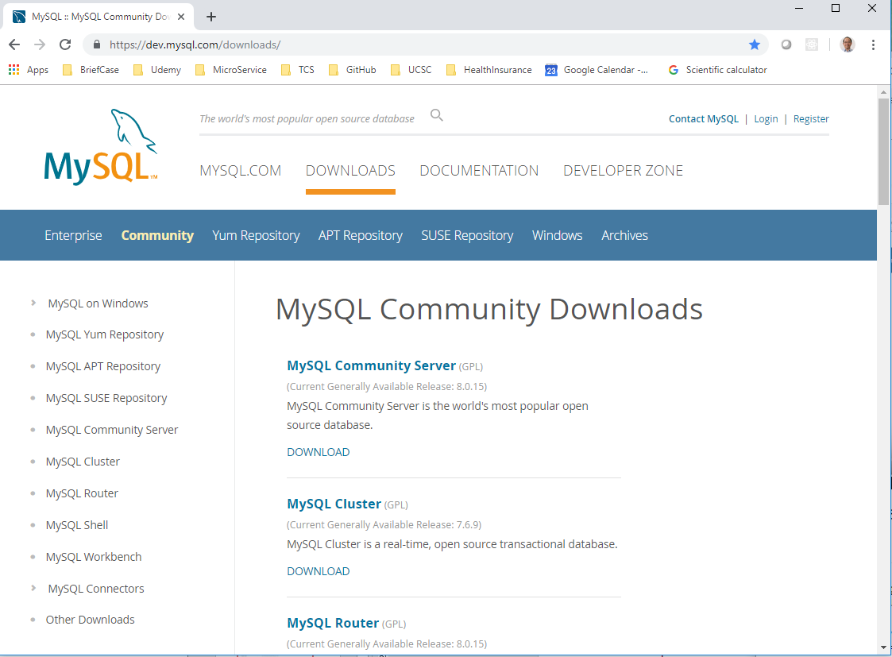
Ch00 MySQL Installation
https://www.youtube.com/watch?v=WuBcTJnIuzo&t=1197s
We are interested the “MySQL Community Server (GPL)”.

Slide 7
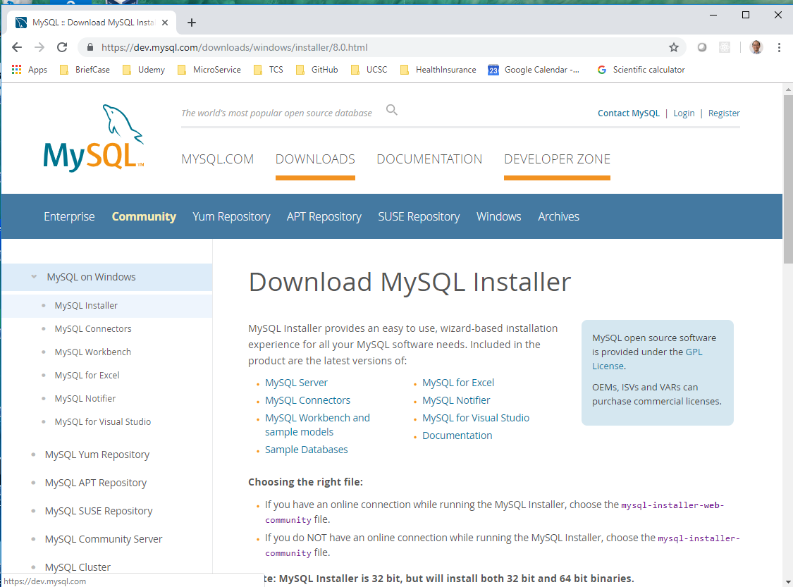
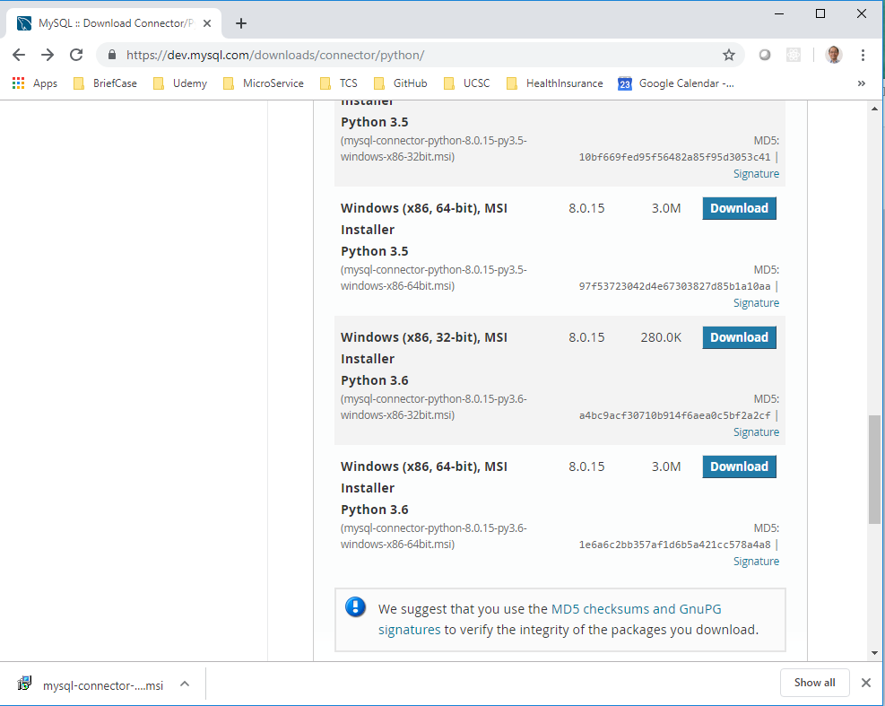
Ch00 MySQL Installation
https://www.youtube.com/watch?v=WuBcTJnIuzo&t=1197s
In the “Download MySQL Installer”, scrolled down again to see “Microsoft“.
Read carefully, one is for web-based installer, one it for local installer.
Web-based installer is smaller but have to connect to internet. Second one is installer without internet. We will download the second one.
Note: Since my Tensorflow uses Python 3.6.8, I need to pick up Python 3.6 Version for MySQL.

Slide 8
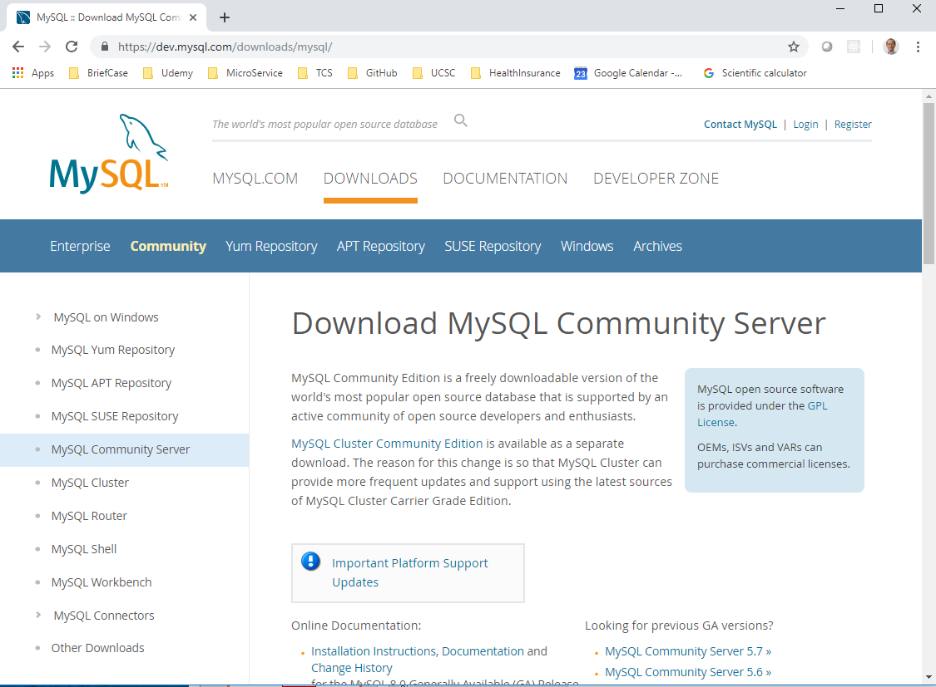
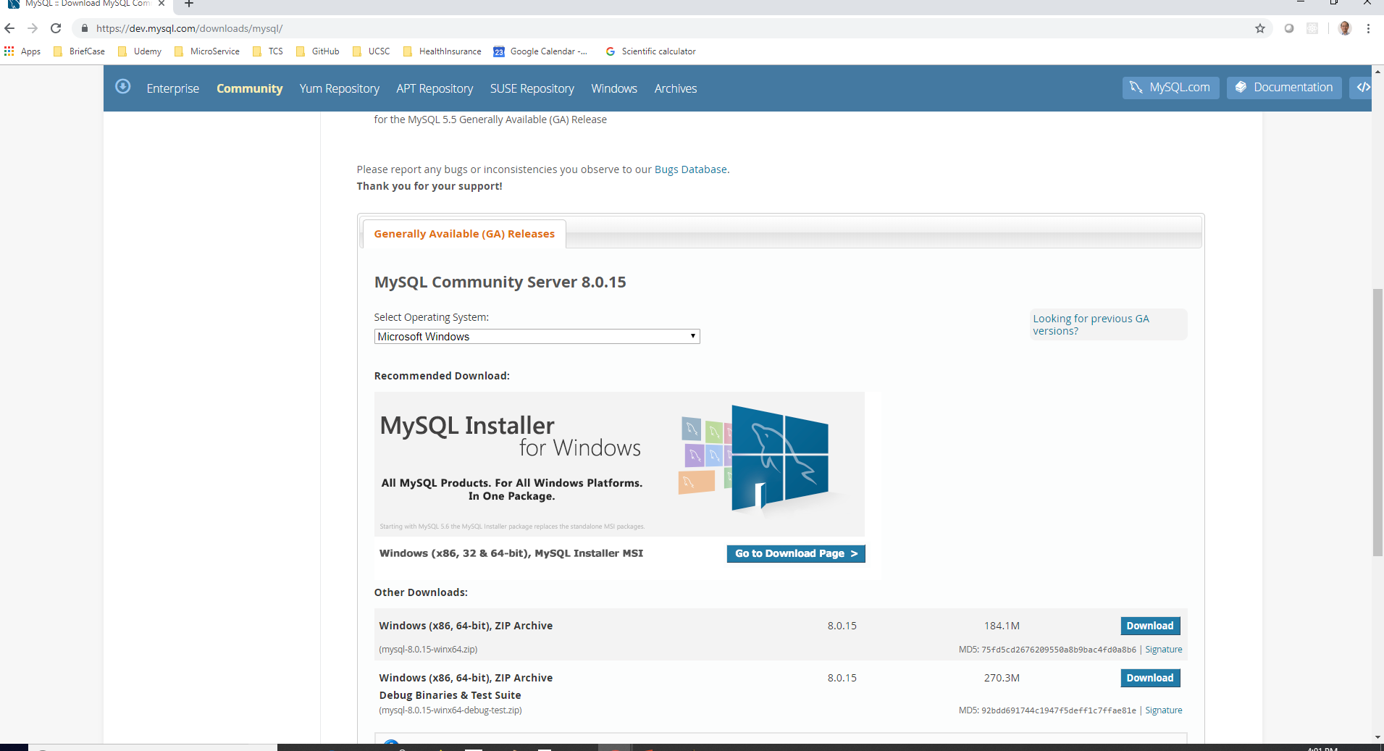
Ch00 MySQL Installation
https://www.youtube.com/watch?v=WuBcTJnIuzo&t=1197s
In the “Download MySQL Community Server”, scrolled down to see “Microsoft“.
Continue to scroll down and download the MySQL Windows Installer MSI.

Slide 9
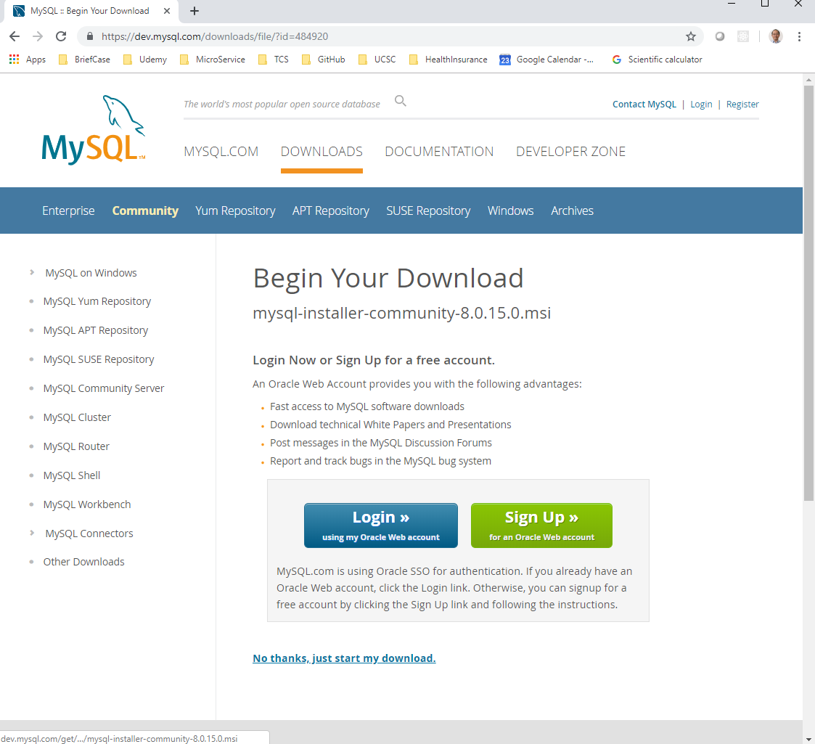
Ch00 MySQL Installation
https://www.youtube.com/watch?v=WuBcTJnIuzo&t=1197s
Scroll down to the bottom. There is Login and Signup for Oracle account.
You do not want to do that. Just click “No thanks, just started my download”

Slide 10
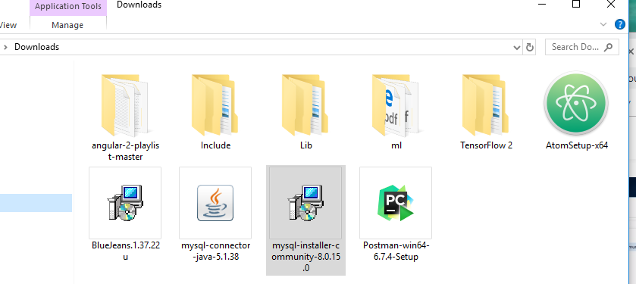
Ch00 MySQL Installation
https://www.youtube.com/watch?v=WuBcTJnIuzo&t=1197s
Double click “mysql-installer-community-8.0.15” to install.

Slide 11
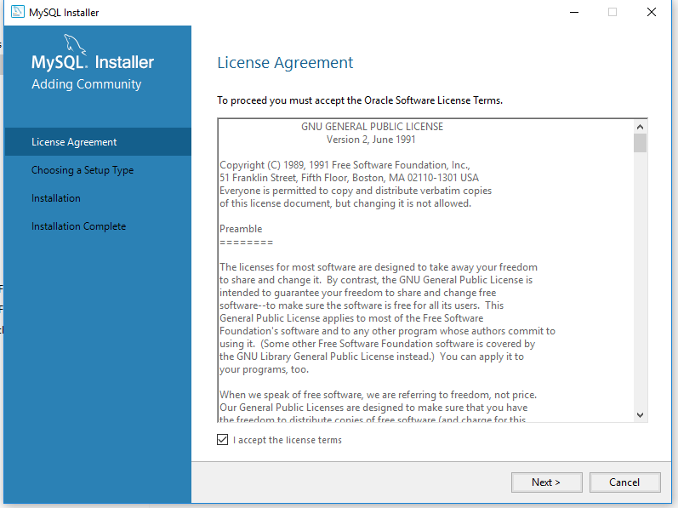
Ch00 MySQL Installation
https://www.youtube.com/watch?v=WuBcTJnIuzo&t=1197s
There are Virus protection for installation, you have to click and allowed this MySQL installer to install.
Double click “mysql-installer-community-8.0.15” to install.

Slide 12
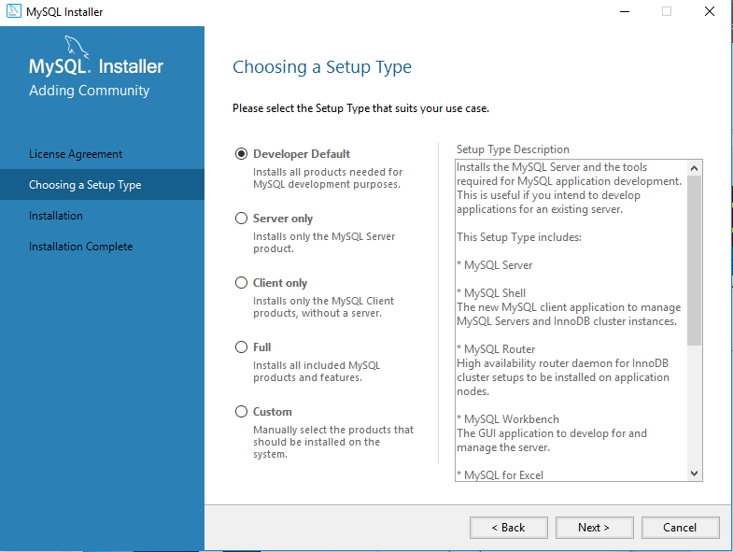
Ch00 MySQL Installation
https://www.youtube.com/watch?v=WuBcTJnIuzo&t=1197s
There are several options: We would like to choose the default (Developer Default).
Almost everything.

Slide 13
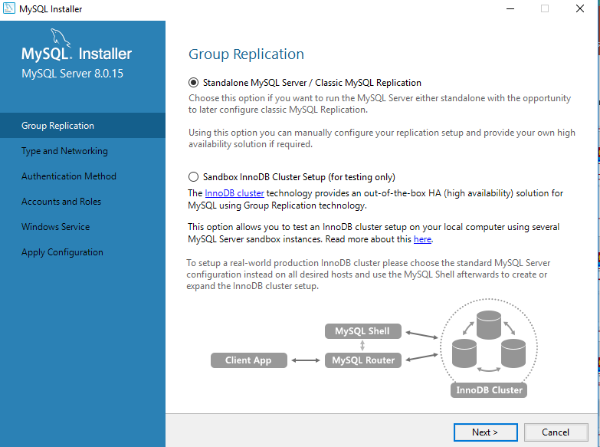
Ch00 MySQL Installation
https://www.youtube.com/watch?v=WuBcTJnIuzo&t=1197s
Use the default Standalone MySQL Server/Client MySQL Replication.
If you have more complicated cluster, you may configure the other option.

Slide 14
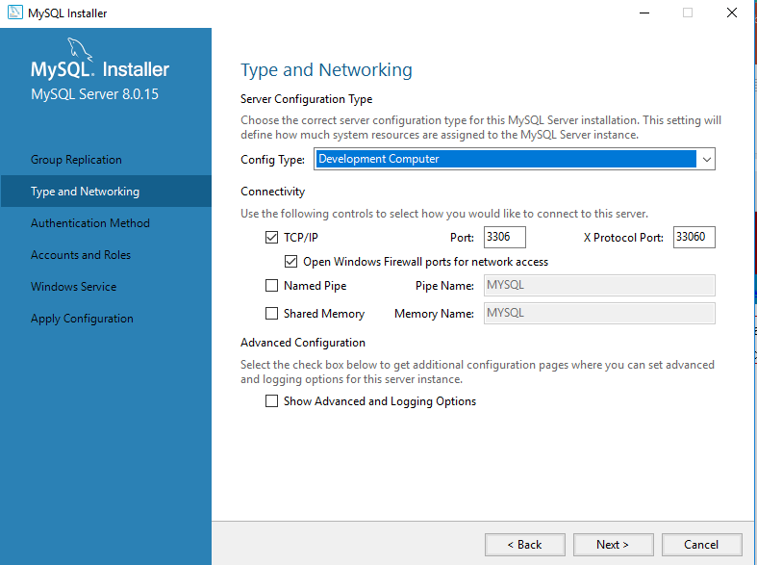
Ch00 MySQL Installation
https://www.youtube.com/watch?v=WuBcTJnIuzo&t=1197s
Keep Development Computer and port number.

Slide 15
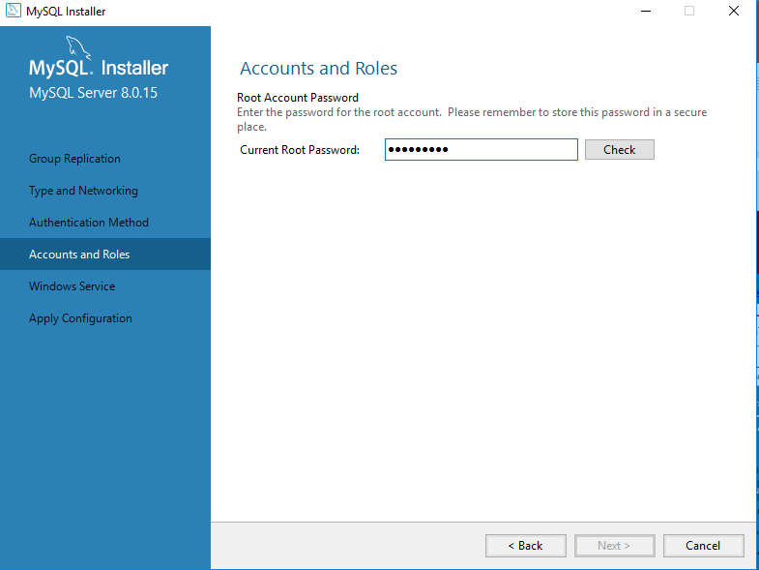
Ch00 MySQL Installation
https://www.youtube.com/watch?v=WuBcTJnIuzo&t=1197s
Password: Pc1997=ch

Slide 16
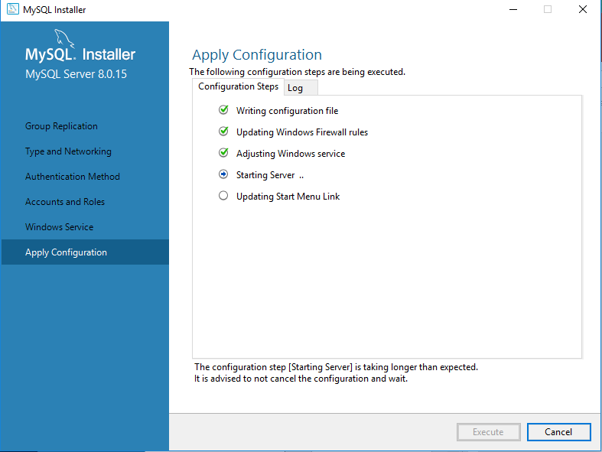
Ch00 MySQL Installation
https://www.youtube.com/watch?v=WuBcTJnIuzo&t=1197s
Configuration take long time.

Slide 17
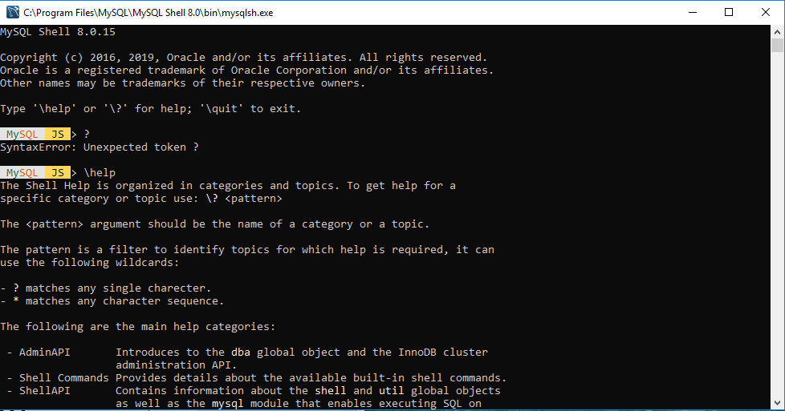
Ch00 MySQL Installation
https://www.youtube.com/watch?v=WuBcTJnIuzo&t=1197s
Note:
MySQL 8.0.15 requires Python 7.0 for Connector
When re-installed, do not use Control-panel to uninstalled, instead, restart the Oracle MySQL installer. The installer will ask you to uninstall and then automatically reboot your system to clear the system password.
After installed MySQL, you can set back the Tensorflow for Python 6.8.0.

Slide 18
End of Chapter

