Slide 1

Ch01 Connect MySQL Workbench
Peter H. Chen

Slide 2
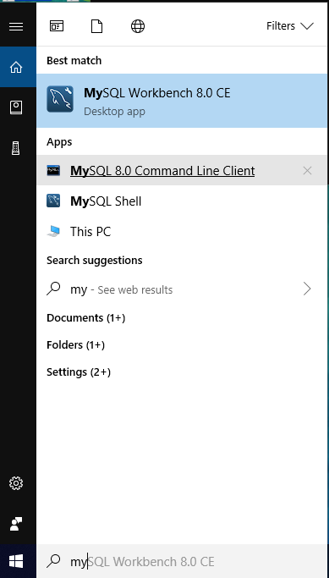
Ch01 Connect MySQL Workbench
https://www.youtube.com/watch?v=OWfq_JlvJxM&list=PLsyeobzWxl7oJca2fwLyKbDwlKUDPl3RE
Last section, we installed the “MySQL Community version 8.0.15” which includes the MySQL Workbench, API connectors for Java, C++, Python, and etc.
MySQL Workbench is the GUI version of MySQL Console Operation.
This sections discusses how to use MySQL Workbench.
In order to use MySQL Workbench, we need to verify the MySQL setup on our machine. We start the MySQL Console first.
On Windows, search “MySQL 8.0 Command Line Client”.
Note: If we don’t have the Console, we have to download MySQL Community Edition again in the previous section.

Slide 3
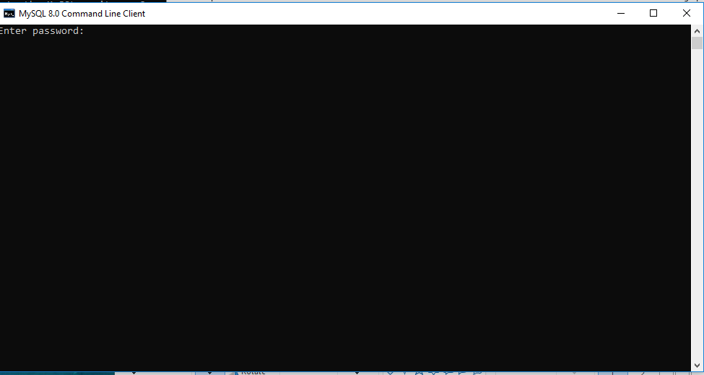
Ch01 Connect MySQL Workbench
https://www.youtube.com/watch?v=OWfq_JlvJxM&list=PLsyeobzWxl7oJca2fwLyKbDwlKUDPl3RE
Select “MySQL 8.0 Command Line Client”, we have “MySQL 8.0 Command Line Client” pop up.
There is “Enter password:” prompt. Enter my password: “Pc1997=ch” to get in.

Slide 4
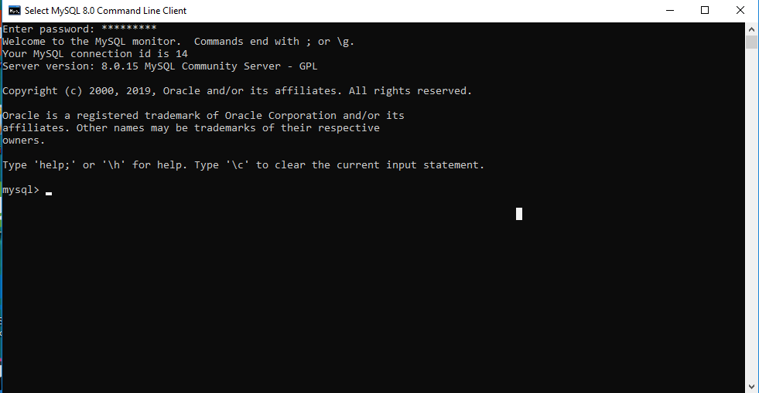
Ch01 Connect MySQL Workbench
https://www.youtube.com/watch?v=OWfq_JlvJxM&list=PLsyeobzWxl7oJca2fwLyKbDwlKUDPl3RE
At “Enter password:” prompt, enter password: “Pc1997=ch”
We have the “mysql >” as follow.
The password was setup when you installed MySQL Community Edition in the last section.
From this console, you can create database, create tables, insert values, request database by query. We have all the operation in console-based only.

Slide 5
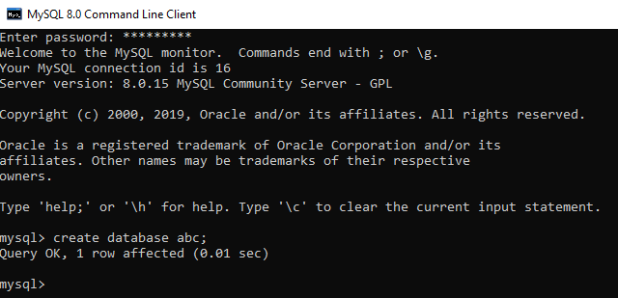
Ch01 Connect MySQL Workbench
https://www.youtube.com/watch?v=OWfq_JlvJxM&list=PLsyeobzWxl7oJca2fwLyKbDwlKUDPl3RE
Create database abc.
> create database abc;
Everything we do here is console-based. We need more features, for example, login, utilities, libraries, bug reporters, user friendly, and etc. This console level application is not good enough. We need a GUI or IDE software where we can get all the features.

Slide 6
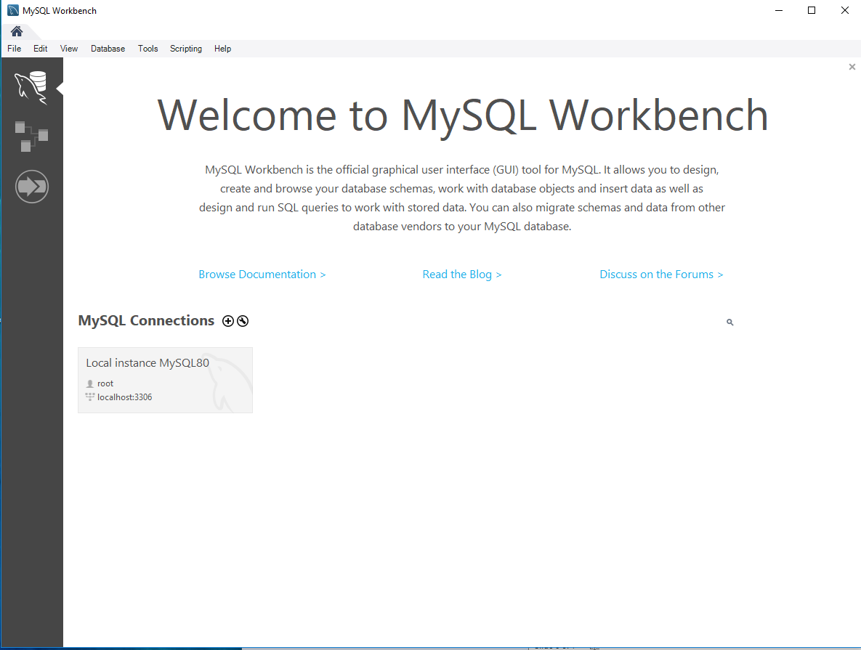
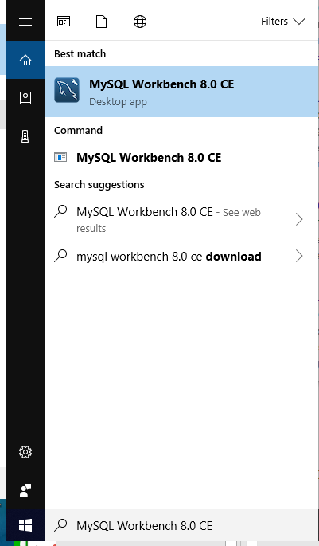
Ch01 Connect MySQL Workbench
https://www.youtube.com/watch?v=OWfq_JlvJxM&list=PLsyeobzWxl7oJca2fwLyKbDwlKUDPl3RE
In order to use MySQL workbench, in Windows start menu, type “MySQL Workbench”. Select “MySQL Workbench 8.0 CE”.
The “Welcome to MySQL Workbench” will be popped up.

Slide 7
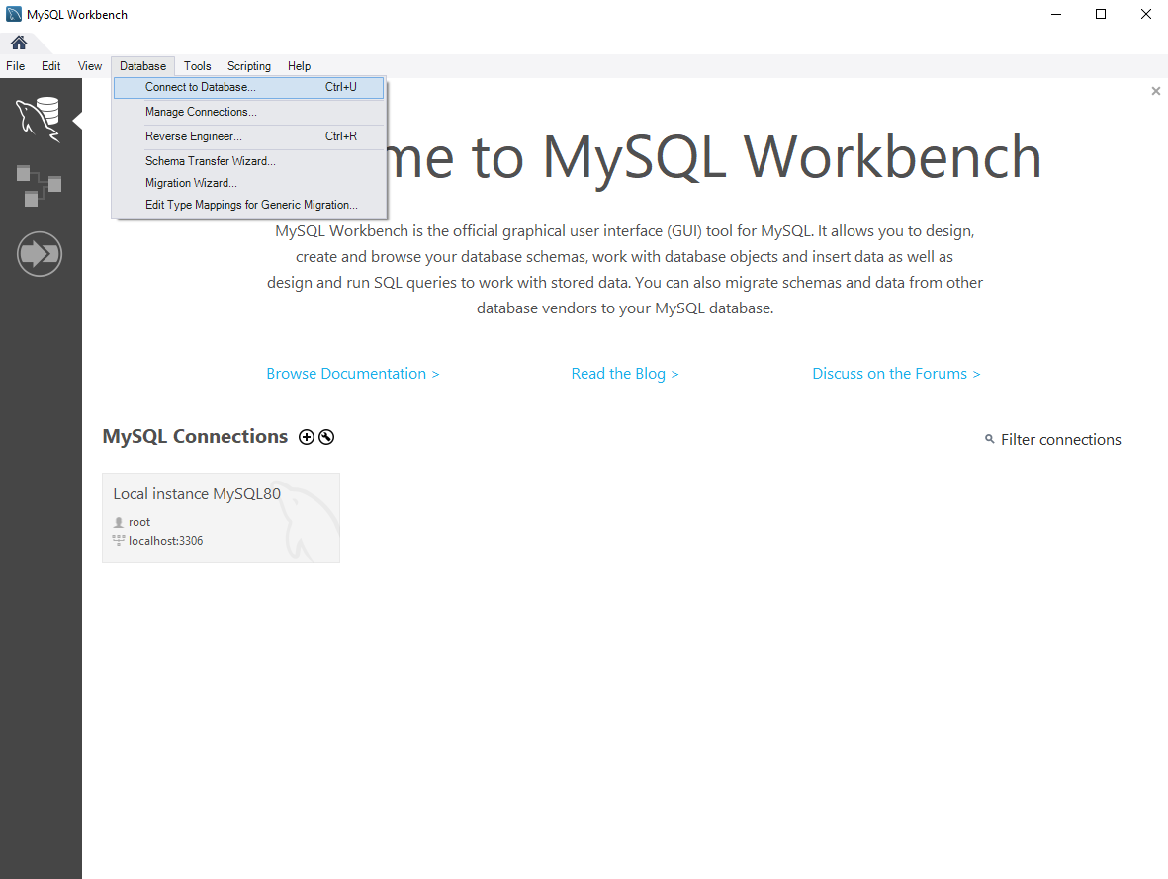
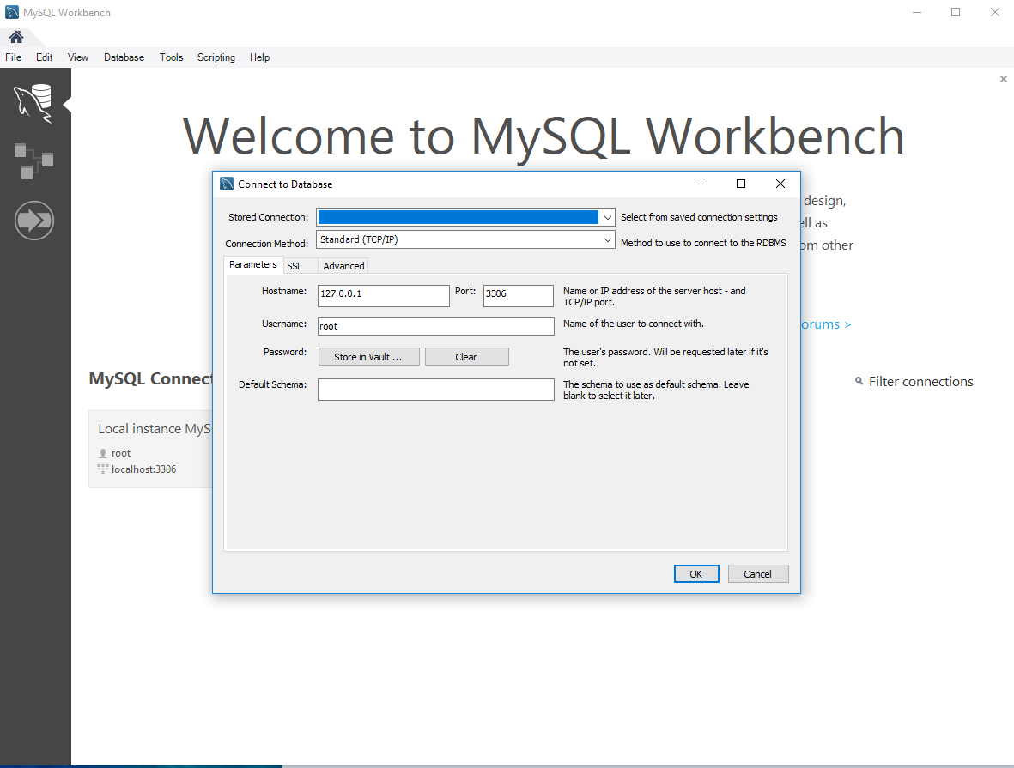
Ch01 Connect MySQL Workbench
https://www.youtube.com/watch?v=OWfq_JlvJxM&list=PLsyeobzWxl7oJca2fwLyKbDwlKUDPl3RE
Database > Connect to Database …
The “Connect to Database …” Windows pop up.

Slide 8
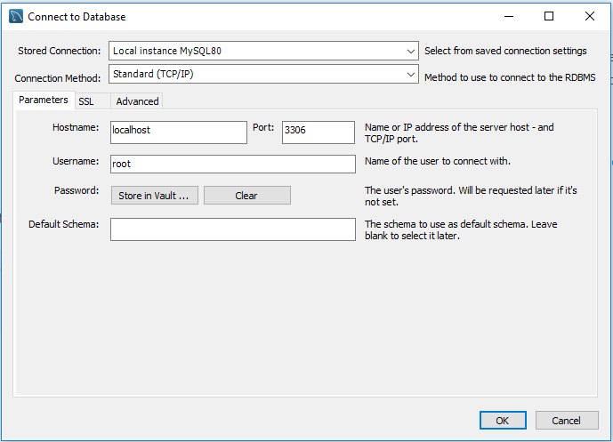
Ch01 Connect MySQL Workbench
https://www.youtube.com/watch?v=OWfq_JlvJxM&list=PLsyeobzWxl7oJca2fwLyKbDwlKUDPl3RE
Select the “Local instance MySQL80” for Stored Connection.
MySQL ask for “hostname” for machine address. We have MySQL hostname “localhost”. We can install the hostname on other machine belong to the same network.
Because we use the same machine for database server, the hostname for us is “localhost”. We can use the lookback address which is “127.0.0.1”.
We have to specify the port number: 3306. This 3306 is the default port number configured during the MySQL installation. If the installation configured port number 2000, then we have to use port number 2000. Since we install the with port number 3306, we keep the same port number 3306.
For MySQL, the user name is root.
It will ask you password later.
And that is. Click OK.

Slide 9
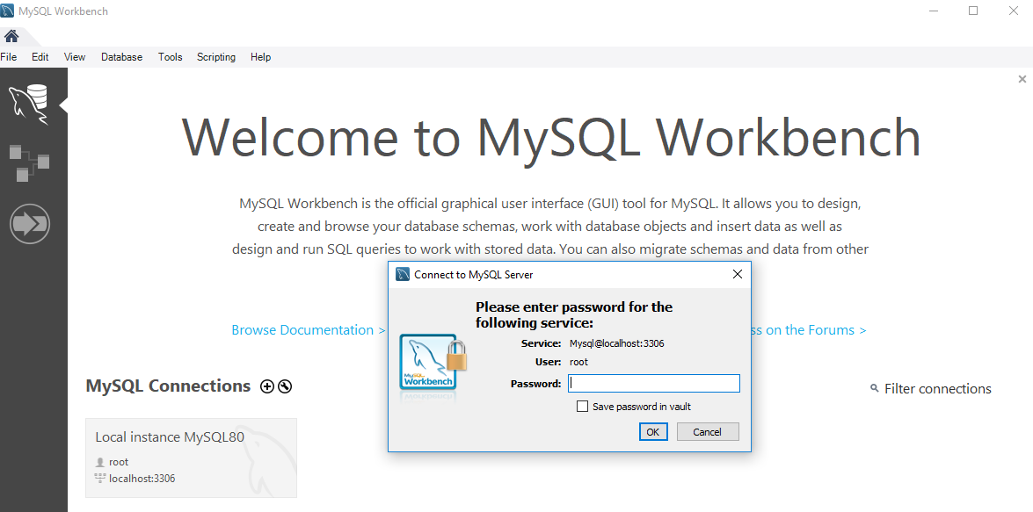
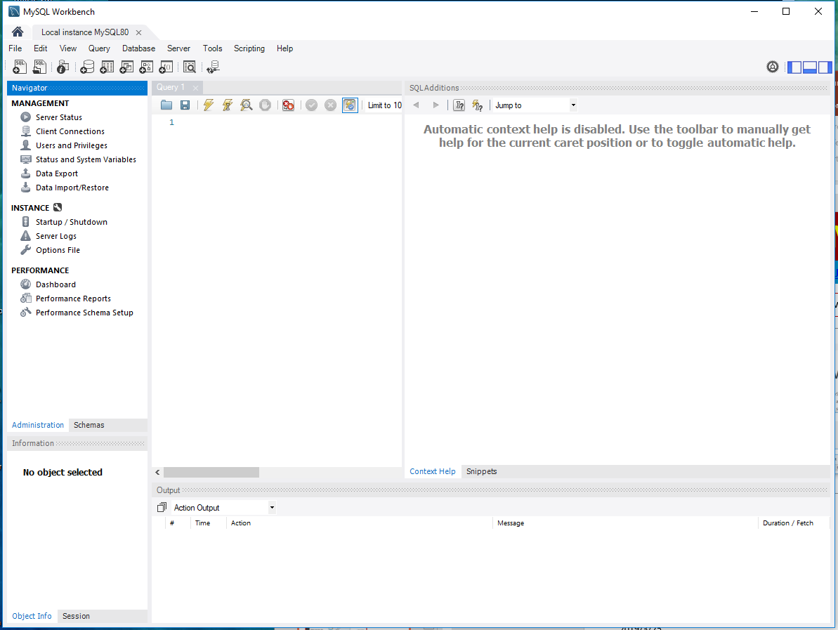
Ch01 Connect MySQL Workbench
https://www.youtube.com/watch?v=OWfq_JlvJxM&list=PLsyeobzWxl7oJca2fwLyKbDwlKUDPl3RE
Enter the Password: (The password was setup during the installation is “Pc1997=ch”)
This password is same as the password in the MySQL Console.
The MySQL workbench will be displayed as the right hand side picture.

Slide 10
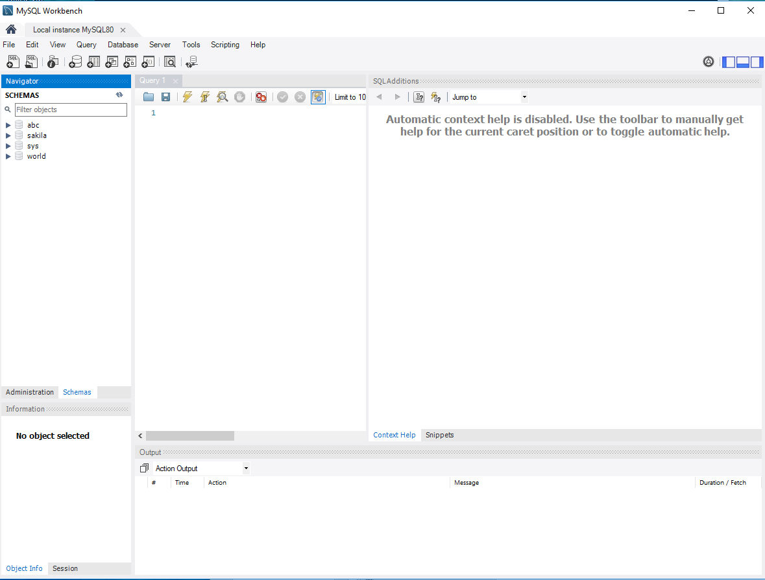
Ch01 Connect MySQL Workbench
https://www.youtube.com/watch?v=OWfq_JlvJxM&list=PLsyeobzWxl7oJca2fwLyKbDwlKUDPl3RE
Click the “Schemas” tab in the Navigator of MySQL workbench.
Display all the Schemas (Schema means “Outline of the Models”) on the right side picture below. The Schemas display all the databases available.

Slide 11
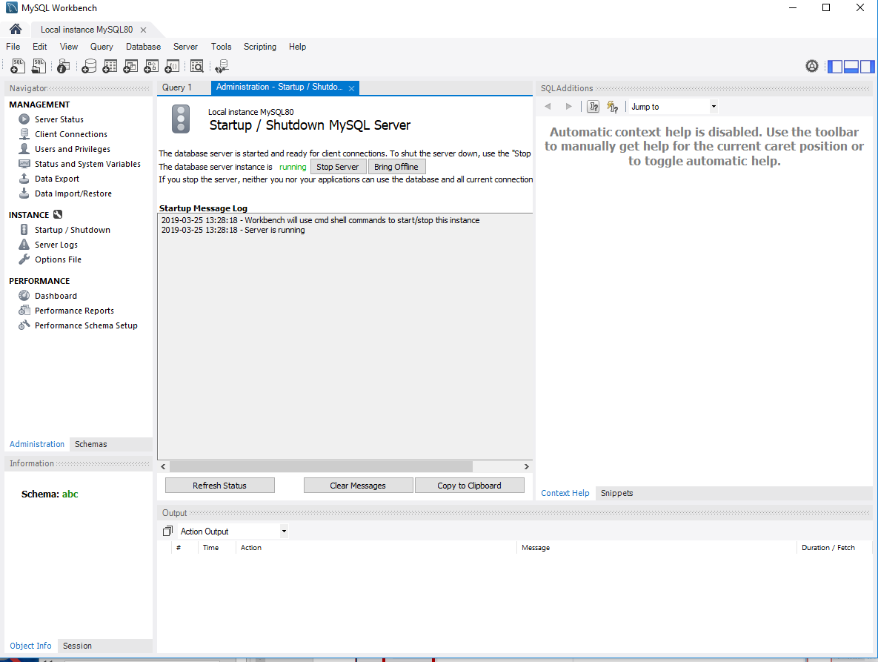
Ch01 Connect MySQL Workbench
https://www.youtube.com/watch?v=OWfq_JlvJxM&list=PLsyeobzWxl7oJca2fwLyKbDwlKUDPl3RE
Instance > Start /Stop is to start or stop the server.

Slide 12
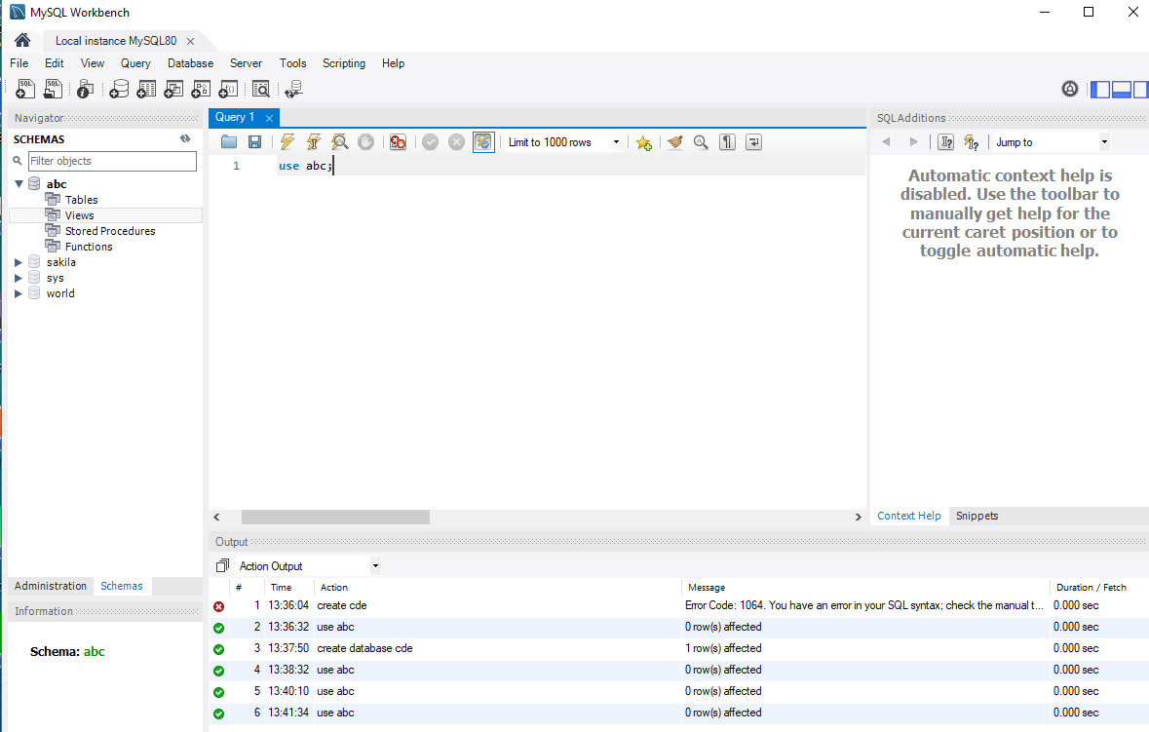
Ch01 Connect MySQL Workbench
https://www.youtube.com/watch?v=OWfq_JlvJxM&list=PLsyeobzWxl7oJca2fwLyKbDwlKUDPl3RE
First, we can “create database cde;” in MySQL Workbench.
Since we have database abc here, we can simple “use abc;” and then “Control <Enter>” or click execute button to execute the command.

Slide 13
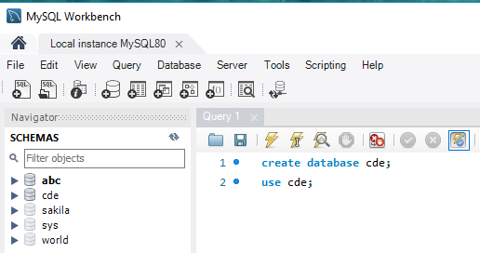
Ch01 Connect MySQL Workbench
https://www.youtube.com/watch?v=OWfq_JlvJxM&list=PLsyeobzWxl7oJca2fwLyKbDwlKUDPl3RE
You also can “create database cde;” and “use cde;”
Exit and login to check the schema. The database cde is in the schema.

Slide 14
End of Chapter

