Slide 1

Ch03 Commit/Rollback
Peter H. Chen

Slide 2
Ch03 Commit/Rollback
https://www.youtube.com/watch?v=aBB-OPL1XV0&list=PLsyeobzWxl7oJca2fwLyKbDwlKUDPl3RE&index=3
In the last section, we create table, insert data, and select data by DDL (Data Definition Language), DML (Data Manipulation Language), and DRL/DQL (Data Retrieve Language/ Data Query Language).
In this section, we discuss commit and rollback.
We will talk about TCL (Transaction Control Language).
If you have multiple tables, such as, inventory table, stock of materials.
You have a web-site for e-Commerce and you selling mobile phone. You have to update multiple tables and delete the stock and update the amount of table. You have to do a lot of transactions. You have to execute lots of queries.
If you execute lots of query together which complete one task that becomes one transaction.
What happens when you execute multiple queries?
Some query do the insert, some query do the update, some query will be deleted.
If you insert some field in some table which directly connect to other table and the transaction fails, it makes your system unstable.
We execute the SQL statement and commit them.
When we have six query is error, we will ask for a rollback. Then, it should looks like nothing is happened before. We have to use something called commit and auto commit.

Slide 3
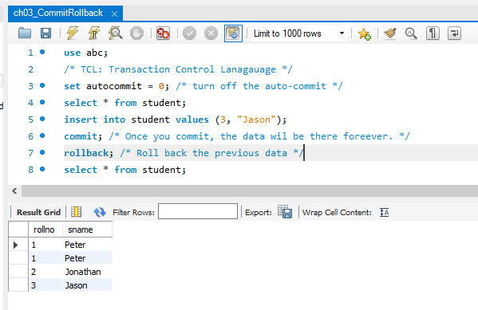
Ch03 Commit/Rollback
https://www.youtube.com/watch?v=aBB-OPL1XV0&list=PLsyeobzWxl7oJca2fwLyKbDwlKUDPl3RE&index=3
My SQL default is auto commit. Whatever you execute the statement, it will get committed.
We want to have “set autocommit = 0” statement at very beginning. It will remove the auto commit.
When we commit, the data will be into the database.
We can use rollback to take it back from database.
We run several times, in the first time, we did not use rollback.
The “Jason” was insert int eh previous run.

Slide 4
End of Chapter

