Slide 1

Ch04 Delete/Drop
Peter H. Chen

Slide 2
Ch04 Delete/Drop
https://www.youtube.com/watch?v=M9PftruJiJM&index=4&list=PLsyeobzWxl7oJca2fwLyKbDwlKUDPl3RE
In the last section, we discuss the TCL (Transaction Control Language).
We have seen how to create table and insert value, and select and display values.
In this section, we discuss the delete data, truncate data, drop table, and drop database.

Slide 3
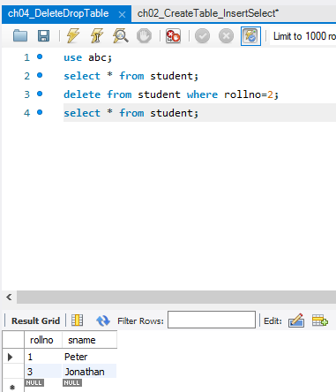
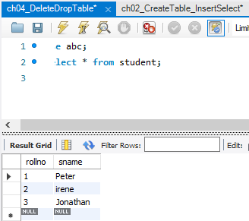
Ch04 Delete/Drop
https://www.youtube.com/watch?v=M9PftruJiJM&index=4&list=PLsyeobzWxl7oJca2fwLyKbDwlKUDPl3RE
In the database, we first very the data in the table student “select * from student”
Then, we want to delete all the data with ID = 3.

Slide 4
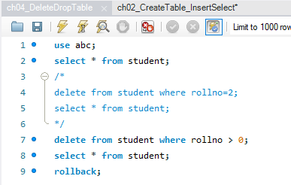
Ch04 Delete/Drop
https://www.youtube.com/watch?v=M9PftruJiJM&index=4&list=PLsyeobzWxl7oJca2fwLyKbDwlKUDPl3RE
Delete all of them.

Slide 5
End of Chapter

