Slide 1

Ch06 Order By
Peter H. Chen

Slide 2
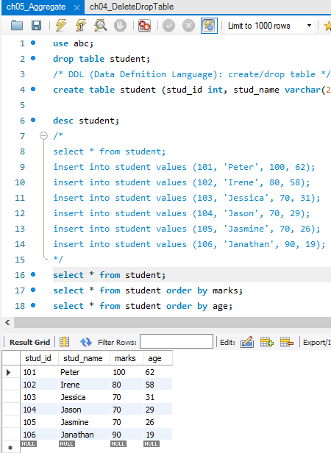
Ch06 Order By
https://www.youtube.com/watch?v=3dsr3RuYbDg&list=PLsyeobzWxl7oJca2fwLyKbDwlKUDPl3RE&index=6
This section discusses Order by Claude.
Right now, we select * from student by default order.

Slide 3
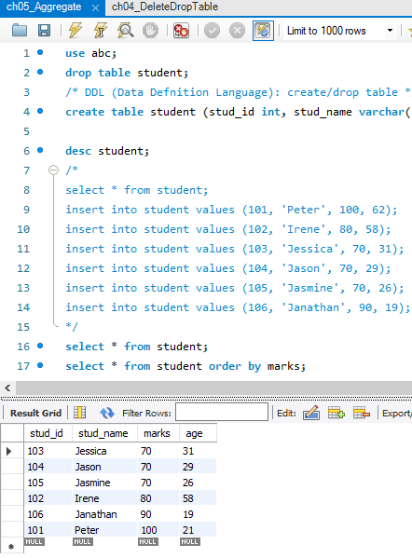
Ch06 Order By
https://www.youtube.com/watch?v=3dsr3RuYbDg&list=PLsyeobzWxl7oJca2fwLyKbDwlKUDPl3RE&index=6
We want to order by marks.
> select * from student order by marks

Slide 4
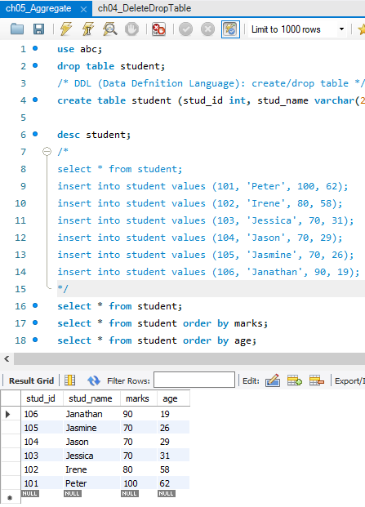
Ch06 Order By
https://www.youtube.com/watch?v=3dsr3RuYbDg&list=PLsyeobzWxl7oJca2fwLyKbDwlKUDPl3RE&index=6
We want to order by marks.
> select * from student order by age

Slide 5
Ch06 Order By
https://www.youtube.com/watch?v=3dsr3RuYbDg&list=PLsyeobzWxl7oJca2fwLyKbDwlKUDPl3RE&index=6
We want to order by marks by descending order.
> select * from student order by marks desc

Slide 6
End of Chapter

