Slide 1

16.02 JDBC Practice
Peter H. Chen

Slide 2
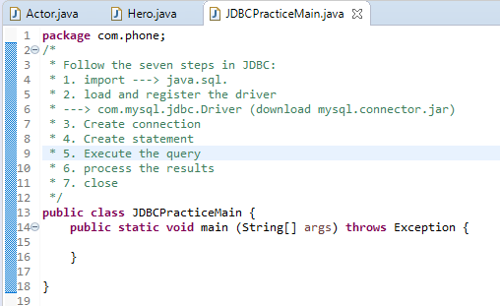
16.02 JDBC Practice
https://www.youtube.com/watch?v=5vzCjvUwMXg&list=PLGwb7xZHg-oMv1pOlTHAqAEjw0EPALzlL&index=159
We discuss JDBC (Java Database Connectivity)
For ODBC, we cannot used Java 7 or Java 8. So, we need to go to with specific type of drivers for this specific type if DBMS. For example, we work with Oracle, we need to go with Oracle driver. If we work with MySQL, we have to go with MySQL driver.
In this example, we use MySQL, we have to use MySQL driver. We have to load the MySQL driver. The MySQL driver is com.mysql.jdbc.Driver. We cannot find this in Eclipse by default. If you use NetBeans, then you have this driver inbuilds. But if you use Eclipse, you have to download it from internet.

Slide 3
16.02.1 Download MySQL Driver
Peter H. Chen

Slide 4
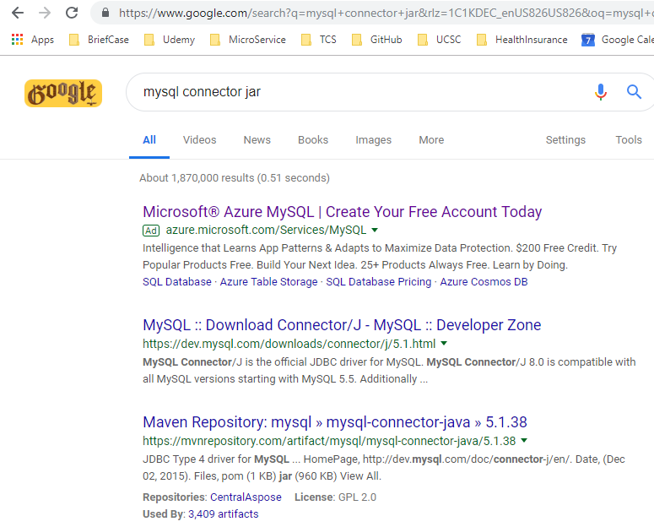
16.02.1 Download MySQL Driver
https://www.youtube.com/watch?v=5vzCjvUwMXg&list=PLGwb7xZHg-oMv1pOlTHAqAEjw0EPALzlL&index=159
Search for “mysql connector jar”. The best place to download is “maven repository”.
Maven repository is the global place where you will have all the libraries available. It doesn’t matter Java framework or libraries that you will find them there.

Slide 5
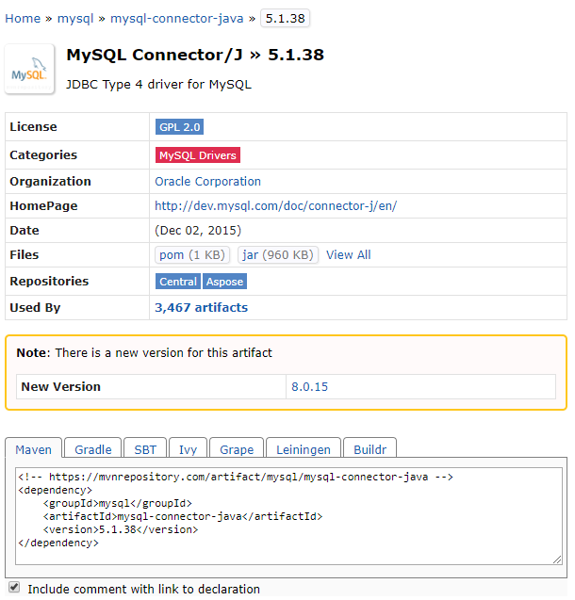
16.02.1 Download MySQL Driver
https://www.youtube.com/watch?v=5vzCjvUwMXg&list=PLGwb7xZHg-oMv1pOlTHAqAEjw0EPALzlL&index=159
Go to the maven mysql connector jar.
You can use maven dependencies or you can use “JDBC Type 4 for MySQL”.
We can click .jar (960K) to download the jar file.
We can click .jar (960K) to download the jar file.

Slide 6
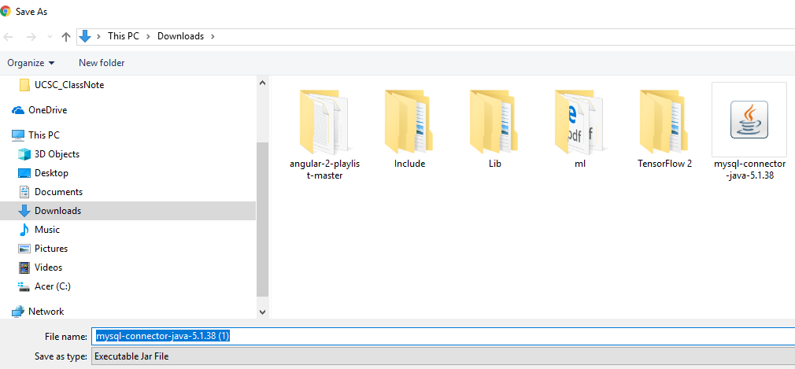
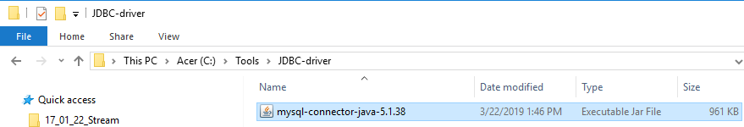
16.02.1 Download MySQL Driver
https://www.youtube.com/watch?v=5vzCjvUwMXg&list=PLGwb7xZHg-oMv1pOlTHAqAEjw0EPALzlL&index=159
We have downloaded the mysql-connector-java-5.1.38.
Copy this mysql-connector-java-* to C:\Tools\JDBC-driver folder

Slide 7
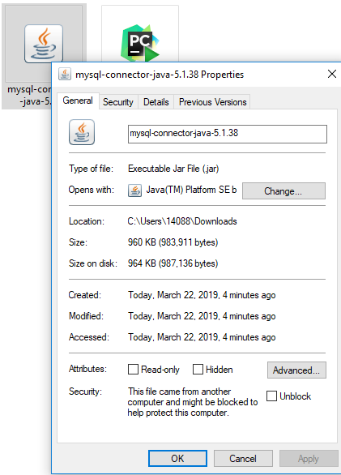
16.02.1 Download MySQL Driver
https://www.youtube.com/watch?v=5vzCjvUwMXg&list=PLGwb7xZHg-oMv1pOlTHAqAEjw0EPALzlL&index=159
The size of mysql-connector-jdbc-5.1.38 is approximately 1MB.

Slide 8
16.02.2 Setup MySQL Driver in Eclipse
Peter H. Chen

Slide 9
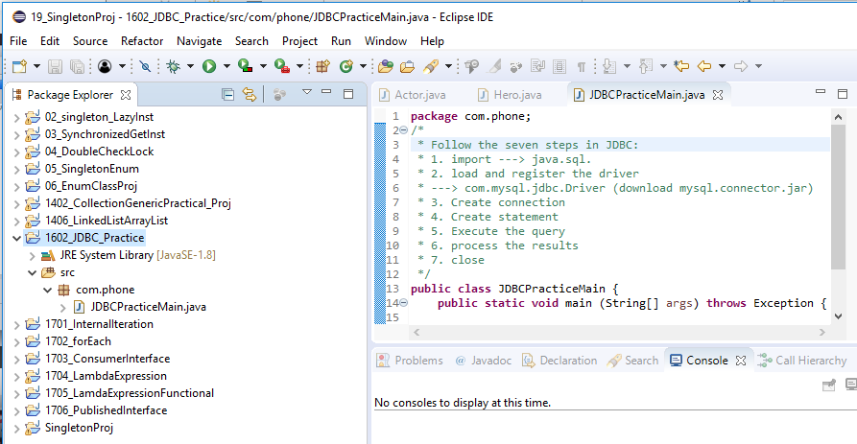
16.02.2 Setup MySQL Driver in Eclipse
https://www.youtube.com/watch?v=5vzCjvUwMXg&list=PLGwb7xZHg-oMv1pOlTHAqAEjw0EPALzlL&index=159
Go back to Eclipse. We need to load this driver.
Whenever we work with external Java files, we need to add that jar file into JRE System Library in your project.

Slide 10
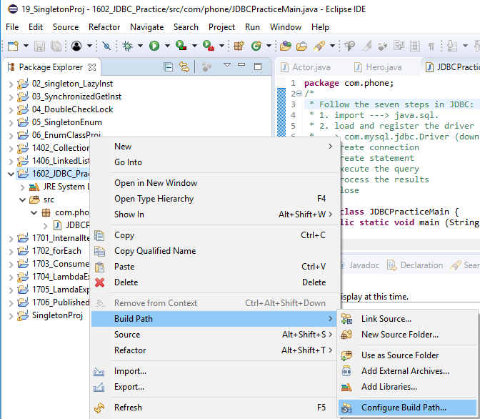
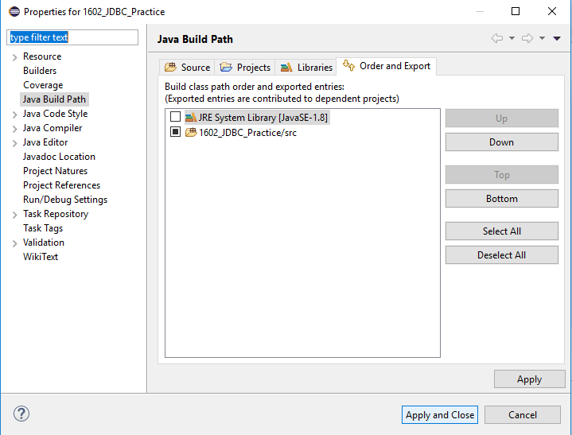
16.02.2 Setup MySQL Driver in Eclipse
https://www.youtube.com/watch?v=5vzCjvUwMXg&list=PLGwb7xZHg-oMv1pOlTHAqAEjw0EPALzlL&index=159
The steps to add to JRE System Library:
Click the project name > RMB (Right Mouse Button) > Build Path > Configure Build Path ….

Slide 11
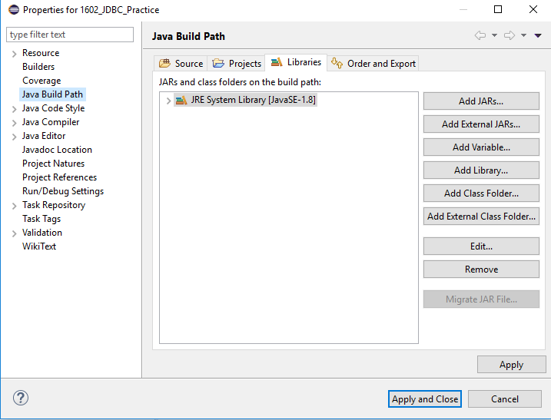
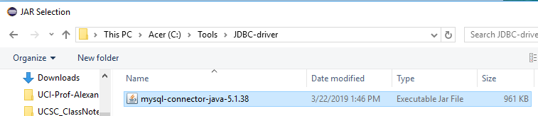
16.02.2 Setup MySQL Driver in Eclipse
https://www.youtube.com/watch?v=5vzCjvUwMXg&list=PLGwb7xZHg-oMv1pOlTHAqAEjw0EPALzlL&index=159
Click Libraries tag.
Click “Add External JARs…” button.
Select downloaded mysql-connector-java-5.1.38

Slide 12
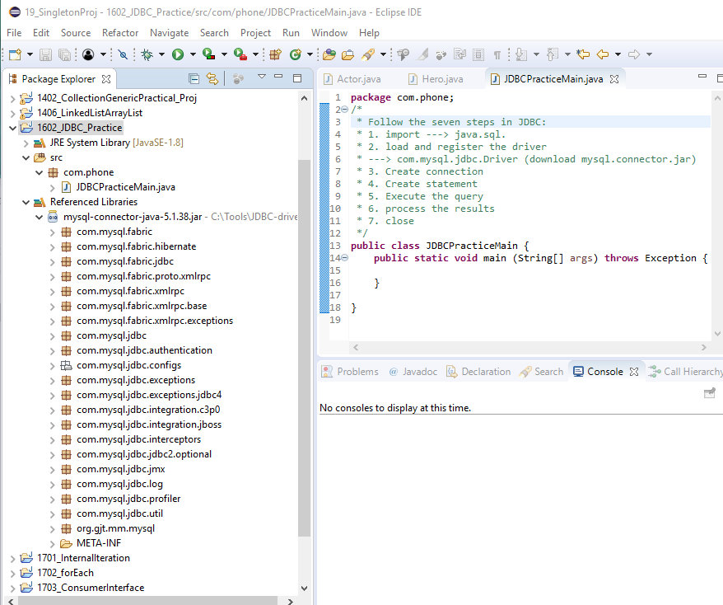
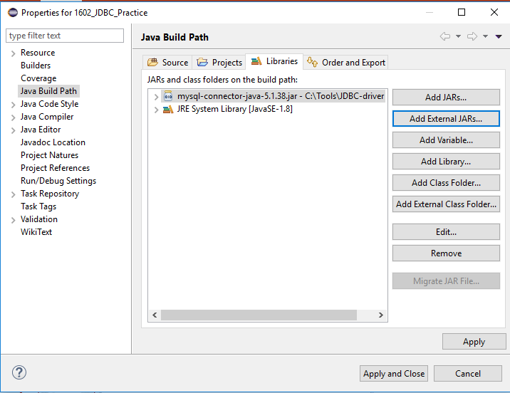
16.02.2 Setup MySQL Driver in Eclipse
https://www.youtube.com/watch?v=5vzCjvUwMXg&list=PLGwb7xZHg-oMv1pOlTHAqAEjw0EPALzlL&index=159
Now, we have mysql-connector-java-* in our project build path.

Slide 13
16.02.3 Import, register, and Connection
Peter H. Chen

Slide 14
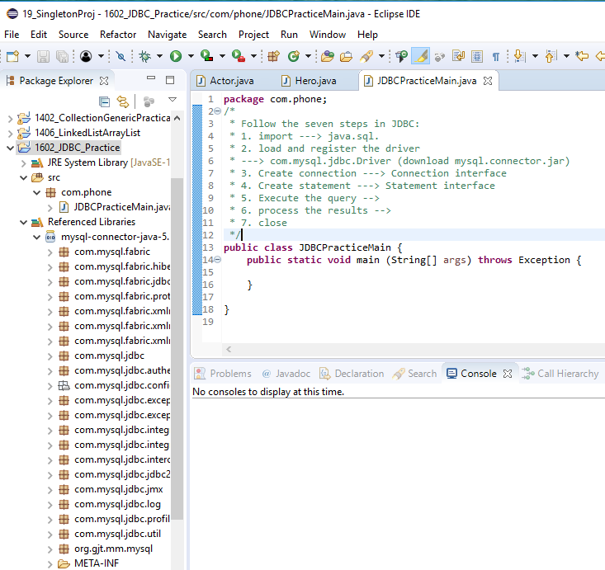
16.02.3 Import, register, and Connection
https://www.youtube.com/watch?v=5vzCjvUwMXg&list=PLGwb7xZHg-oMv1pOlTHAqAEjw0EPALzlL&index=159
Go back the Eclipse the start the coding.

Slide 15
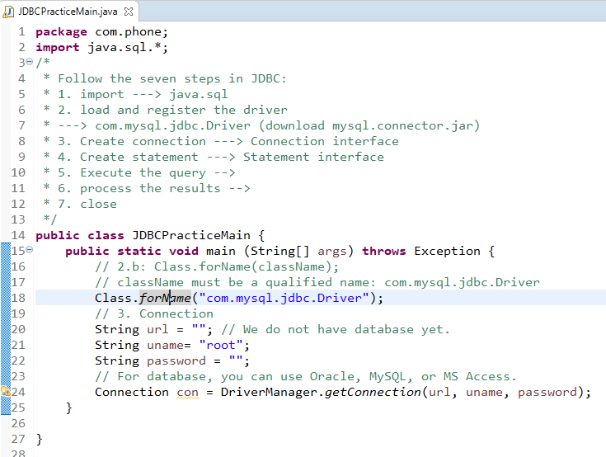
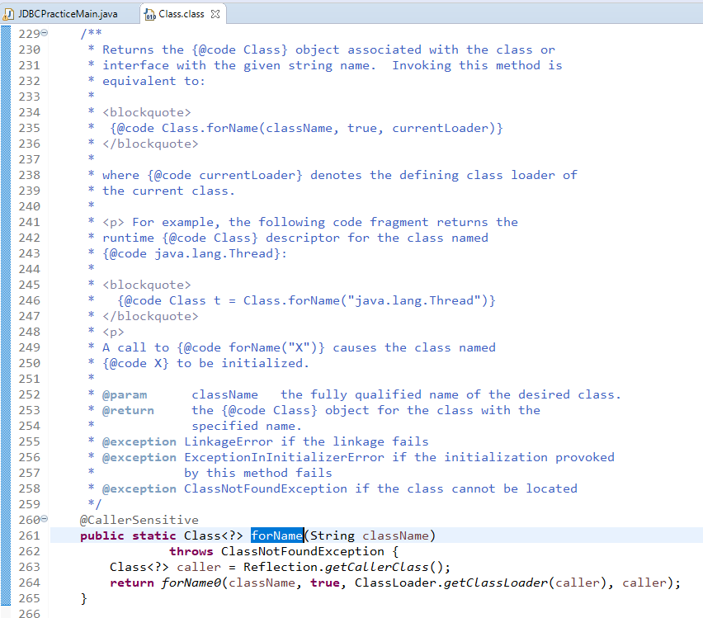
16.02.3 Import, register, and Connection
https://www.youtube.com/watch?v=5vzCjvUwMXg&list=PLGwb7xZHg-oMv1pOlTHAqAEjw0EPALzlL&index=159
Now, we have JDBC package, we can Import java.sql.*
Use Class.forName to register the mysql.connecrtor.jar
Press Control and select “forName”.
Note: If you can not see the JavaDoc. Just click the error message, click attach button, and select jdk.1.8_191/src.zip. You will see the JavaDoc source.

Slide 16
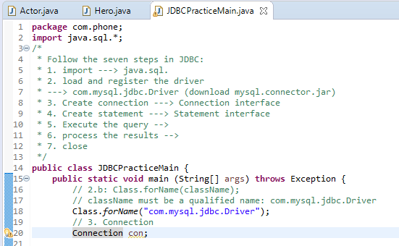
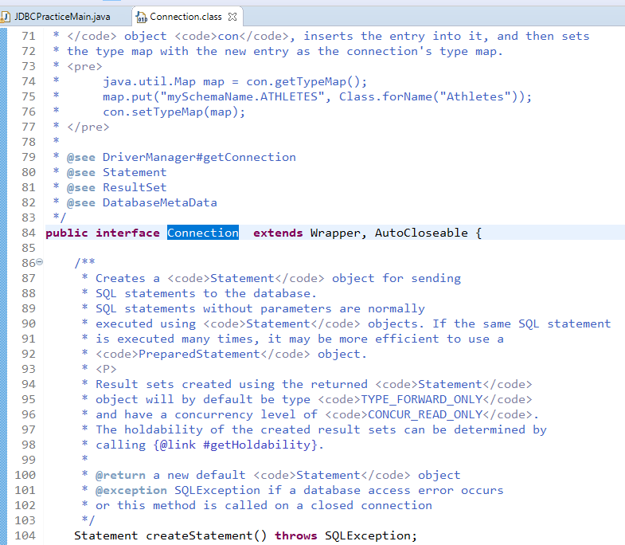
16.02.3 Import, register, and Connection
https://www.youtube.com/watch?v=5vzCjvUwMXg&list=PLGwb7xZHg-oMv1pOlTHAqAEjw0EPALzlL&index=159
Connection is an interface. We cannot create object of interface directly.
We need to search for the class which implements the Connection interface.
Or we need to search for the method which will give you the instance of connection.
Press Control and Select “Connection”

Slide 17
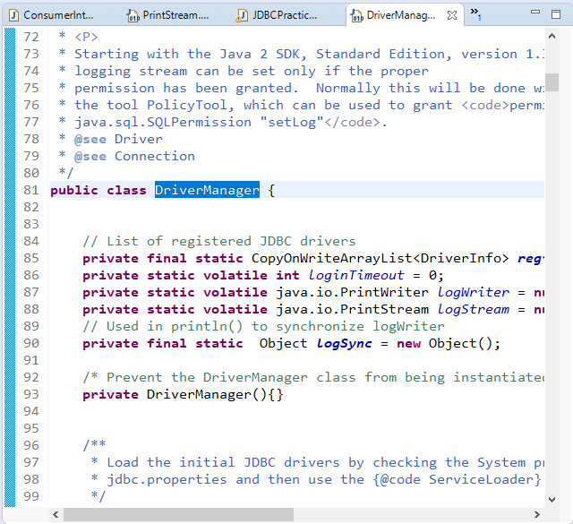
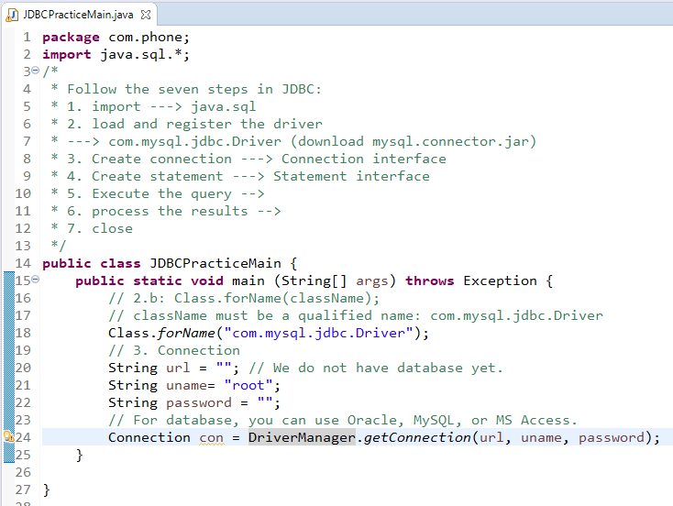
16.02.3 Import, register, and Connection
https://www.youtube.com/watch?v=5vzCjvUwMXg&list=PLGwb7xZHg-oMv1pOlTHAqAEjw0EPALzlL&index=159
We will use the method which will give you the instance of connection.
getConnection() is a method in Java which will give you the instance of connection.
So, this getConnection() is a method of a class called DriverManager. The DriverManager have a method getConnection() which is a static method.
Press Control and Select “DriverManager”

Slide 18
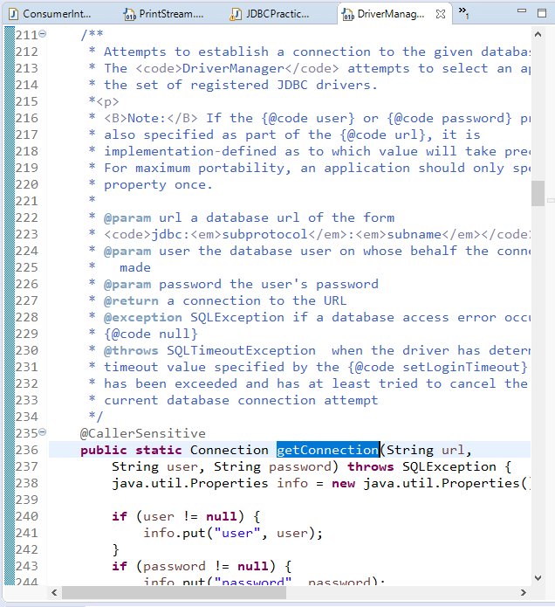
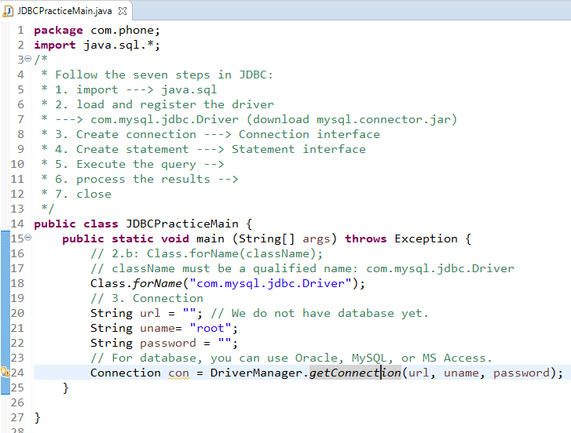
16.02.3 Import, register, and Connection
https://www.youtube.com/watch?v=5vzCjvUwMXg&list=PLGwb7xZHg-oMv1pOlTHAqAEjw0EPALzlL&index=159
If you go to source code of DriverManager, you can see the getConnection() belongs the same package which you are working with java or SQL and in the package or in this class DriverManager, we have a lot of methods available. One of methods is getConnection().
Because getConnection() method is a static method which return the instance of Connection.
We have to pass three parameters, i.e., URL, User-name, and Password, to achieve the Connection.
Press Control and selct “getConnection”

Slide 19
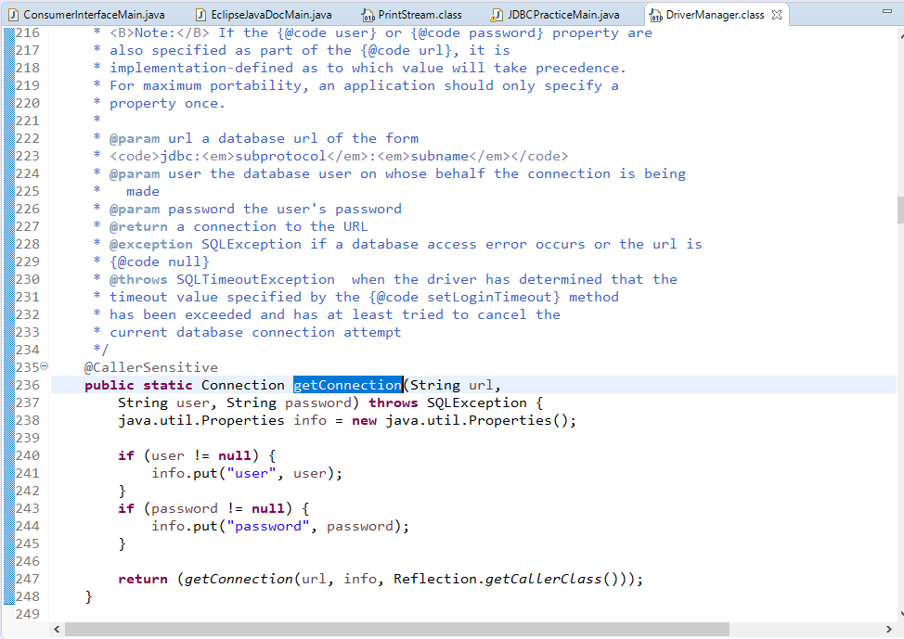
16.02.3 Import, register, and Connection
https://www.youtube.com/watch?v=5vzCjvUwMXg&list=PLGwb7xZHg-oMv1pOlTHAqAEjw0EPALzlL&index=159
We have to pass three parameters, i.e., URL, User-name, and Password, to achieve the Connection.
This is the method getConnection (URL, User-name, password).

Slide 20
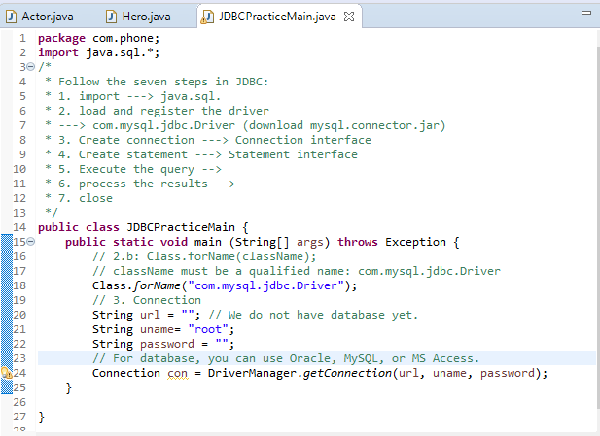
16.02.3 Import, register, and Connection
https://www.youtube.com/watch?v=5vzCjvUwMXg&list=PLGwb7xZHg-oMv1pOlTHAqAEjw0EPALzlL&index=159
Go back to Eclipse. We need to pass URL, user-name, and password.

Slide 21
16.02.4 MySQL Workbench
Peter H. Chen

Slide 22
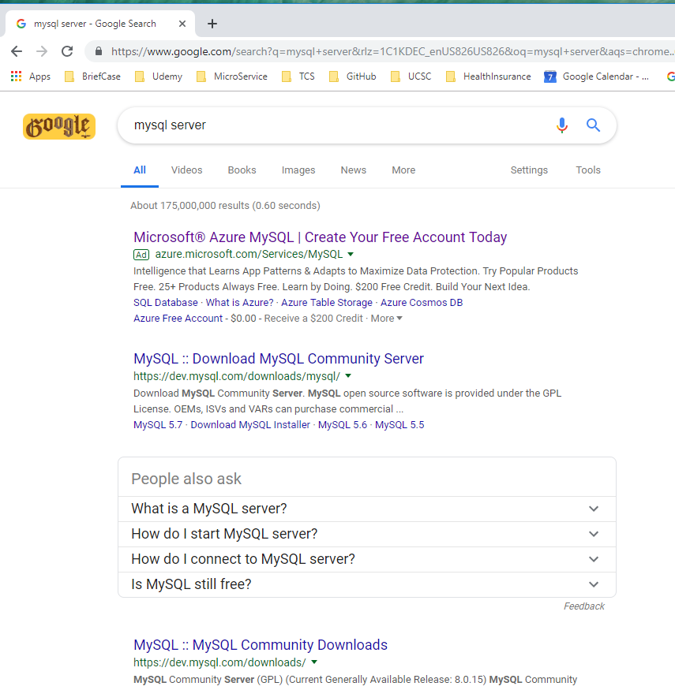
16.02.4 MySQL Workbench
https://www.youtube.com/watch?v=5vzCjvUwMXg&list=PLGwb7xZHg-oMv1pOlTHAqAEjw0EPALzlL&index=159
Search for “mysql server”. These are for command line MySQL and not flexible.

Slide 23
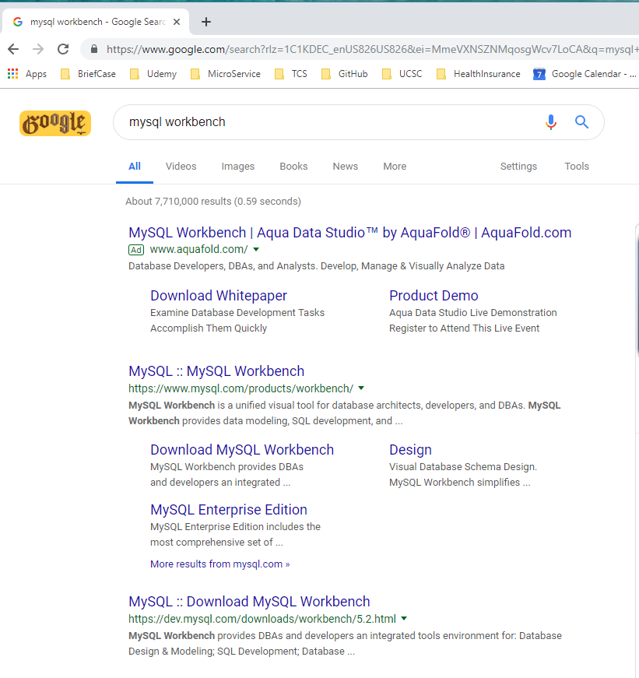
16.02.4 MySQL Workbench
https://www.youtube.com/watch?v=5vzCjvUwMXg&list=PLGwb7xZHg-oMv1pOlTHAqAEjw0EPALzlL&index=159
We want GUI based MySQL. You can search for “mysql workbench”

Slide 24
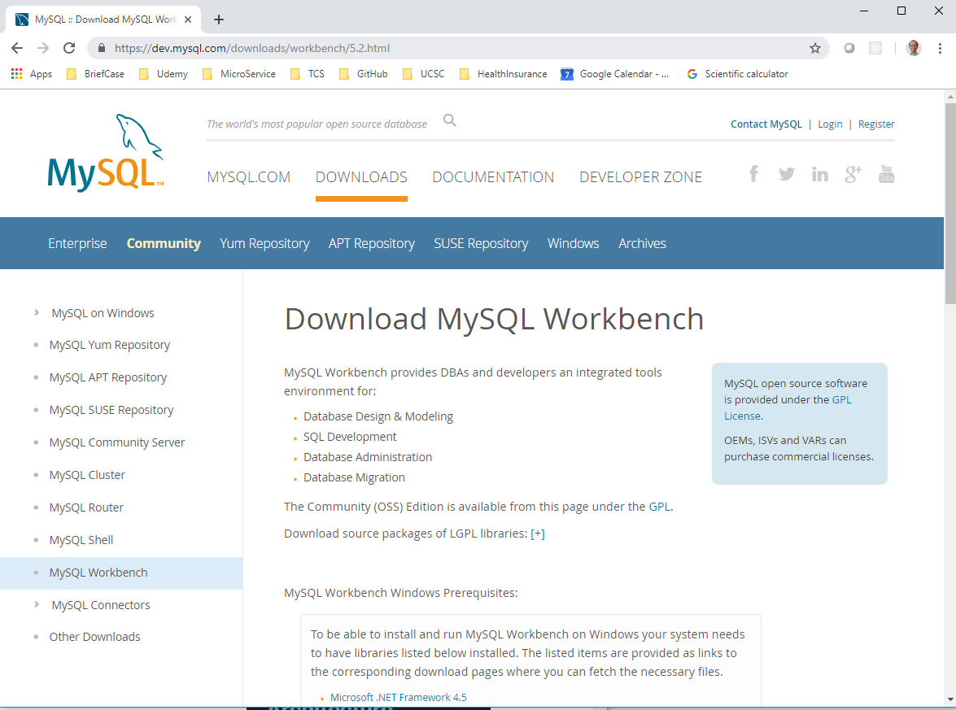
16.02.4 MySQL Workbench
https://www.youtube.com/watch?v=5vzCjvUwMXg&list=PLGwb7xZHg-oMv1pOlTHAqAEjw0EPALzlL&index=159
This is the GUI version of MySQL which is MySQL workbench.

Slide 25
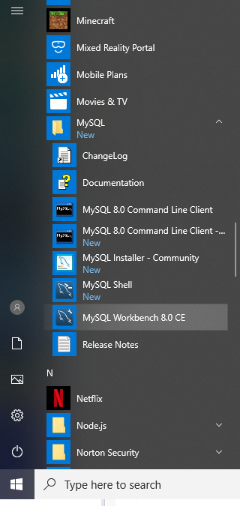
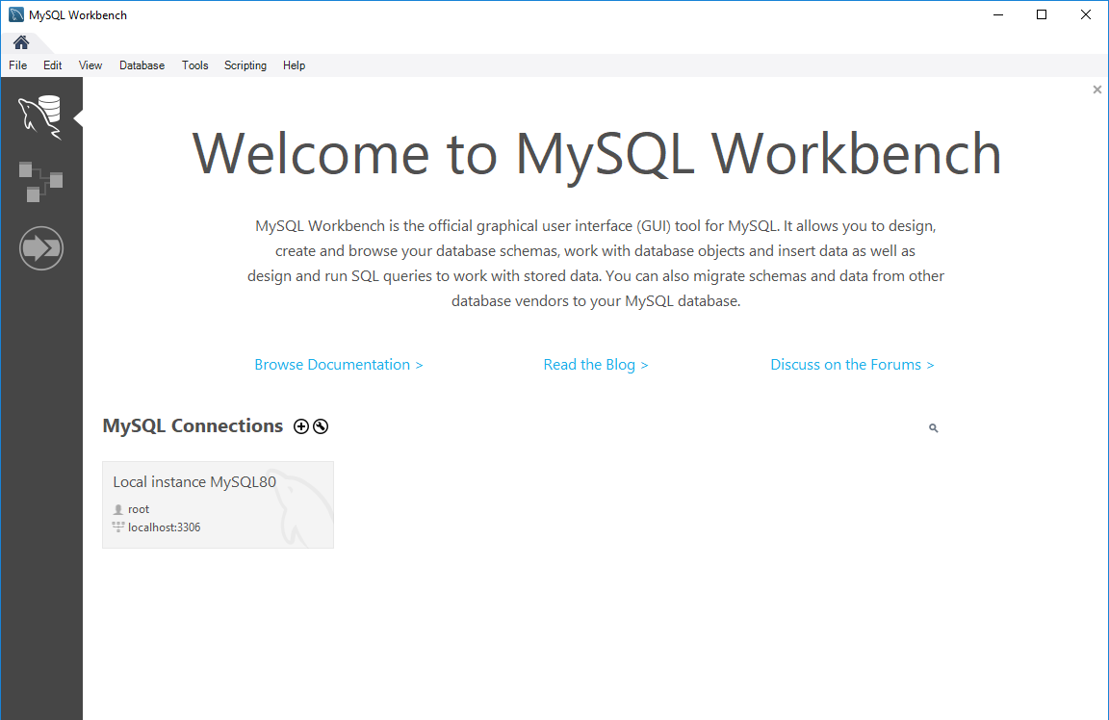
16.02.4 MySQL Workbench
https://www.youtube.com/watch?v=5vzCjvUwMXg&list=PLGwb7xZHg-oMv1pOlTHAqAEjw0EPALzlL&index=159
After MySQL Community Edition is installed we have MySQL Workbench.
We can search “MySQL Workbench 8.0 CE” or Windows Start Menu: MySQL > MySQL Workbench 8.0 CE.

Slide 26
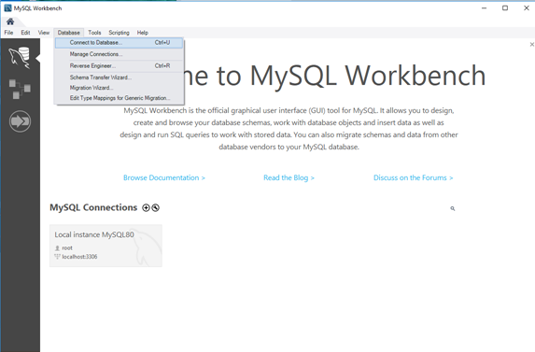
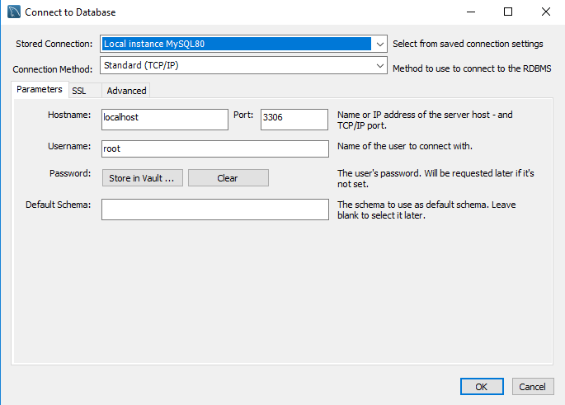
16.02.4 MySQL Workbench
https://www.youtube.com/watch?v=5vzCjvUwMXg&list=PLGwb7xZHg-oMv1pOlTHAqAEjw0EPALzlL&index=159
Database > Connect Database …

Slide 27
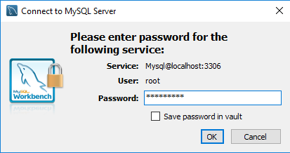
16.02.4 MySQL Workbench
https://www.youtube.com/watch?v=5vzCjvUwMXg&list=PLGwb7xZHg-oMv1pOlTHAqAEjw0EPALzlL&index=159
Click OK. Type Password: “Pc1997=ch”

Slide 28
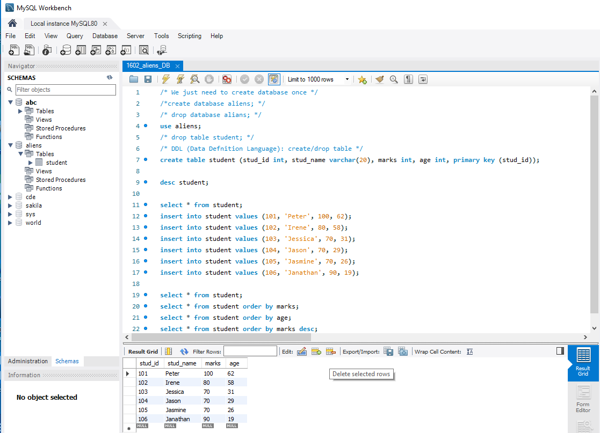
16.02.4 MySQL Workbench
https://www.youtube.com/watch?v=5vzCjvUwMXg&list=PLGwb7xZHg-oMv1pOlTHAqAEjw0EPALzlL&index=159
Control + <Enter> to execute the MySQL script line-by-line. You can comment (/* .. */) the code out if the database aliens already created.
Use “select * from student” to see the student table.

Slide 29
16.02.4 MySQL Workbench
https://www.youtube.com/watch?v=5vzCjvUwMXg&list=PLGwb7xZHg-oMv1pOlTHAqAEjw0EPALzlL&index=159
You can “insert into student values ()” to insert the data for database aliens.

Slide 30
16.02.5 JDBC
Peter H. Chen

Slide 31
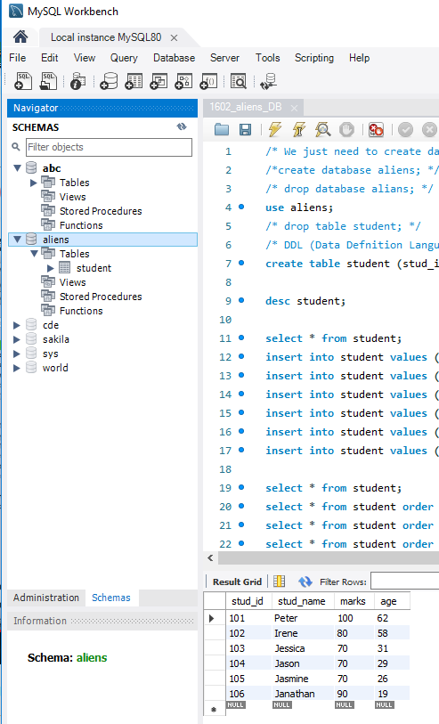
16.02.4 MySQL Workbench
https://www.youtube.com/watch?v=5vzCjvUwMXg&list=PLGwb7xZHg-oMv1pOlTHAqAEjw0EPALzlL&index=159
Back to Eclipse. First, we have database name “aliens”.

Slide 32
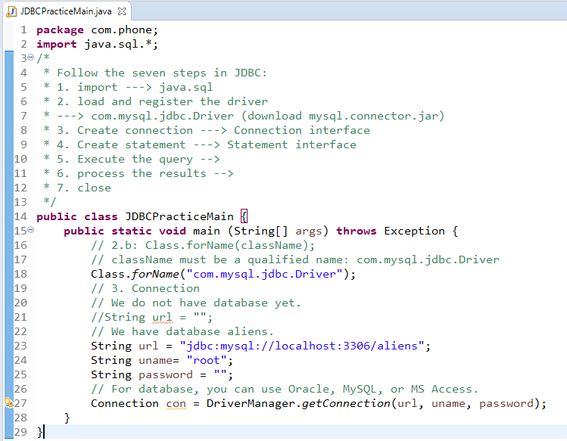
16.02.4 MySQL Workbench
https://www.youtube.com/watch?v=5vzCjvUwMXg&list=PLGwb7xZHg-oMv1pOlTHAqAEjw0EPALzlL&index=159
The url = “jdbc:mysql:aliens” is used to specify the JDBC and MySQL.
Because MySQL is the LAN Type of database server, we need to specify IP Address (localhost) and port number (3306) in order to access the database server.
The port number 3306 is specified when we install the MySQL Community Edition.

Slide 33
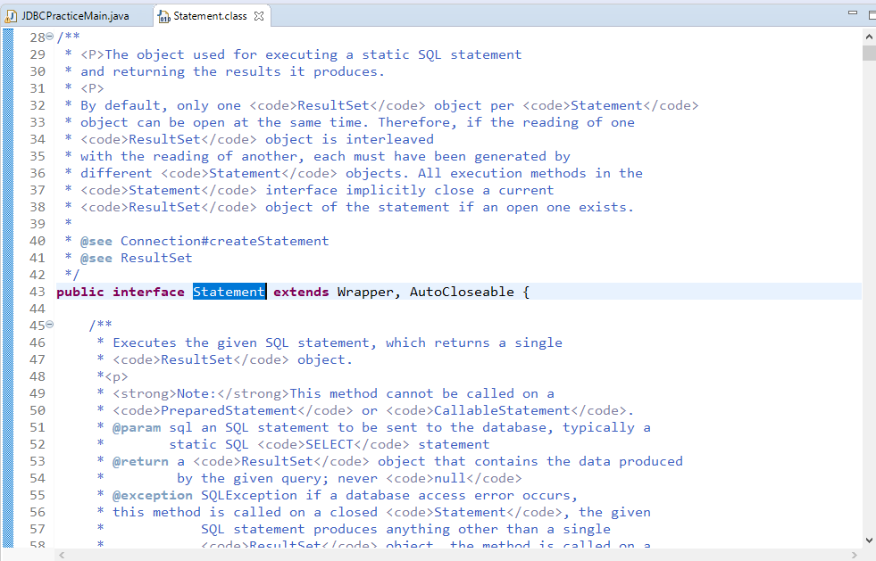
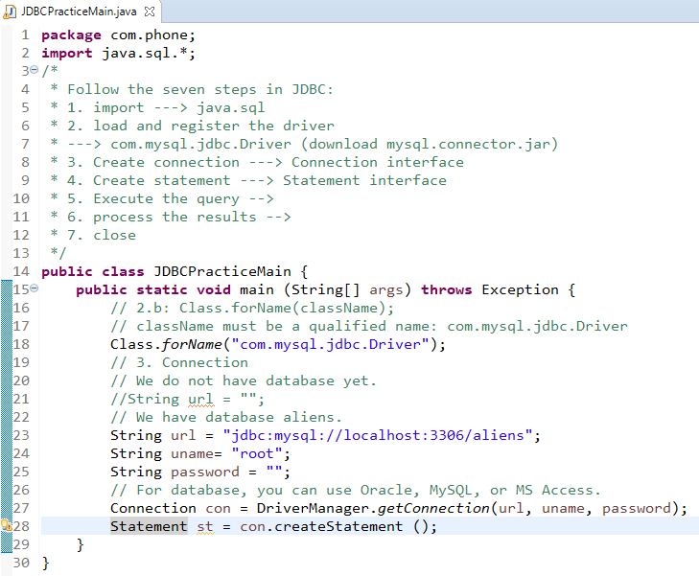
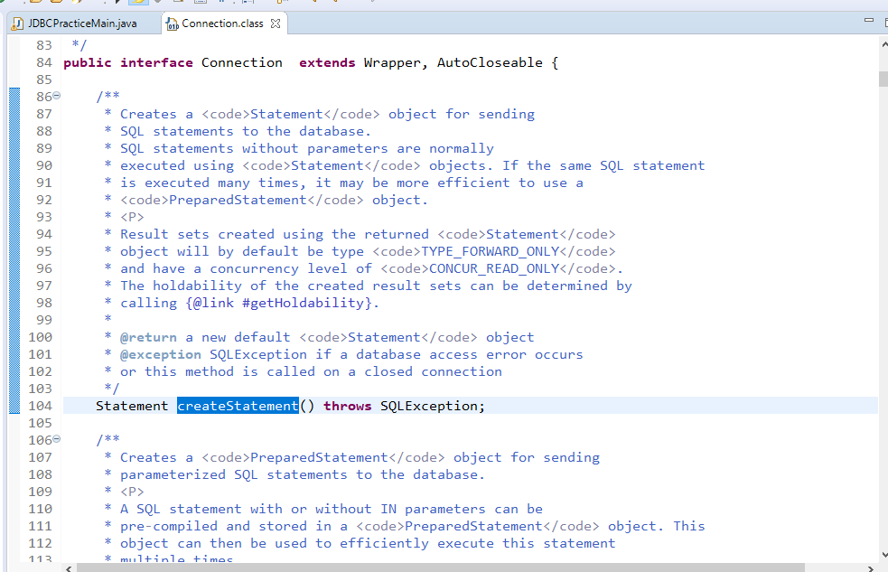
16.02.4 MySQL Workbench
https://www.youtube.com/watch?v=5vzCjvUwMXg&list=PLGwb7xZHg-oMv1pOlTHAqAEjw0EPALzlL&index=159
We need to create the statement method.
Statement is a interface. Control + Select “Statement”

Slide 34
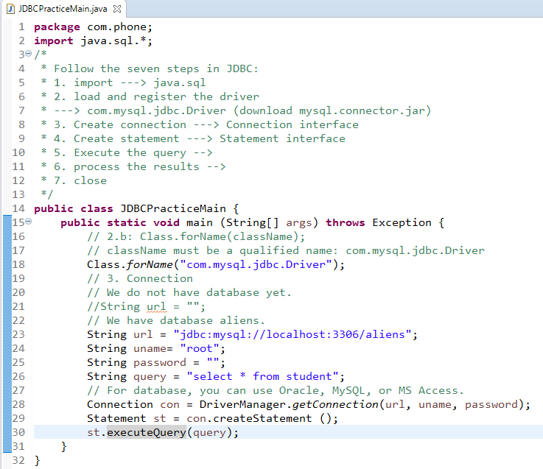
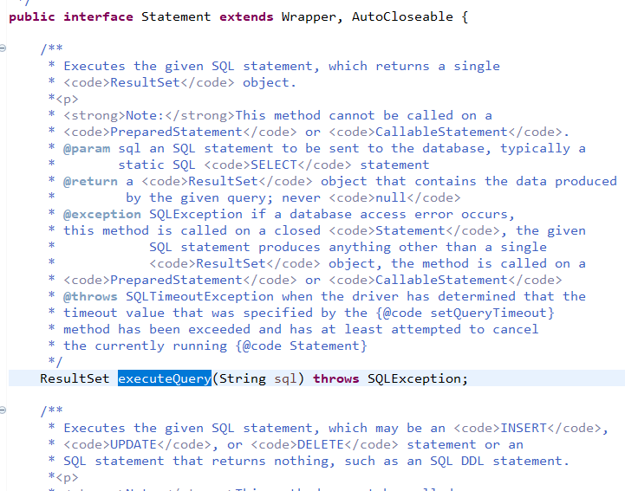
16.02.4 MySQL Workbench
https://www.youtube.com/watch?v=5vzCjvUwMXg&list=PLGwb7xZHg-oMv1pOlTHAqAEjw0EPALzlL&index=159
String query = “select * from student”;
Execute the st.executeQuery (query);.

Slide 35
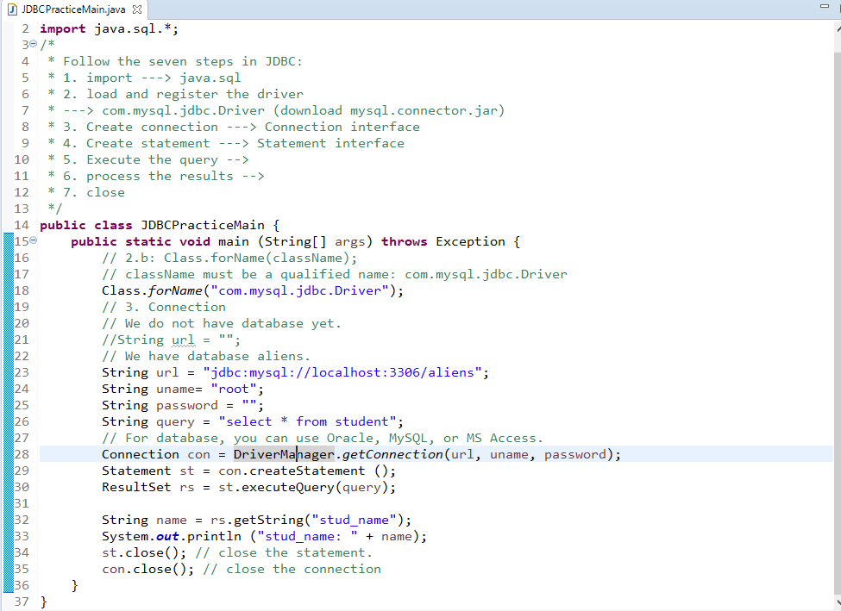
16.02.4 MySQL Workbench
https://www.youtube.com/watch?v=5vzCjvUwMXg&list=PLGwb7xZHg-oMv1pOlTHAqAEjw0EPALzlL&index=159
ResultSet has the power to store chunk of data and tabular structure.
In the rs, we have the data now. We can print the data.

Slide 36
16.02.4 MySQL Workbench
https://www.youtube.com/watch?v=5vzCjvUwMXg&list=PLGwb7xZHg-oMv1pOlTHAqAEjw0EPALzlL&index=159
We can close the statement and connection.

Slide 37
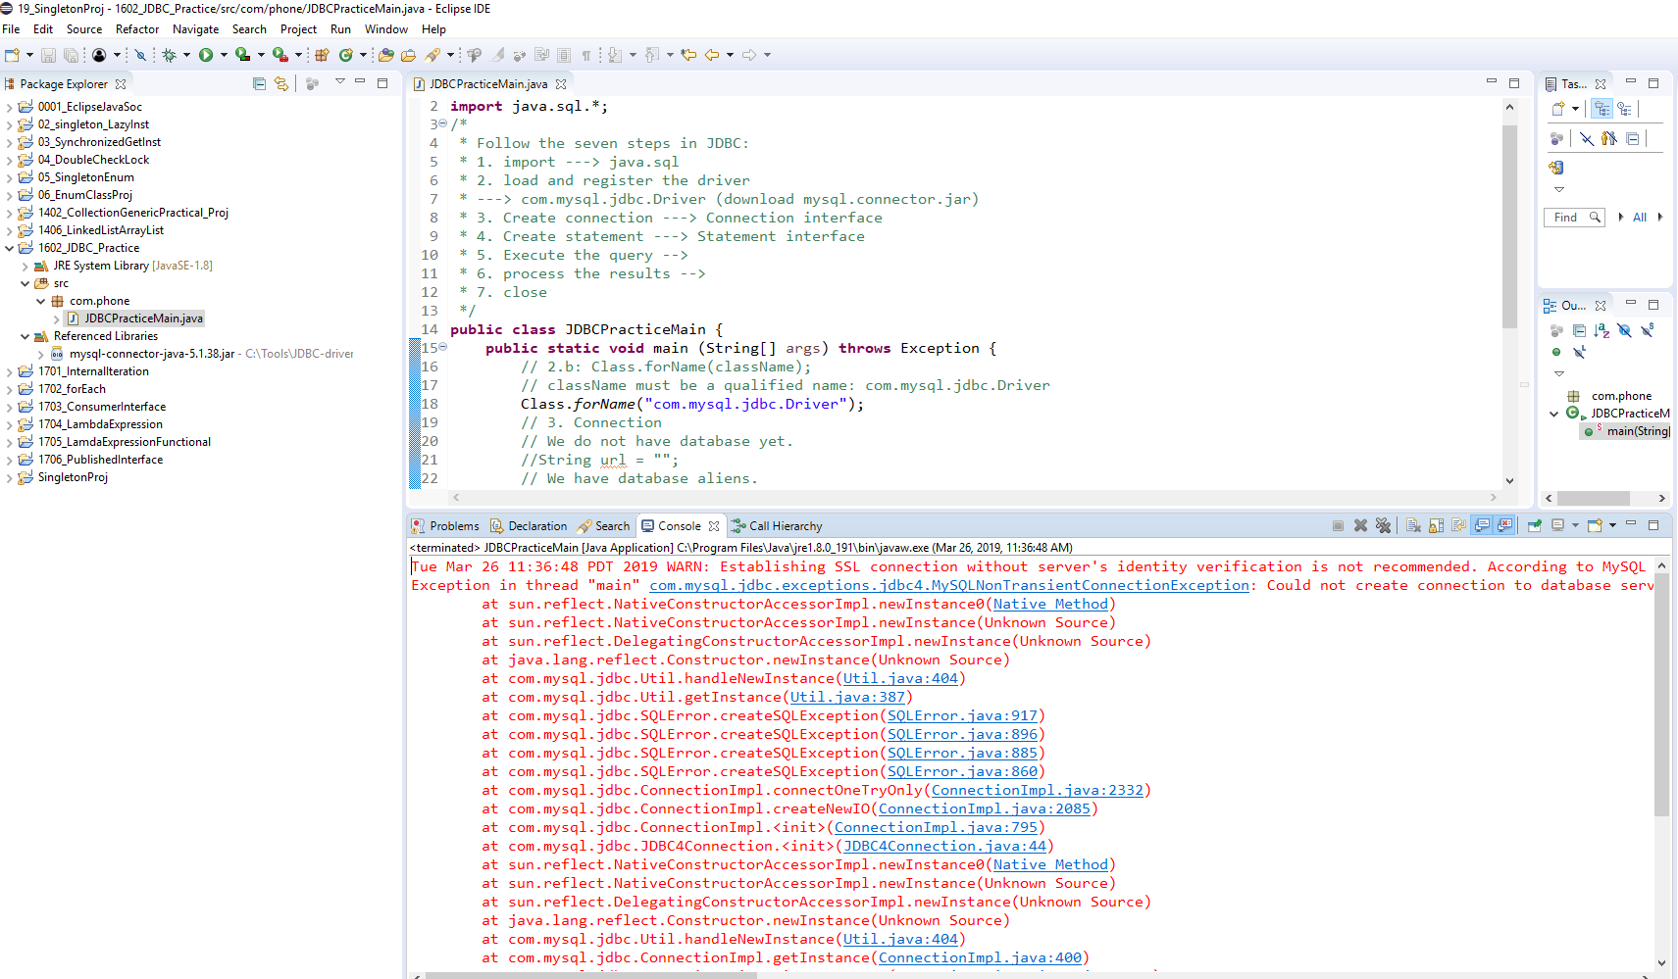
16.02.4 MySQL Workbench
https://www.youtube.com/watch?v=5vzCjvUwMXg&list=PLGwb7xZHg-oMv1pOlTHAqAEjw0EPALzlL&index=159
Run the code.
We got the error: There is a SSL certificate error between the client and Server.

Slide 38
16.02.5 Download New Java Connector
Peter H. Chen

Slide 39
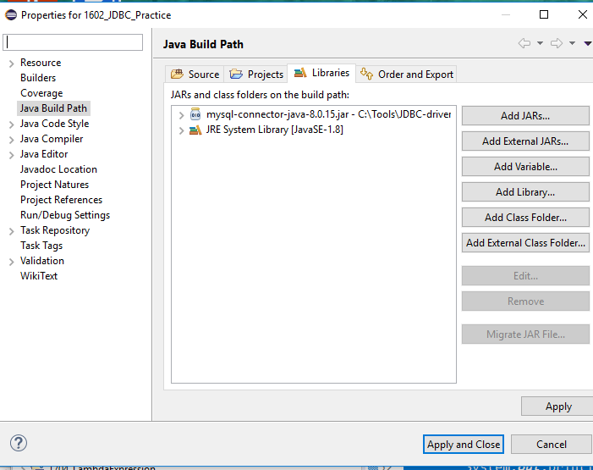
16.02.5 Download New Java Connector
https://www.youtube.com/watch?v=5vzCjvUwMXg&list=PLGwb7xZHg-oMv1pOlTHAqAEjw0EPALzlL&index=159
Remove the older version of Connector and
Attached the new version mysql-connector-java-8.0.15 for MySQL 8.0.15.

Slide 40
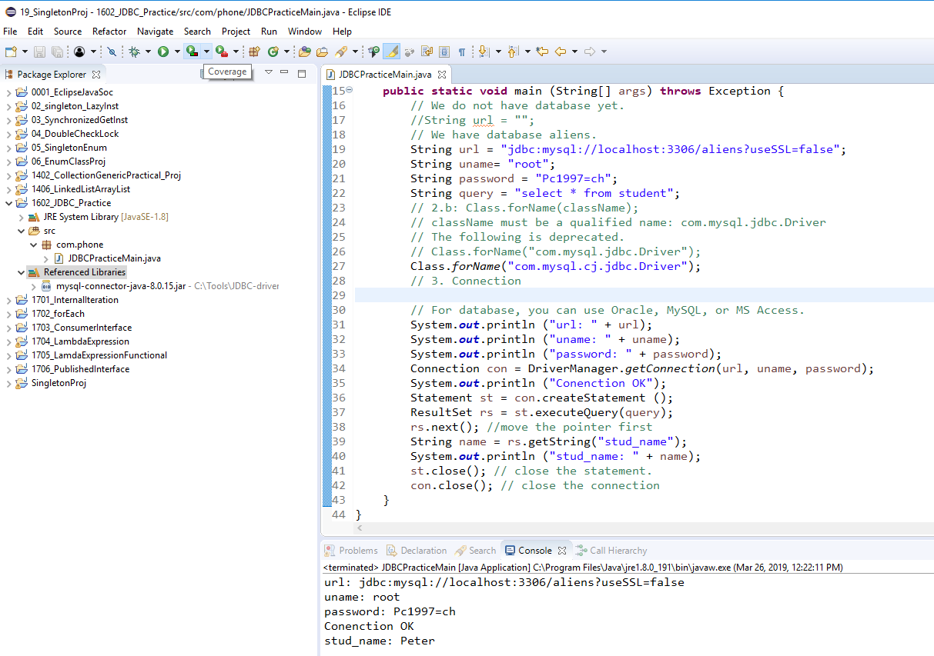
16.02.5 Download New Java Connector
https://www.youtube.com/watch?v=5vzCjvUwMXg&list=PLGwb7xZHg-oMv1pOlTHAqAEjw0EPALzlL&index=159
Re-run Java Code:

Slide 41
End of Chapter

