Slide 1

17.04 Lambda Expression
Peter H. Chen

Slide 2
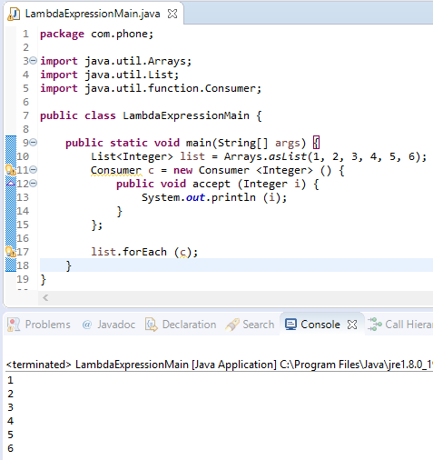
17.04 Lambda Expression
https://www.youtube.com/watch?v=8man0ZNx3FU&list=PLsyeobzWxl7oZ-fxDYkOToURHhMuWD1BK&index=167
In this section, we discuss the Lambda Expression.
How to make the code more efficient in Consumer Interface?
We have Consumer Interface object pass into forEach (c).
The interface object c converted into the parameter i in the accept (i).
Can we make it into more efficient of one line of code?

Slide 3
17.04 Lambda Expression
https://www.youtube.com/watch?v=8man0ZNx3FU&list=PLsyeobzWxl7oZ-fxDYkOToURHhMuWD1BK&index=167
What is import here is parameter I, nothing to do with interface Consumer, new class Consumer, and accept method.

Slide 4
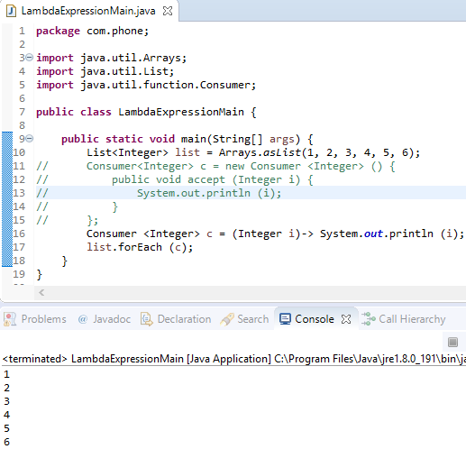
17.04 Lambda Expression
https://www.youtube.com/watch?v=8man0ZNx3FU&list=PLsyeobzWxl7oZ-fxDYkOToURHhMuWD1BK&index=167
For every value of i, we want to print it out.
Consumer c = (Integer i) -> System.out.println (i);

Slide 5
17.04 Lambda Expression
https://www.youtube.com/watch?v=8man0ZNx3FU&list=PLsyeobzWxl7oZ-fxDYkOToURHhMuWD1BK&index=167
What we have now is to specify the parameter name which is i.

Slide 6
17.04 Lambda Expression
https://www.youtube.com/watch?v=8man0ZNx3FU&list=PLsyeobzWxl7oZ-fxDYkOToURHhMuWD1BK&index=167
Use the lambda expression here to specify the body which is System.out.println (i).

Slide 7
17.04 Lambda Expression
https://www.youtube.com/watch?v=8man0ZNx3FU&list=PLsyeobzWxl7oZ-fxDYkOToURHhMuWD1BK&index=167
But if you know the consumer type is integer.
Why should we specify our integer here?

Slide 8
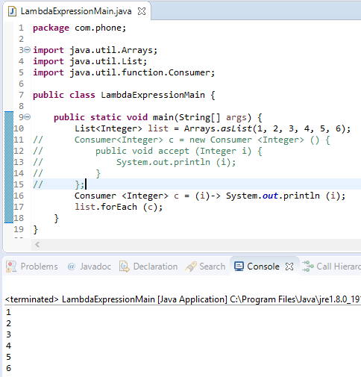
17.04 Lambda Expression
https://www.youtube.com/watch?v=8man0ZNx3FU&list=PLsyeobzWxl7oZ-fxDYkOToURHhMuWD1BK&index=167
We can remove the Integer here.

Slide 9

17.04 Lambda Expression
https://www.youtube.com/watch?v=8man0ZNx3FU&list=PLsyeobzWxl7oZ-fxDYkOToURHhMuWD1BK&index=167
We can remove the bracket here.

Slide 10
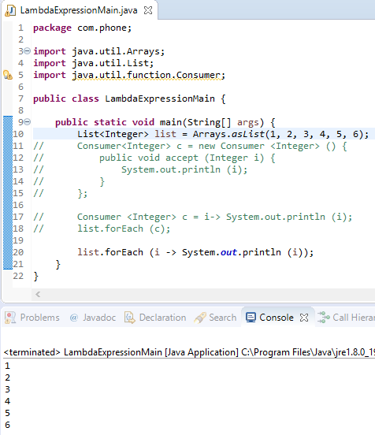
17.04 Lambda Expression
https://www.youtube.com/watch?v=8man0ZNx3FU&list=PLsyeobzWxl7oZ-fxDYkOToURHhMuWD1BK&index=167
We can remove the Consumer declaration and just the lambda expression inside the forEach.

Slide 11
End of Chapter

