Slide 1

1 Singleton
Peter H. Chen

Slide 2
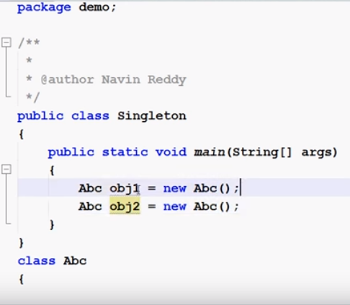
1 Singleton
https://www.youtube.com/watch?v=KUTqnWswPV4&list=PLsyeobzWxl7rqhgfVySFnwhtS4QUT4805
This section discusses the singleton.
We creates two instances in the following code example.

Slide 3
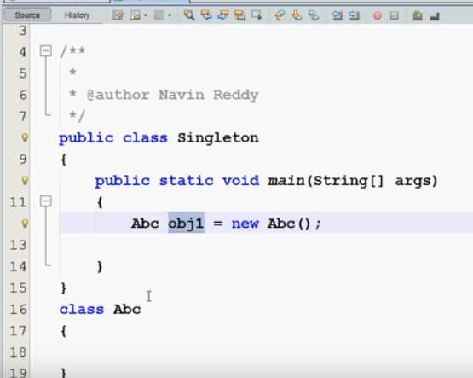
1 Singleton
https://www.youtube.com/watch?v=KUTqnWswPV4&list=PLsyeobzWxl7rqhgfVySFnwhtS4QUT4805
If you allowed me to create one instance only. That is mean your class is singleton.
We do not have any keyword call “singleton” in front of class. We have to create singleton by ourselves with concept in Java.

Slide 4
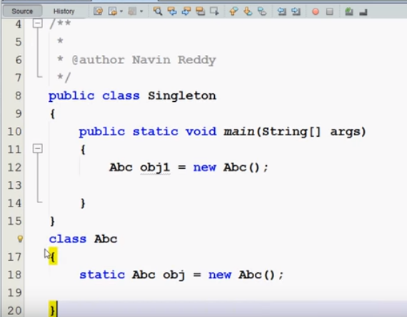
1 Singleton
https://www.youtube.com/watch?v=KUTqnWswPV4&list=PLsyeobzWxl7rqhgfVySFnwhtS4QUT4805
The following steps are used to create the singleton class.
Step 1: in class Abc, we have to say “static Abc obj = new Abc();
In class Abc, we only have one instance which is obj.

Slide 5
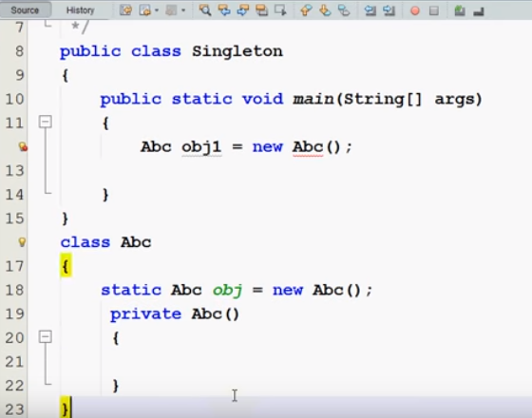
1 Singleton
https://www.youtube.com/watch?v=KUTqnWswPV4&list=PLsyeobzWxl7rqhgfVySFnwhtS4QUT4805
Step 2: Do not allow user to create another instance with default constructor.
If I have a private constructor Abc () in the class, then user cannot instantiate from outside.

Slide 6
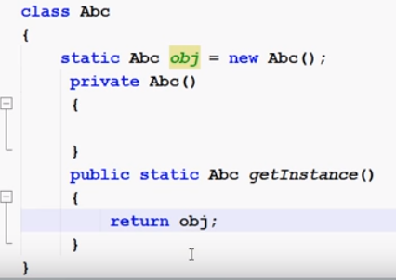
1 Singleton
https://www.youtube.com/watch?v=KUTqnWswPV4&list=PLsyeobzWxl7rqhgfVySFnwhtS4QUT4805
Step 3: Now, we need a getInstance which return the class object obj.

Slide 7
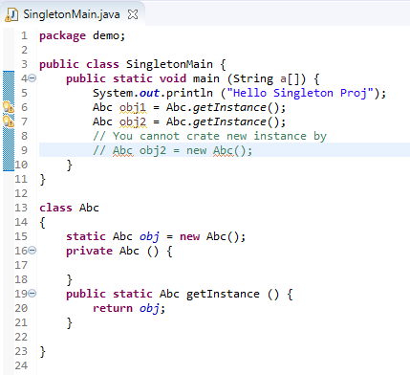
1 Singleton
https://www.youtube.com/watch?v=KUTqnWswPV4&list=PLsyeobzWxl7rqhgfVySFnwhtS4QUT4805
Step 4: Now, we can Abc obj1 = Abc.getInstance() to get the instance from class Abc.
You cannot create another instance. This is the advantage of singleton.

Slide 8
End of Chapter

