Slide 1

17.02 forEach
Peter H. Chen

Slide 2
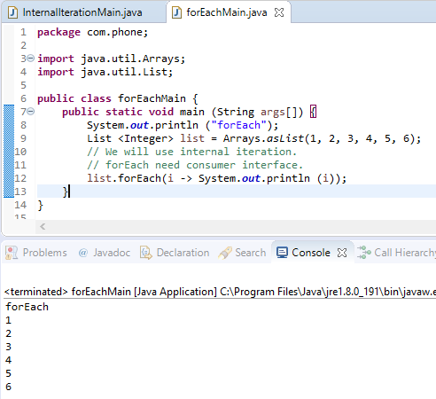
17.02 forEach
https://www.youtube.com/watch?v=A620gzL0XPU&index=165&list=PLsyeobzWxl7oZ-fxDYkOToURHhMuWD1BK
We discuss the forEach.
The forEach use consumer interface. Each consumer interface is a Lambda expression.
The method name is an object which is one parameter.
list.forEach (i -> System.out.println (i));
This “i -> Syste,.out.print (i)” is the function interface. It simply says, for every value of i, it will print the value of i. So it will iterate from the first value of the list to the last value of the list. The values are from 1 to 6. It will print all the values.
So this concept is called as Internal Iteration.

Slide 3
17.02 forEach
https://www.youtube.com/watch?v=A620gzL0XPU&index=165&list=PLsyeobzWxl7oZ-fxDYkOToURHhMuWD1BK
What is exactly of this line?
We will see how to define the consumer interface and different features of Stream API in the next section.

Slide 4
End of Chapter

