Slide 1

1 Factory Design Pattern
Peter H. Chen

Slide 2
1 Factory Design Pattern
https://www.youtube.com/watch?v=pt1IbV1aSZ4
This section discussed the Factory Design Pattern.
We have multiple implementations for the same interface. For example, we have an interface OS. The interface OS has multiple implementations for Android OS, iOS, and Windows OS. Now, if we want to create an object which can choose Android OS, iOS, or Windows.
We want to hide the logic we created.
Client
(main)
<<interface>>
OS
OperatingSystemFactory (String str)
Passed in string = “Open Phone OS”, “Closed Phone OS”, or “PC OS”
Class/Object
Android OS
Class/Object
iOS
Class/Object
Window OS

Slide 3
1 Factory Design Pattern
https://www.youtube.com/watch?v=pt1IbV1aSZ4
First, we create one Interface OS.
Second, we create three classes: Android OS, iOS OS, and Windows OS.
Third, we create a factory to switch the passed in parameter and instantiate the Andtoid, iOS, and Windows.
Finally, in the main program, we pass the specification with string to factory design pattern. The factory will match the specification and pick up the object through the interface.

Slide 4
1.1 Create Main
Peter H. Chen

Slide 5
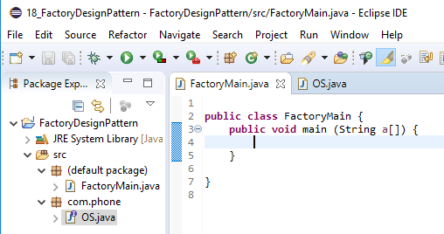
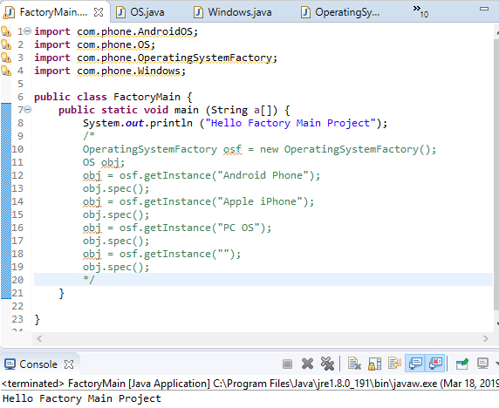
1.1 Create Main
https://www.youtube.com/watch?v=pt1IbV1aSZ4
Create a Java Project: FactoryDesignPattern
Create class: FactoryMain
Add the print command: System.out.println (“Hello Factory Main Project”);
Run and test. This is make sure the project is launched and run in Eclipse.

Slide 6
1.2 Create Interface
Peter H. Chen

Slide 7
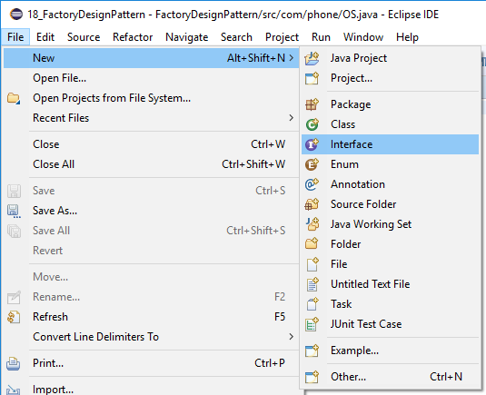
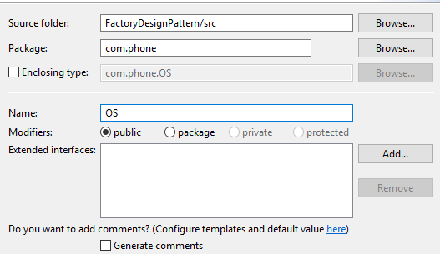
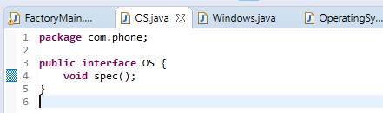
1.2 Create Interface
https://www.youtube.com/watch?v=pt1IbV1aSZ4
Create a Interface: OS, Package: com.phone
The interface method spec() has to be defined.

Slide 8
1.3 Create Classes
Peter H. Chen

Slide 9
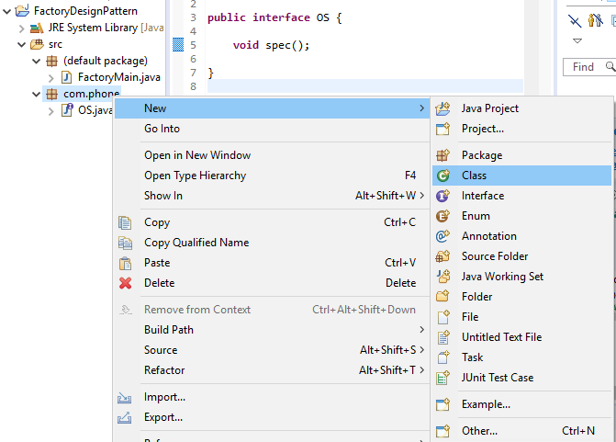
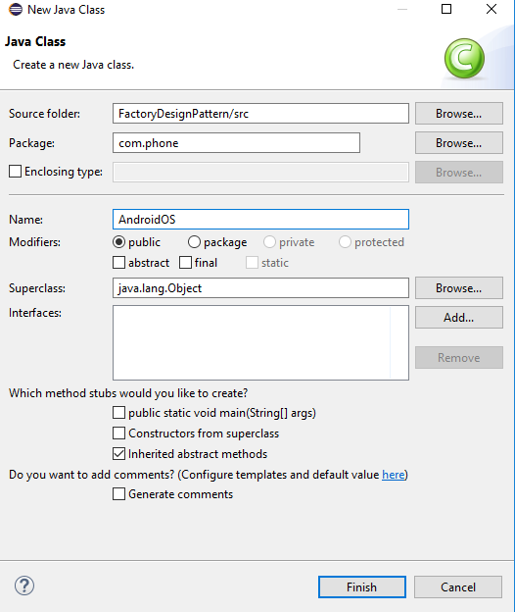
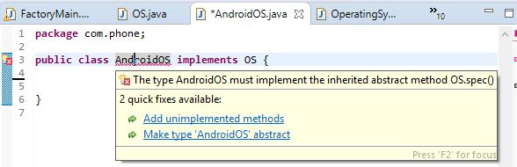
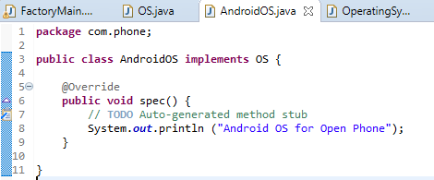
1.3 Create Classes
https://www.youtube.com/watch?v=pt1IbV1aSZ4
We have to create three classes: Android, iOS, and Windows.
First, create a class called AndroidOS.
1
2
3
4

Slide 10
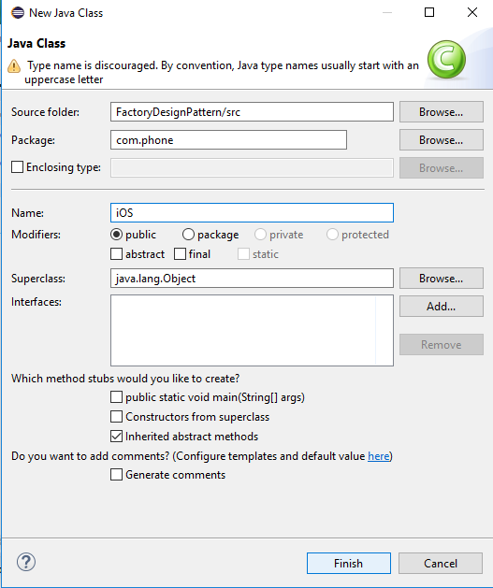
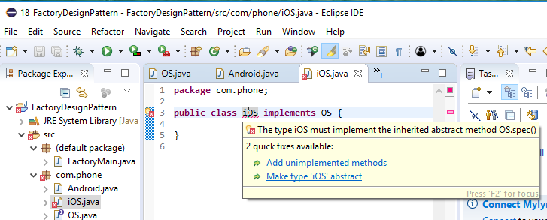
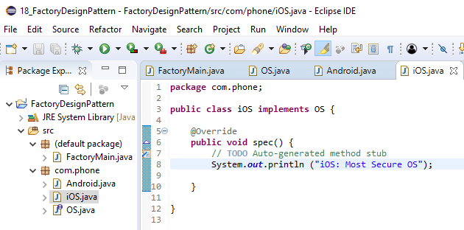
1.3 Create Three Classes
https://www.youtube.com/watch?v=pt1IbV1aSZ4
Second, create a class called iOS.
1
2
3
4

Slide 11
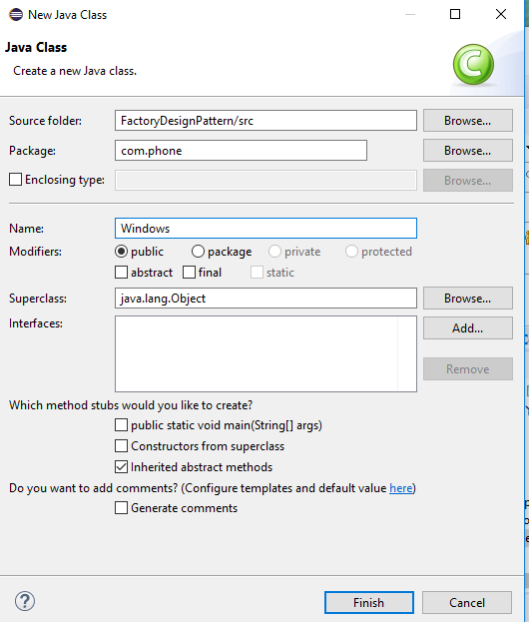
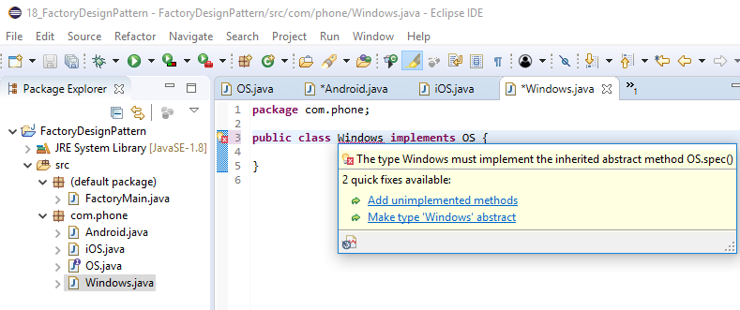
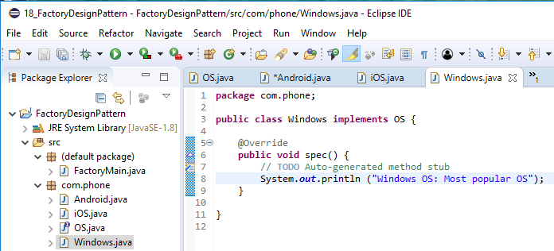
1.3 Create Three Classes
https://www.youtube.com/watch?v=pt1IbV1aSZ4
Third, create a class called Windows.
1
2
3
4

Slide 12
1.4 Factory Class
Peter H. Chen

Slide 13
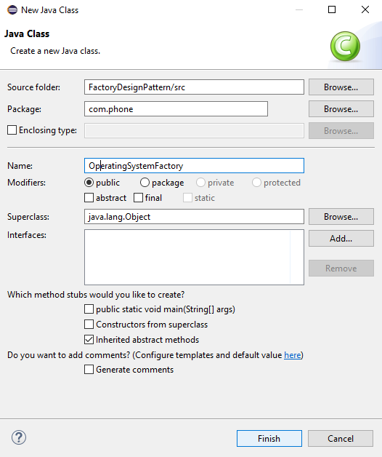
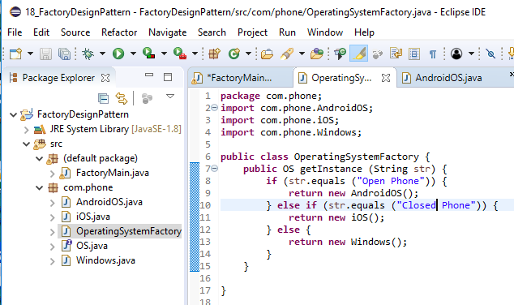
1.4 Factory Class
https://www.youtube.com/watch?v=pt1IbV1aSZ4
Now, we need to create the factory class: OperatingSystemFactory. This class is used to switch the input string to selected OS.
1
2
3

Slide 14
1.5 Instantiate Obj
Peter H. Chen

Slide 15
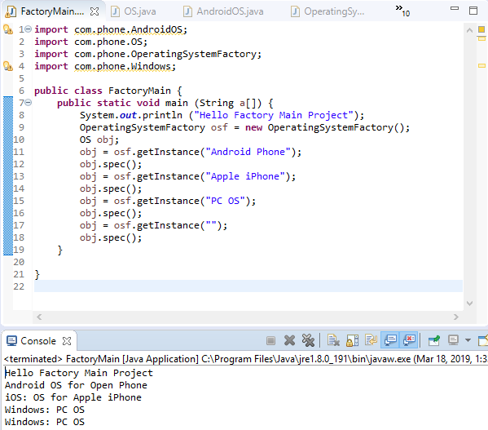
1.4 Instantiate Obj
https://www.youtube.com/watch?v=pt1IbV1aSZ4
In the main program, we instantiate the OperatingSystemFactory object osf and interface object obj.
We assign the interface Object obj different instance by osf.getInstance (pass-in-string).
Then we use obj.spec() to switch different object with different output.

Slide 16
End of Chapter

