Slide 1

2 Singleton Lazy Instantiation
Peter H. Chen

Slide 2
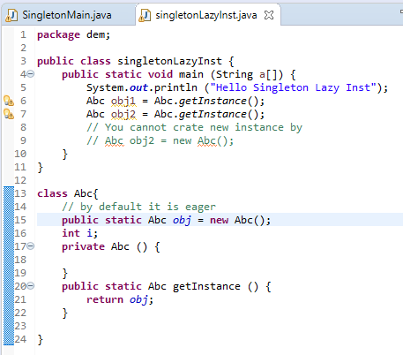
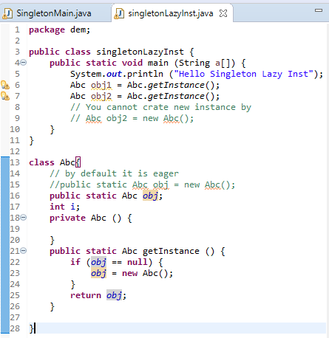
2 Singleton Lazy Instantiation
https://www.youtube.com/watch?v=KUTqnWswPV4&list=PLsyeobzWxl7rqhgfVySFnwhtS4QUT4805
This section discusses the singleton Lazy Instantiation.
By default, the memory is create eagerly. We want to have lazy creation.

Slide 3
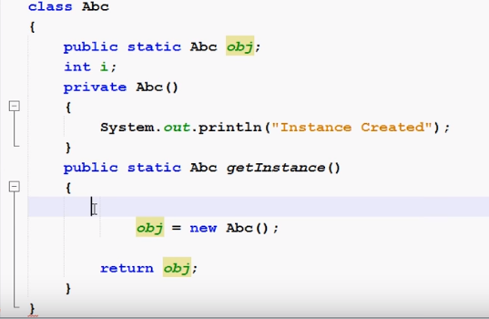
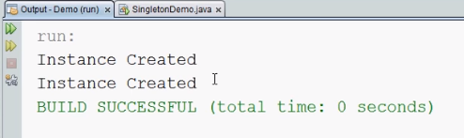
2 Singleton Lazy Instantiation
https://www.youtube.com/watch?v=KUTqnWswPV4&list=PLsyeobzWxl7rqhgfVySFnwhtS4QUT4805
If you remove the if (obj == null) check, you can see the instance is create twice.

Slide 4
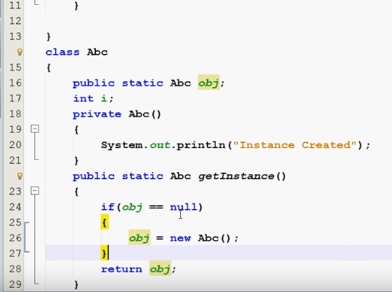
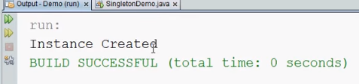
2 Singleton Lazy Instantiation
https://www.youtube.com/watch?v=KUTqnWswPV4&list=PLsyeobzWxl7rqhgfVySFnwhtS4QUT4805
If you add the if (obj == null) check, the instance just crated once.

Slide 5
End of Chapter

