Slide 1

3 Synchronized Get Instance
Peter H. Chen

Slide 2
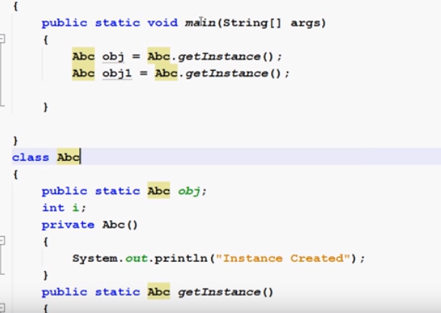
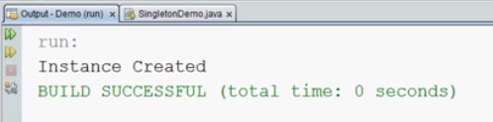
3 Synchronized Get Instance
https://www.youtube.com/watch?v=KUTqnWswPV4&list=PLsyeobzWxl7rqhgfVySFnwhtS4QUT4805
This section discusses how to synchronized getInstance().
In the previous sections, we have two objects executed sequentially.

Slide 3
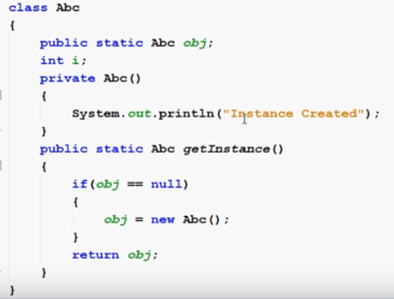
3 Synchronized Get Instance
https://www.youtube.com/watch?v=KUTqnWswPV4&list=PLsyeobzWxl7rqhgfVySFnwhtS4QUT4805
When we executed it, then we just get one instance

Slide 4
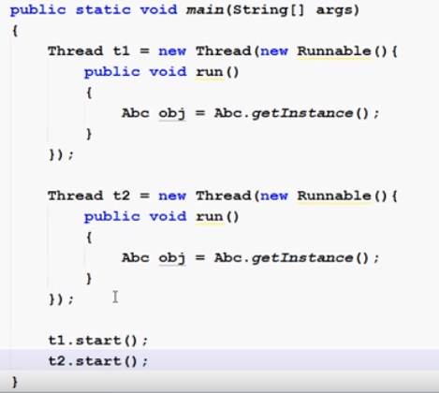
3 Synchronized Get Instance
https://www.youtube.com/watch?v=KUTqnWswPV4&list=PLsyeobzWxl7rqhgfVySFnwhtS4QUT4805
If we change two object into Thread execution, what will be happened?

Slide 5
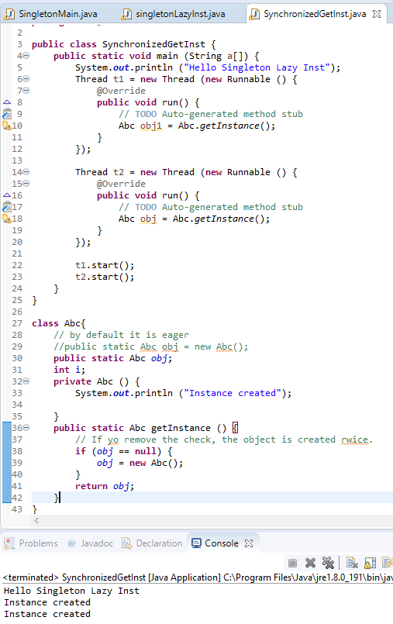
3 Synchronized Get Instance
https://www.youtube.com/watch?v=KUTqnWswPV4&list=PLsyeobzWxl7rqhgfVySFnwhtS4QUT4805
There are two instances created in the memory.
Why? Both getInstances executed at the same time and the obj is null when if (obj == null) check, so two instances are created.

Slide 6
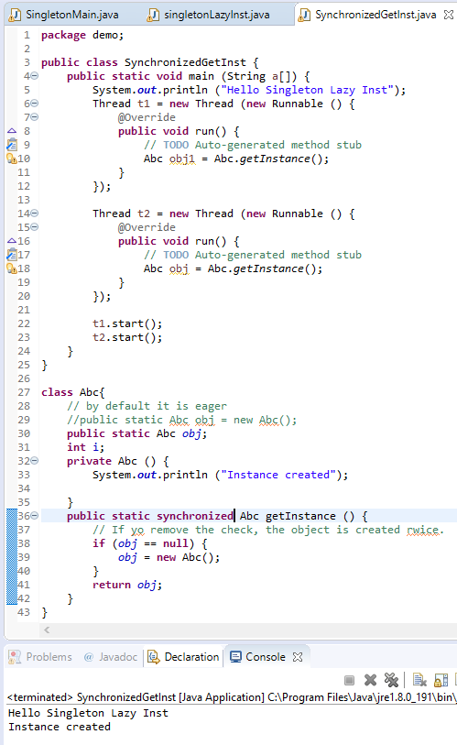
3 Synchronized Get Instance
https://www.youtube.com/watch?v=KUTqnWswPV4&list=PLsyeobzWxl7rqhgfVySFnwhtS4QUT4805
How to solve two getInstance() executed at the same time?
One of the easiest ways to solve this is to put a synchronized key word before the return type of “Abc getInstance()”.
This means one the executing the object, the other one has to wait.

Slide 7
3 Synchronized Get Instance
https://www.youtube.com/watch?v=KUTqnWswPV4&list=PLsyeobzWxl7rqhgfVySFnwhtS4QUT4805
Synchronized is 100 times slower than unsynchronized.
We will solve the slowness problem in the next section.

Slide 8
End of Chapter

