Slide 1

14.11 HashMap vs. HashTable
Peter H. Chen

Slide 2
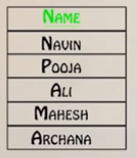
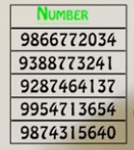
14.11 HashMap vs. HashTable
https://www.youtube.com/watch?v=z5tZ0Zb5rJQ&t=8s
We discuss the Java HashMap and HashTable.
Image you wan to create a phone book application.
We have a list of Name:
We have a list of Name:
We a list of phone number:

Slide 3
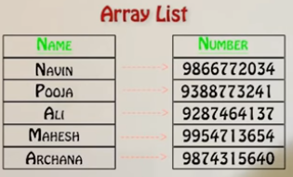
14.11 HashMap vs. HashTable
https://www.youtube.com/watch?v=z5tZ0Zb5rJQ&t=8s
We want to map a number with a name. We can create two array, one for the phone number, one for the names.
For particular name, we have particular number.

Slide 4
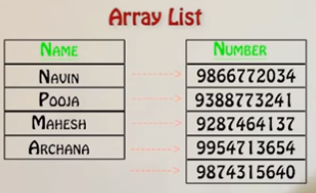
14.11 HashMap vs. HashTable
https://www.youtube.com/watch?v=z5tZ0Zb5rJQ&t=8s
What if I remove one of the names ‘Ali’ in the name array. The other names will move up. The remaining elements are there.
The tables become mismatch,.

Slide 5
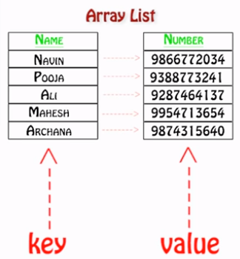
14.11 HashMap vs. HashTable
https://www.youtube.com/watch?v=z5tZ0Zb5rJQ&t=8s
That is the reason we need the Key and Value in the table.
When we search for the phone number, we require a key.

Slide 6
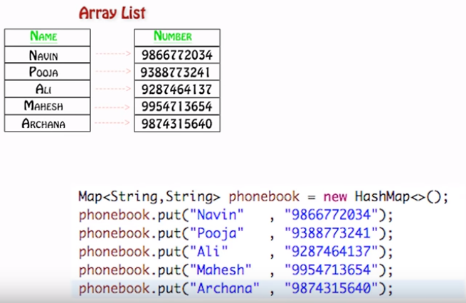
14.11 HashMap vs. HashTable
https://www.youtube.com/watch?v=z5tZ0Zb5rJQ&t=8s
Instead of using array list, we use map interface.
In the map interface, we have to specify two things: one for key and one for the value.

Slide 7
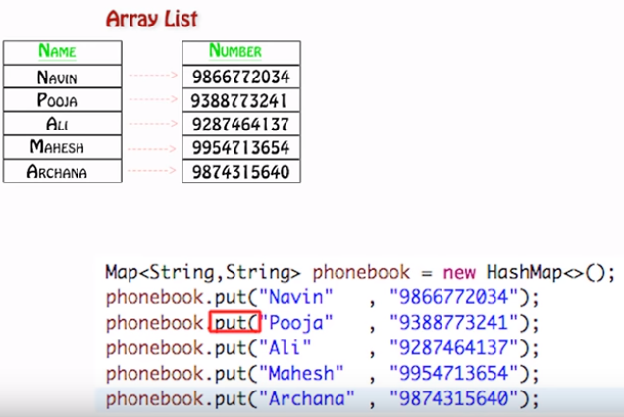
14.11 HashMap vs. HashTable
https://www.youtube.com/watch?v=z5tZ0Zb5rJQ&t=8s
We can have type of string, integer, or float for the phone number.
You have to use the put method to put these values. The first argument is the key, the second argument is the value.

Slide 8
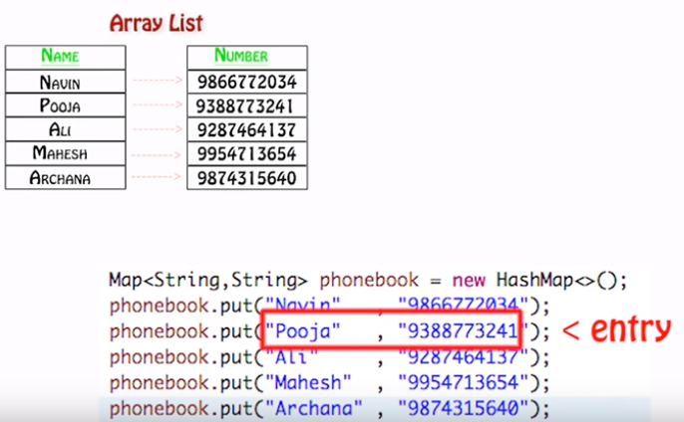
14.11 HashMap vs. HashTable
https://www.youtube.com/watch?v=z5tZ0Zb5rJQ&t=8s
We have map and entry interface. Each entry in the map interface represents one information.

Slide 9
14.11 HashMap vs. HashTable
https://www.youtube.com/watch?v=z5tZ0Zb5rJQ&t=8s
We have four classes implement the map interface. We have hashMap, HashTable, TreeHashMap, and LinkedHashMap.
Map
implements
HashMap
HashTable
TreeHashMap
LinkedHashTable

Slide 10
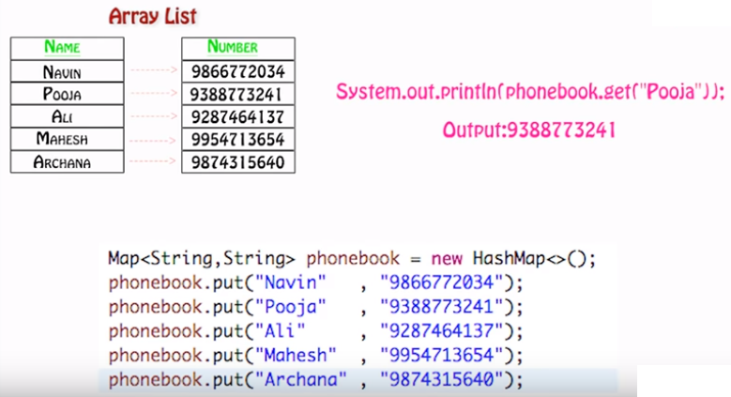
14.11 HashMap vs. HashTable
https://www.youtube.com/watch?v=z5tZ0Zb5rJQ&t=8s
hashMap class is the easiest one, we have to push key and value into the class hashMap.
We need something extra in the hasMap, for example, we need the phonebook.get( “Pooja”) to print the value “938877324”.

Slide 11
14.11.1 HashMap Class for Map
Peter H. Chen

Slide 12
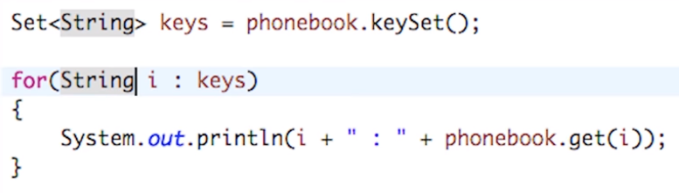
14.11.1 HashMap Class for Map
https://www.youtube.com/watch?v=z5tZ0Zb5rJQ&t=8s
The problem is: How do I know all the key?
Is this possible to ask map for all the keys? Yes
First way: Map has all the key set with all the keys.
You can have all the keys and get all the keys.
This is one way.

Slide 13
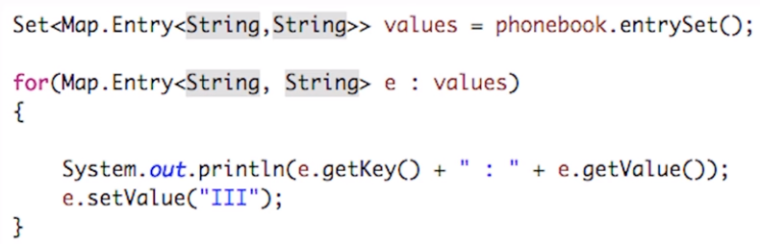
14.11.1 HashMap Class for Map
https://www.youtube.com/watch?v=z5tZ0Zb5rJQ&t=8s
Second way: Use map entry. This is an interesting question.
The Map.Entry is the interface inside the map interface.
In the Map interface, we have entrySet. Use Entry interface to get all the key values.

Slide 14
14.11.2 HashTable Class for Map
Peter H. Chen

Slide 15
14.11.2 HashTable Class for Map
https://www.youtube.com/watch?v=z5tZ0Zb5rJQ&t=8s
HashTable is almost the same as HashMap.
There are some differences:
HashMap | HashTable
Introduce in Java 1.2 Version | There since Java was introduced
It is not thread safe and asynchronized | It is thread safe and synchronized
It is fast | It is slow
Works with single thread | Works with multiple threads
Allows one null key | Does not allow null key
If you work for multiple thread, you use HashTable.
If you work for single thread, you use HashMap.
In hashMap you can have one key which is null. The HashTable must have all the keys in the table

Slide 16
End of Chapter

