Slide 1

17.01 Internal Iteration
Peter H. Chen

Slide 2
17.01 Internal Iteration
https://www.youtube.com/watch?v=fkqeCvFJs_o&index=164&list=PLsyeobzWxl7oZ-fxDYkOToURHhMuWD1BK
We discuss the Stream API Feature in Java 8.
Most important in Java 8 is Stream API.
In Stream API, it helps to process your data.
In the world of Big Data and Hadoop, we have something called the functional programming.
In Java 1.7, we still work with Object-Oriented Programming (OOP). So everything was object.
In Java 8, we got a new concept called functional programming.
In functional programming, simply says, “You don’t have to focus on how to do thing, just focus on what to do.” The reaming part will be handled by your stream function API.
In Object-Oriented Programming (OOP), we have to focus on both things: First, what to do and Second, how to do.
We will use Stream API for functional programming.

Slide 3
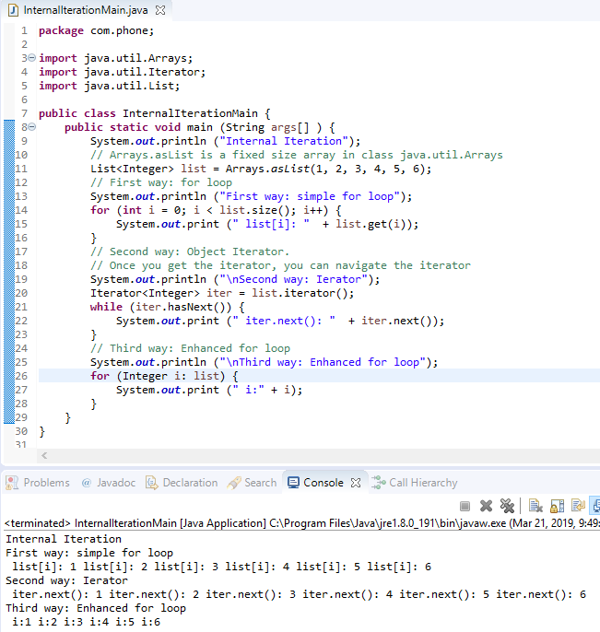
17.01 Internal Iteration
https://www.youtube.com/watch?v=fkqeCvFJs_o&index=164&list=PLsyeobzWxl7oZ-fxDYkOToURHhMuWD1BK
Before we discuss the importance of stream API, we first take a look of the example.
We have three ways to print the array data.
First: we use simple for loop.
Second: use iterator. Get the iterator and then navigate by hasNext() and get element by next()
Third: enhanced for loop.

Slide 4
17.01 Internal Iteration
https://www.youtube.com/watch?v=fkqeCvFJs_o&index=164&list=PLsyeobzWxl7oZ-fxDYkOToURHhMuWD1BK
All three ways in the previous example are using external iterations.
What if we have something called the internal iterations?
What is difference of external iteration and internal iteration?
The for loop outside your object will try to fetch data from the object.
All the loop do the same thing. They fetch value outside.
What if any other in your collection, you will be having a method using which you can increment so that is called internal iterations.
We can achieve the internal iteration with the help of stream API.
How exactly we should be coding for Stream API in the next section?

Slide 5
End of Chapter

