Slide 1

22 While
Peter H. Chen

Slide 2
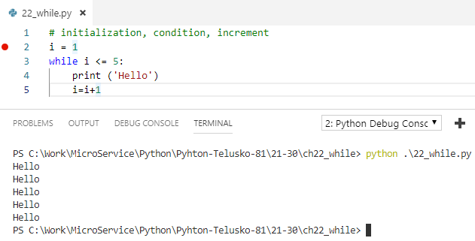
22 While
https://www.youtube.com/watch?v=HZARImviDxg&list=PLsyeobzWxl7poL9JTVyndKe62ieoN-MZ3&index=22
while loop: Initialization, condition, increment

Slide 3
End of Chapter

