Slide 1

7 Tuple and Set
Peter H. Chen

Slide 2
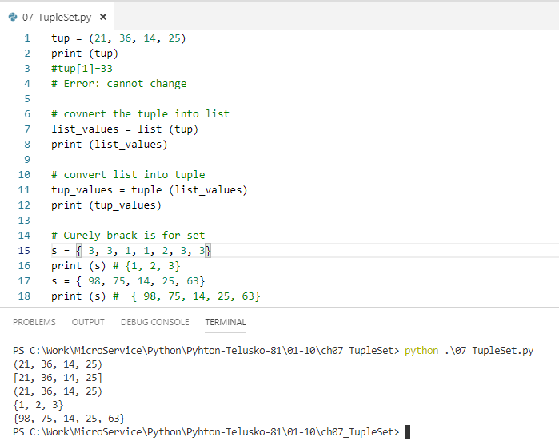
7 Tuple and Set
https://www.youtube.com/watch?v=Mf7eFtbVxFM&list=PLsyeobzWxl7poL9JTVyndKe62ieoN-MZ3&index=7
Tuple is almost same as list. List is mutable and tuple is immutable.
The square bracket [] means list. The round bracket () means tuple.
Tuple is immutable and faster.
You can convert list array to tuple by tuple (list_array) or convert a tuple into the list by list (tup).
A set is q unique elements.
Square Bracket [] is for list, round bracket () for tuple, curly bracket is for set.
Set is unique and not always sort (sometimes, you see the sort order) by itself.
Set is almost same as list. But, set is not maintain the sequence and set is not support duplicate values.

Slide 3
End of Chapter

