Slide 1

38 kwargs
Peter H. Chen

Slide 2
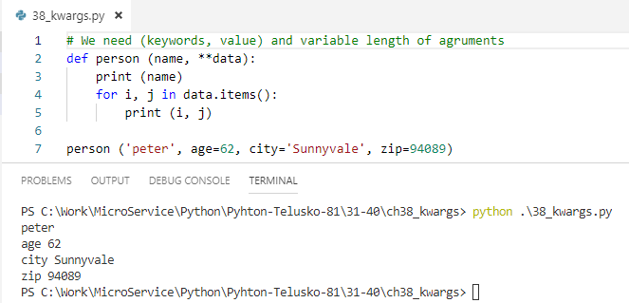
38 kwargs
https://www.youtube.com/watch?v=kB829ciAXo4&list=PLsyeobzWxl7poL9JTVyndKe62ieoN-MZ3&index=38
*kwargs: (Keyword, value) and variable length of arguments.

Slide 3
End of Chapter

