Slide 1

6 List
Peter H. Chen

Slide 2
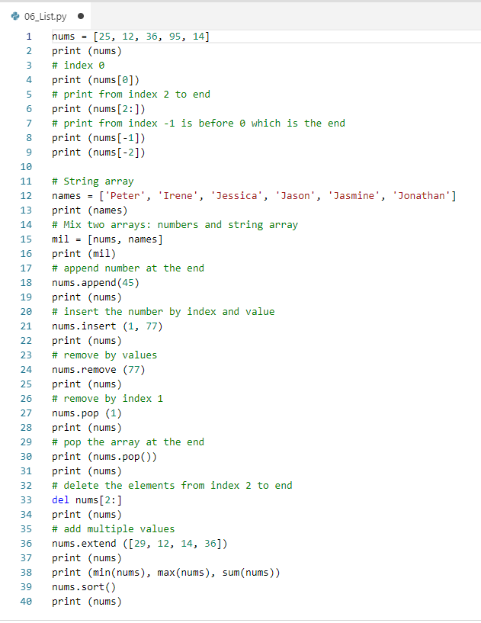
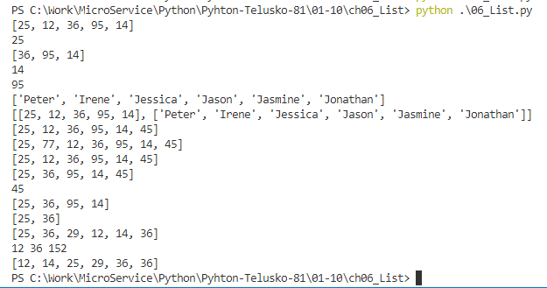
6 List
https://www.youtube.com/watch?v=Eaz5e6M8tL4&list=PLsyeobzWxl7poL9JTVyndKe62ieoN-MZ3&index=6
We want to group number and string together.

Slide 3
End of Chapter

