Slide 1

57 Inner Class
Peter H. Chen

Slide 2
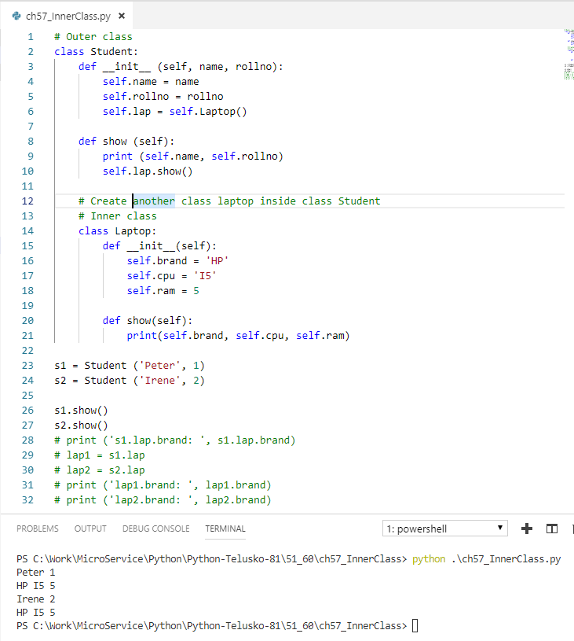
57 Inner Class
https://www.youtube.com/watch?v=b7JzgybKvys&list=PLsyeobzWxl7poL9JTVyndKe62ieoN-MZ3&index=57
We have variables and methods inside a class.
Can we have a class inside the class?
Why do you want to have a class inside the class?
One outer class define Student: name, rollno
One inner class define Laptop: Brand, CPU, RAM

Slide 3
End of Chapter

