Slide 1

8 PATH
Peter H. Chen

Slide 2
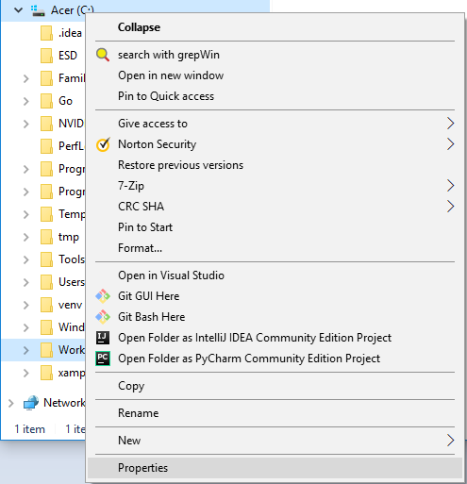
8 PATH
https://www.youtube.com/watch?v=4V14G5_CNGg&list=PLsyeobzWxl7poL9JTVyndKe62ieoN-MZ3&index=8
My Computer > set properties and edit path.

Slide 3
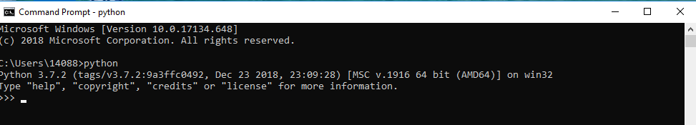
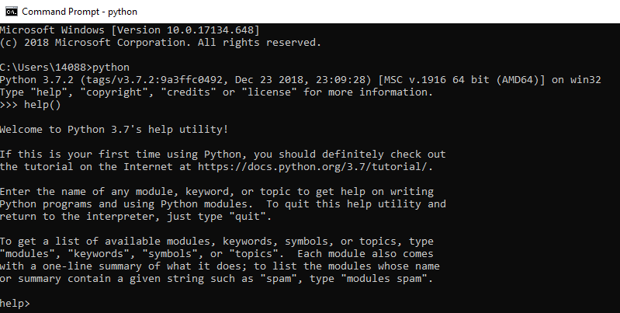
8 PATH
https://www.youtube.com/watch?v=4V14G5_CNGg&list=PLsyeobzWxl7poL9JTVyndKe62ieoN-MZ3&index=8
> python
>>> help ()

Slide 4
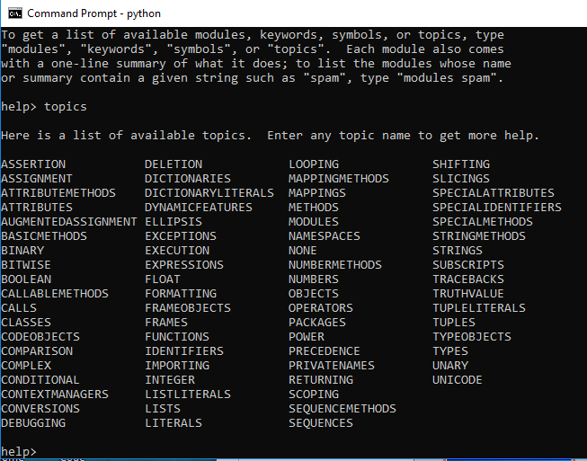
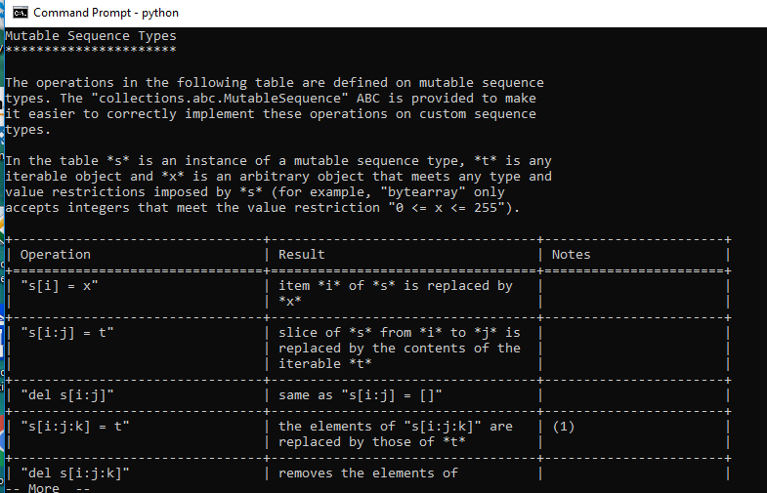
8 PATH
https://www.youtube.com/watch?v=4V14G5_CNGg&list=PLsyeobzWxl7poL9JTVyndKe62ieoN-MZ3&index=8
Help >> topics
>> LISTS

Slide 5
End of Chapter

