Slide 1

75 Workbench
Peter H. Chen

Slide 2
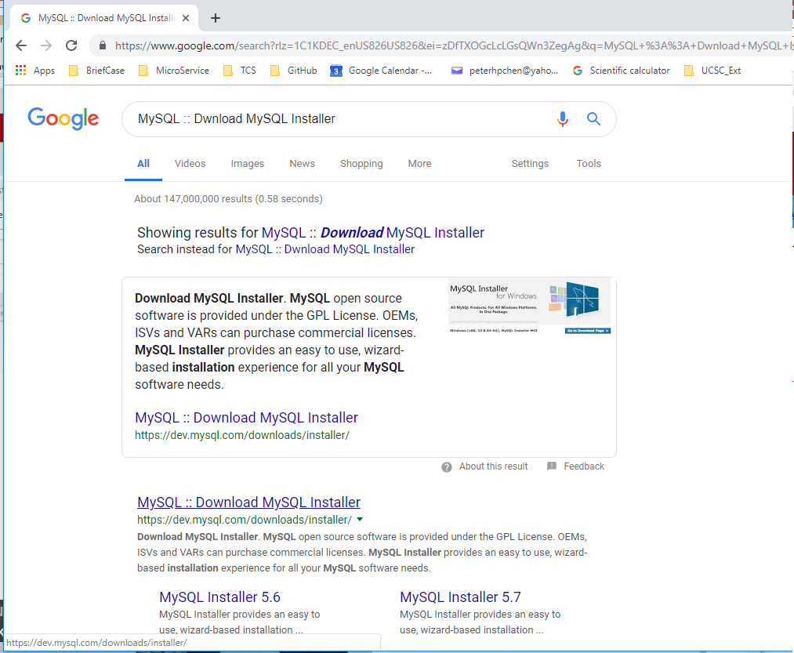
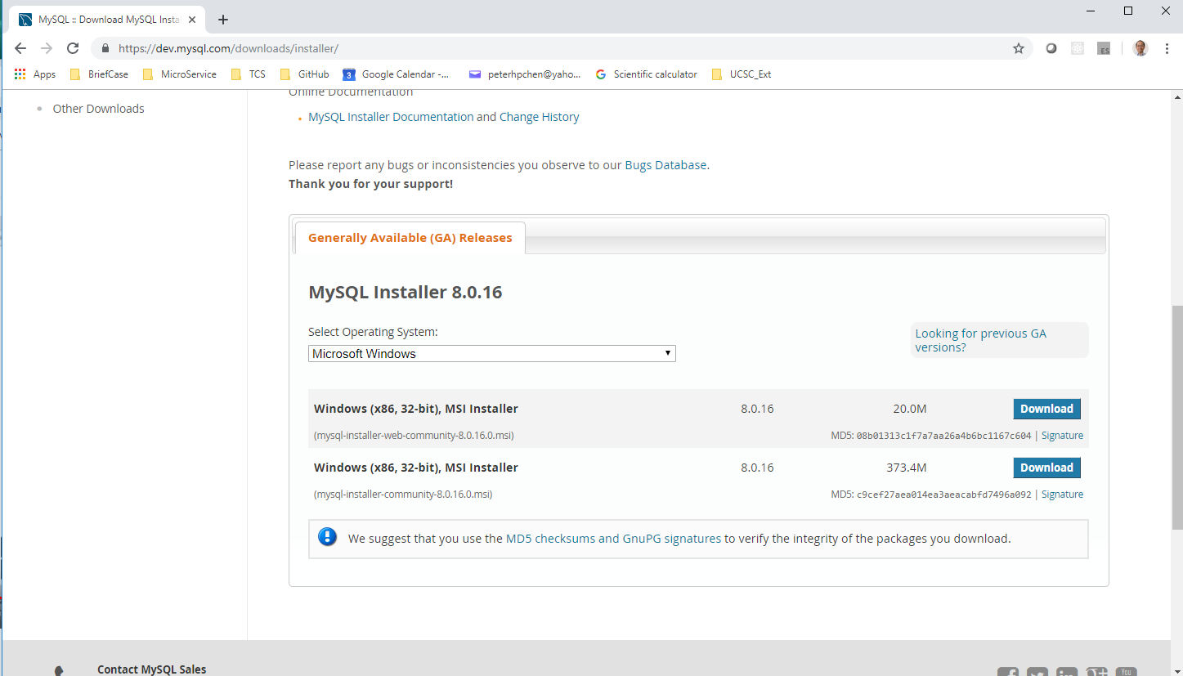
75 Workbench
https://www.youtube.com/watch?v=WDEyt2VHpj4&list=PLsyeobzWxl7poL9JTVyndKe62ieoN-MZ3&index=75
Search for MySQL :: MySQL Installer.
We need entire community version instead of Web Community version.
Port Number: 3306
We need Entire Community Version

Slide 3
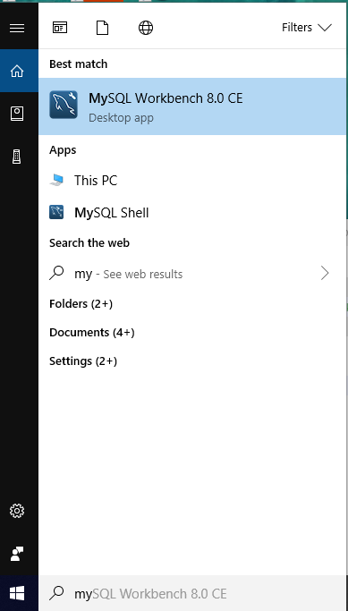
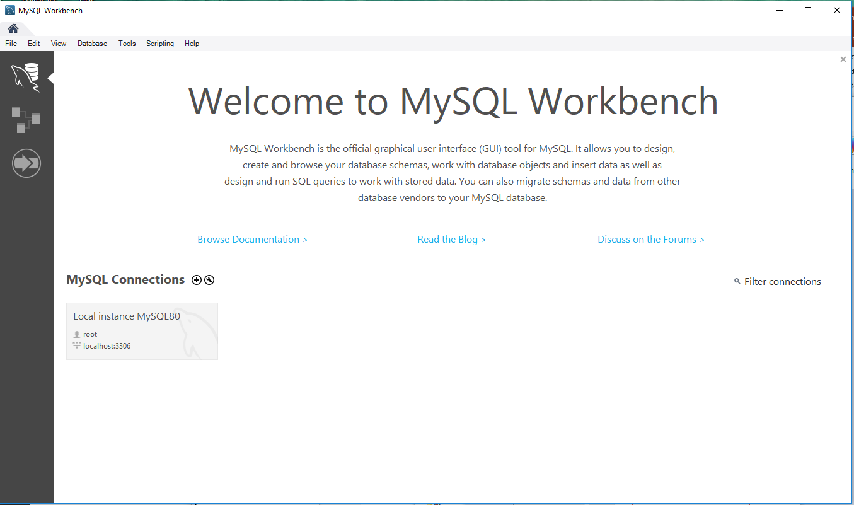
75 Workbench
https://www.youtube.com/watch?v=WDEyt2VHpj4&list=PLsyeobzWxl7poL9JTVyndKe62ieoN-MZ3&index=75
Start MySQL
Click “Local Instance MySQL80”

Slide 4
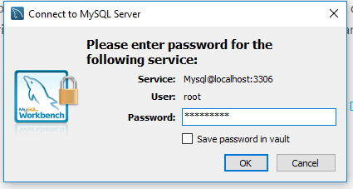
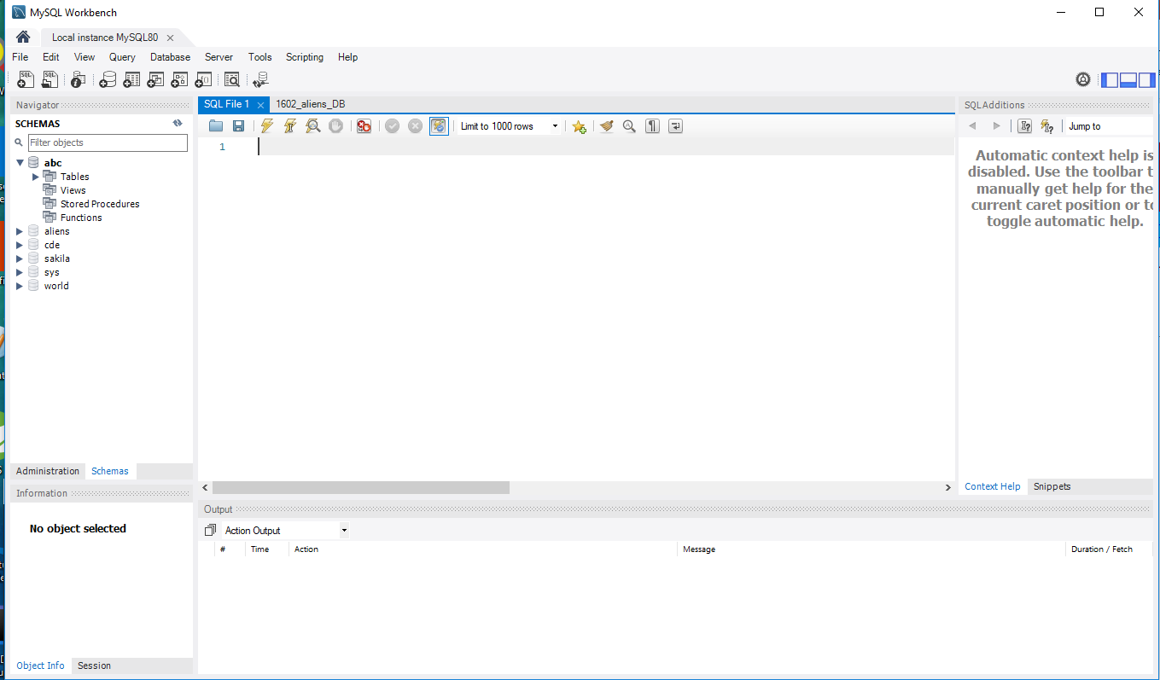
75 Workbench
https://www.youtube.com/watch?v=WDEyt2VHpj4&list=PLsyeobzWxl7poL9JTVyndKe62ieoN-MZ3&index=75
Password: Pc****=**
Start the Workbench.

Slide 5
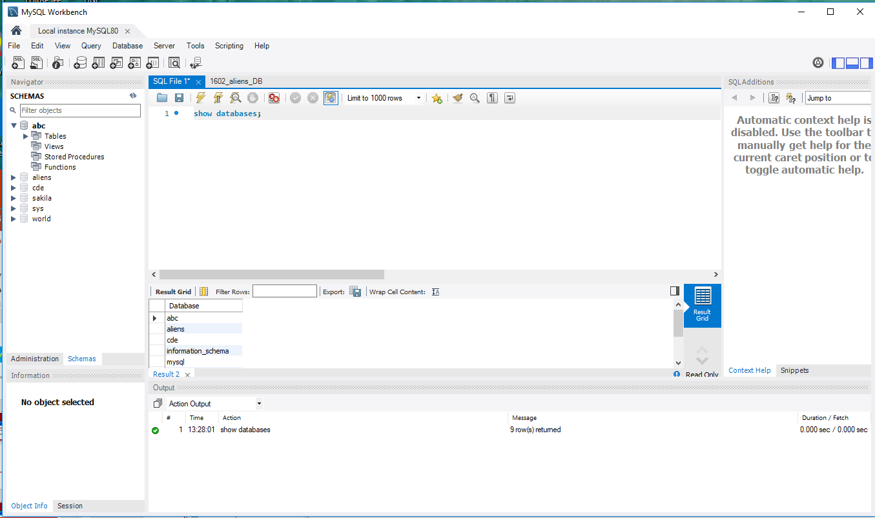
75 Workbench
https://www.youtube.com/watch?v=WDEyt2VHpj4&list=PLsyeobzWxl7poL9JTVyndKe62ieoN-MZ3&index=75
Display Database
Type “show databases:”
Click “Execute”
Display the databases
2
1
3

Slide 6
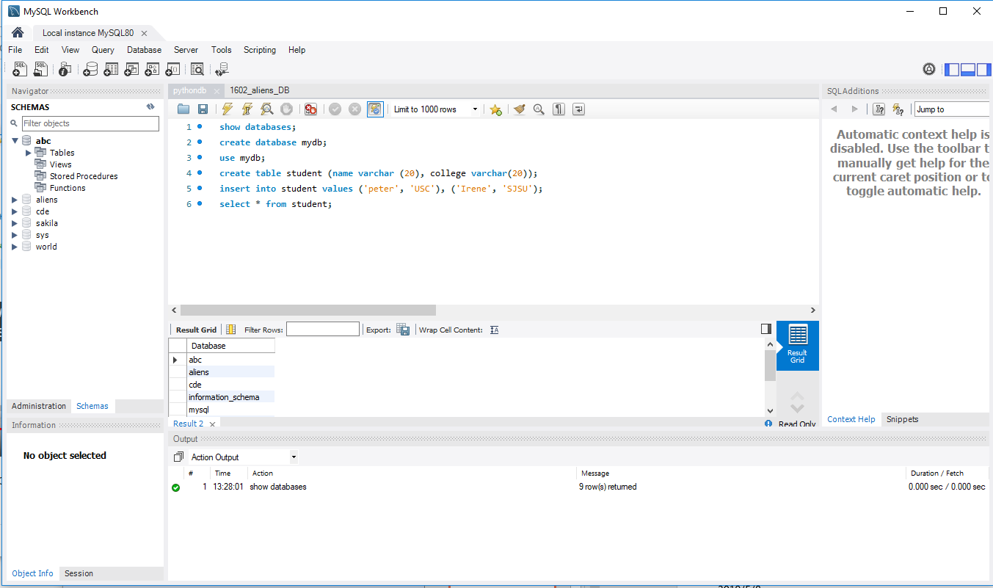
75 Workbench
https://www.youtube.com/watch?v=WDEyt2VHpj4&list=PLsyeobzWxl7poL9JTVyndKe62ieoN-MZ3&index=75
> create database mydb;
> use mydb;
> create table student (name varchar(20), college varchar (20));
> insert into student values (‘peter’, ‘USC’), (‘Irene’, ‘SJSU’);
> select * from student;

Slide 7
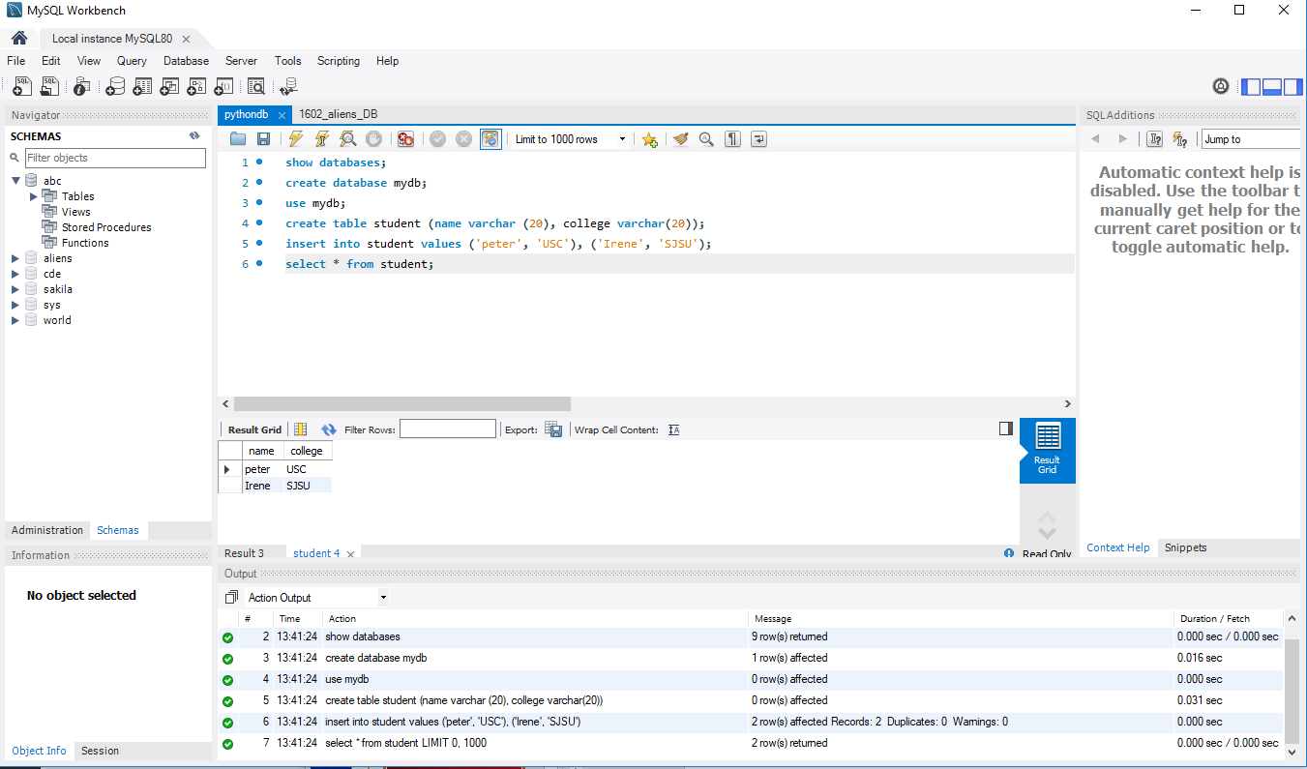
75 Workbench
https://www.youtube.com/watch?v=WDEyt2VHpj4&list=PLsyeobzWxl7poL9JTVyndKe62ieoN-MZ3&index=75
Click “Execute” to display student table.
But we do not want the MySQL operation. We want to fetch data from Python in the next section.

Slide 8
End of Chapter

