Slide 1

36 Function Argument
Peter H. Chen

Slide 2
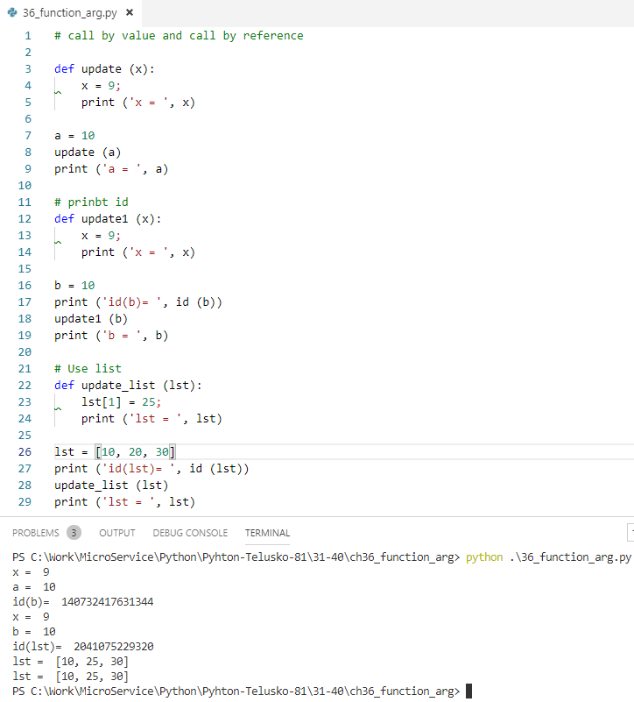
36 Function Argument
https://www.youtube.com/watch?v=ijXMGpoMkhQ&list=PLsyeobzWxl7poL9JTVyndKe62ieoN-MZ3&index=36
Function argument: called by value and called by references.
Use list to call by reference.

Slide 3
End of Chapter

