Slide 1

18 Math Function
Peter H. Chen

Slide 2
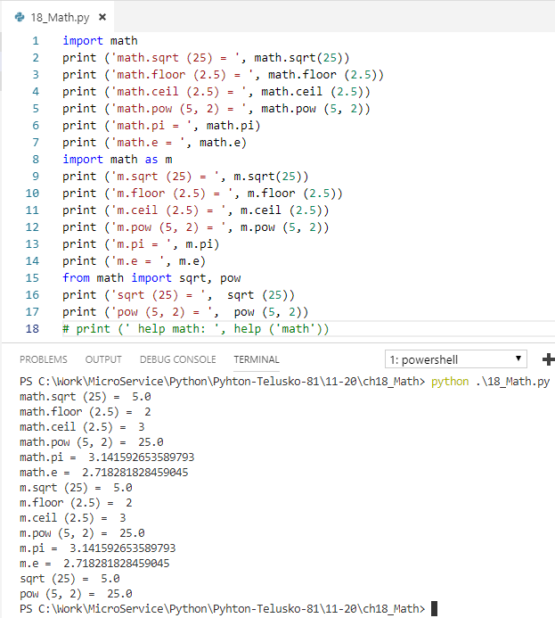
18 Math Function
https://www.youtube.com/watch?v=EkYrfV7M1ks&list=PLsyeobzWxl7poL9JTVyndKe62ieoN-MZ3&index=18
This section discusses the math function.
Import math
x = math.sqrt (25)
If you to use m instead of math
Import math as m
x = m.sqrt (25)
>>> help (‘math’)

Slide 3
End of Chapter

