Slide 1

20 Input Command
Peter H. Chen

Slide 2
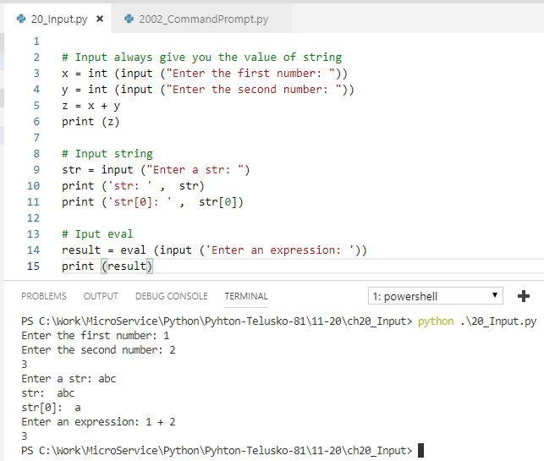
20 Input Command
https://www.youtube.com/watch?v=4OX49nLNPEE&list=PLsyeobzWxl7poL9JTVyndKe62ieoN-MZ3&index=20
Input a string and convert to integer
Input a expression.

Slide 3
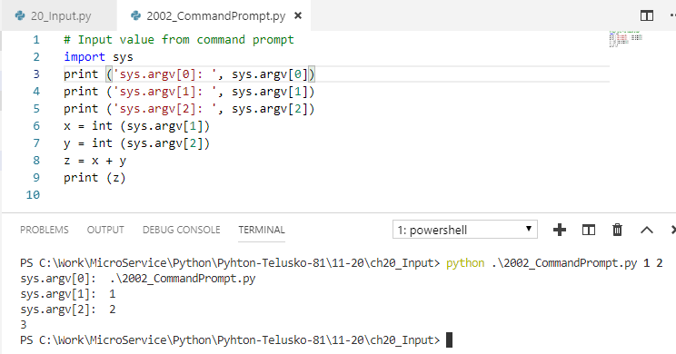
20 Input Command
https://www.youtube.com/watch?v=4OX49nLNPEE&list=PLsyeobzWxl7poL9JTVyndKe62ieoN-MZ3&index=20
Pass value from command line.

Slide 4
End of Chapter

