Slide 1

14 Number Conversion
Peter H. Chen

Slide 2
14 Number Conversion
https://www.youtube.com/watch?v=AWAjbtWBzGs&list=PLsyeobzWxl7poL9JTVyndKe62ieoN-MZ3&index=14
This section discusses the Number System Conversion: Binary format and Decimal format. .We also have Octal and Hexadecimal system.
How to convert the format in Python?
Decimal = 25
> bin (25) # 0x11001
Divide Number | Decimal Number | Remainder
2 | 25
2 | 12 | 1
2 | 6 | 0
2 | 3 | 0
 | 1 | 1
11001

Slide 3
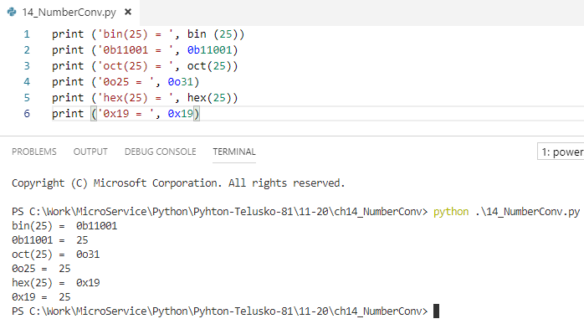
14 Number Conversion
https://www.youtube.com/watch?v=AWAjbtWBzGs&list=PLsyeobzWxl7poL9JTVyndKe62ieoN-MZ3&index=14
Conversion:

Slide 4
End of Chapter

