Slide 1

30 Array
Peter H. Chen

Slide 2
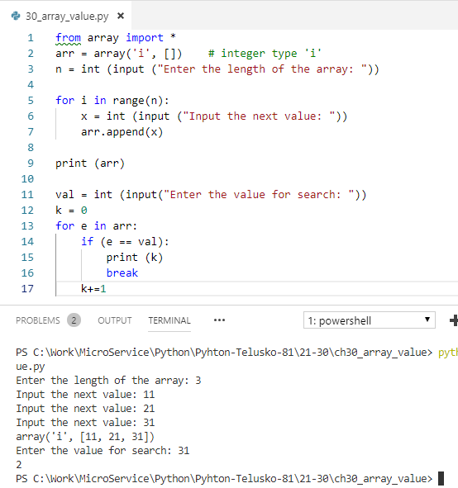
30 Array Value
https://www.youtube.com/watch?v=9c9qhIcB3NA&list=PLsyeobzWxl7poL9JTVyndKe62ieoN-MZ3&index=30
Array Value: Match array value.

Slide 3
End of Chapter

