Slide 1

11 Data Type
Peter H. Chen

Slide 2
11 Data Type
https://www.youtube.com/watch?v=gCCVsvgR2KU&list=PLsyeobzWxl7poL9JTVyndKe62ieoN-MZ3&index=11
When we work on project, all the data have their own type.
How many data type in python?
1) None:
2) Numeric
3) List
4) Tuple
5) Set
6) String
7) Range
8) Map, or you can call it Dictionary.

Slide 3
11 Data Type
https://www.youtube.com/watch?v=gCCVsvgR2KU&list=PLsyeobzWxl7poL9JTVyndKe62ieoN-MZ3&index=11
The first data type is “None”. What is “None” mean? You have a variable but the variable is not assigned with nay value. It is “None”. In other languages, we use the keyword as “NULL”. But in Python, we use “None”.

Slide 4
11.1 Numeric Type
Peter H. Chen

Slide 5
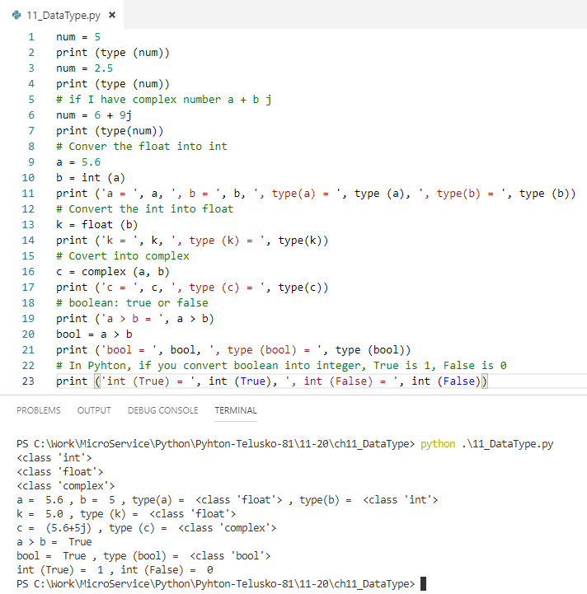
11.1 Numeric Type
https://www.youtube.com/watch?v=gCCVsvgR2KU&list=PLsyeobzWxl7poL9JTVyndKe62ieoN-MZ3&index=11
The second data type is “Numeric” type. We have four numeric types in Python.
a) The first one is “int”, e.g., num = 5, type (num) is <class ‘int’>
b) The second one is “float”, e.g., num = 2.5, type (num) is <class ‘float’>
c) The third one is “complex”, e.g., num = 6 + 9j, type (num) is <class ‘complex’>
d) The fourth one is “bool”, Convert the boolean into integer, True is 1, False is 0.

Slide 6
11.2 Sequence Type
Peter H. Chen

Slide 7
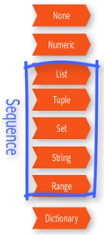
11.2 Sequence Type
https://www.youtube.com/watch?v=gCCVsvgR2KU&list=PLsyeobzWxl7poL9JTVyndKe62ieoN-MZ3&index=11
The next group is called Sequence which include the followings:
3) List: list = {10, 20, 30, 40, 50}
4) Tuple: t = (10, 20, 30, 40, 50)
5) Set: s = {10, 20, 30, 40, 50}
6) String: str = ‘Peter’, c = ‘a’
7) Range: x = range (5)

Slide 8
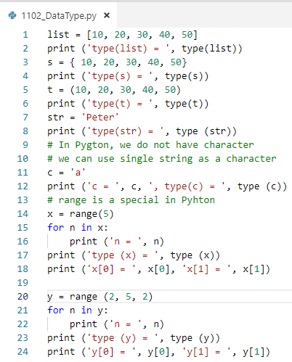
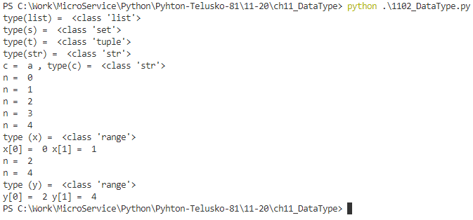
11.2 Sequence Type
https://www.youtube.com/watch?v=gCCVsvgR2KU&list=PLsyeobzWxl7poL9JTVyndKe62ieoN-MZ3&index=11
Sequence (List, Tuple, Set, String, range) examples:

Slide 9
11.3 Map Type
Peter H. Chen

Slide 10
11.3 Map Type
https://www.youtube.com/watch?v=gCCVsvgR2KU&list=PLsyeobzWxl7poL9JTVyndKe62ieoN-MZ3&index=11
Map is the most excited type. Map also called Dictionary.
If you have huge amount of data, you want to fetch data in efficient way.
You can assign a value to a key, for example, the value is an English sentence and the key is an index number.
For dictionary, every value will be assigned a key, for example, all the mobile phone names are the values, and dictionary give each phone names a index number. The index 1 is iPhone-10, index 2 is iPhone-8, index 3 is Samsung Galaxy, and etc. The index 1, 2, 3 can be the integer number or string name of owner.
One thing to remember, key is unique. All the keys in the map or directionary have to be unique. The values can be repeated.
Dictionary use curly bracket, why curly bracket? Because the Dictionary and set are unique. Both Set and Dictionary use curly bracket.
d = {‘Peter’: ‘iPhone-8’, ‘Irene’: ‘Samsung’, ‘Jessica’: ‘iPhone-7’, ‘Jason’: ‘Verizon’, ‘Jasmine’: ‘iPhone-10’, ‘Jonathan’: ‘Verizon’}
d.keys(), d.values()

Slide 11
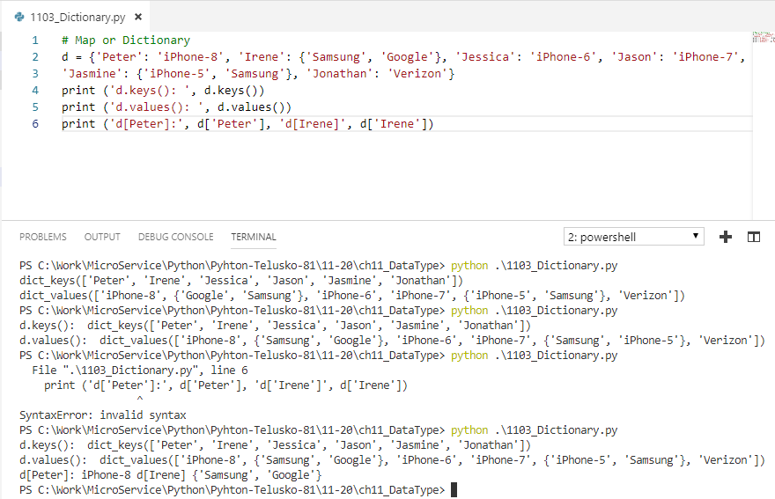
11.3 Map Type
https://www.youtube.com/watch?v=gCCVsvgR2KU&list=PLsyeobzWxl7poL9JTVyndKe62ieoN-MZ3&index=11
Example:

Slide 12
End of Chapter

