Slide 1

10 More on Variable
Peter H. Chen

Slide 2
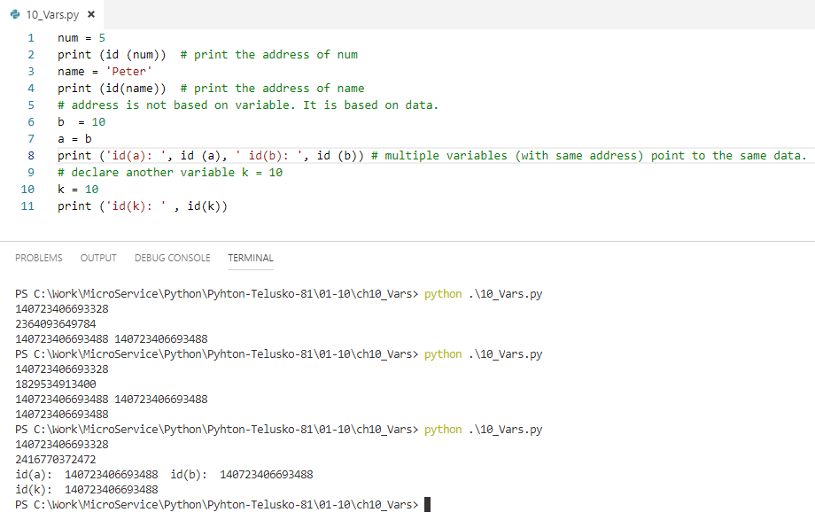
10 More on Variable
https://www.youtube.com/watch?v=_OZIAHg5i7M&index=10&list=PLsyeobzWxl7poL9JTVyndKe62ieoN-MZ3
How to see the address of the variable num?
> id (num)
a = 10
b = a
> print (id(a), id(b) # both variables point to the same address
k = 10
> print (id(k)) # k also share the same address
a
10
b
Address:
140723406693488
k

Slide 3
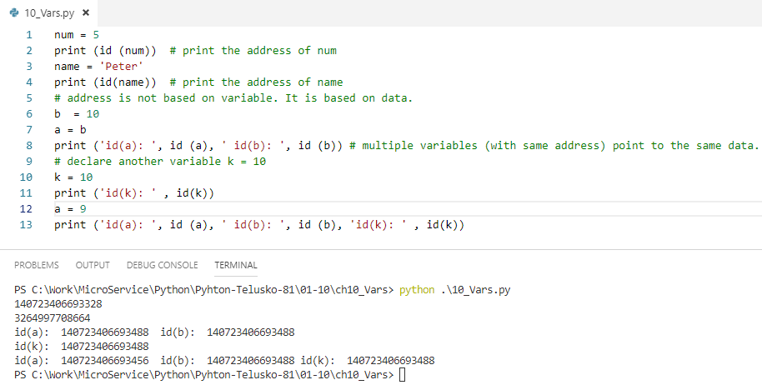
10 More on Variable
https://www.youtube.com/watch?v=_OZIAHg5i7M&index=10&list=PLsyeobzWxl7poL9JTVyndKe62ieoN-MZ3
Let change the value of a
a = 9
> print (id(a), id(b) # both variables point to the same address
10
a
9
b
Address:
140723406693488
k

Slide 4
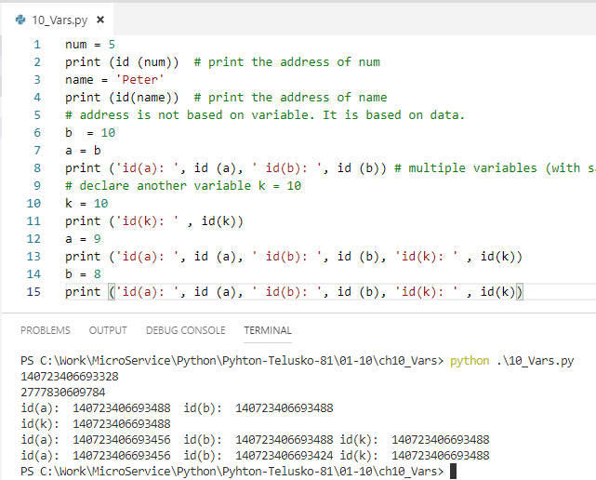
10 More on Variable
https://www.youtube.com/watch?v=_OZIAHg5i7M&index=10&list=PLsyeobzWxl7poL9JTVyndKe62ieoN-MZ3
Let change the value of k = 8.
a = 9
> print (id(a), id(b) # both variables point to the same address
k = 8
10
9
a
8
b
Address:
140723406693488
k

Slide 5
10 More on Variable
https://www.youtube.com/watch?v=_OZIAHg5i7M&index=10&list=PLsyeobzWxl7poL9JTVyndKe62ieoN-MZ3
The 10 and 9 become garbage.
Python will be collected the garbage later.
10
9
a
8
b
Address:
140723406693488
k

Slide 6
End of Chapter

