Slide 1

54 Constructor and Self
Peter H. Chen

Slide 2
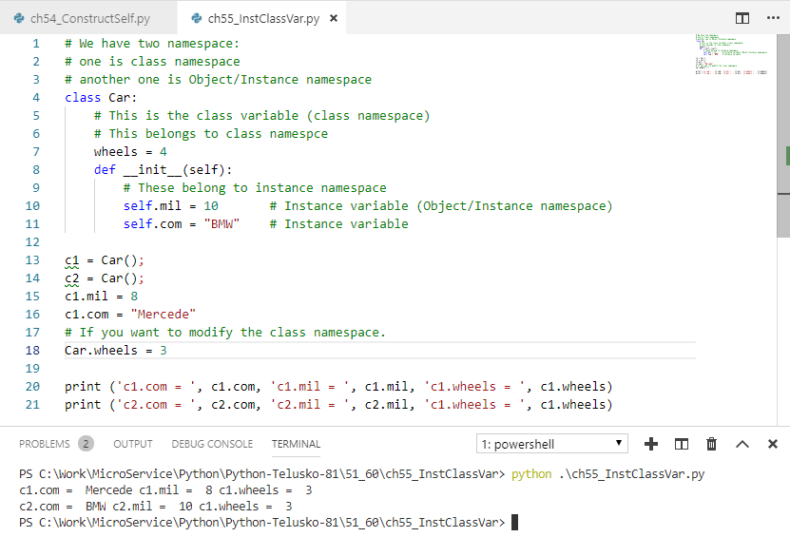
54 Constructor and Self
https://www.youtube.com/watch?v=ic6wdPxcHc0&list=PLsyeobzWxl7poL9JTVyndKe62ieoN-MZ3&index=54
Class variable vs. Instance variable:
Class variable: variables in the class but outside the method.
Instance variable: variables inside the method.

Slide 3
End of Chapter

