Slide 1

29 Array
Peter H. Chen

Slide 2
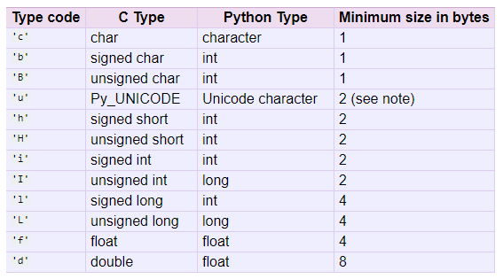
29 Array
https://www.youtube.com/watch?v=6a39OjkCN5I&list=PLsyeobzWxl7poL9JTVyndKe62ieoN-MZ3&index=29
Array:
https://docs.python.org/2/library/array.html

Slide 3
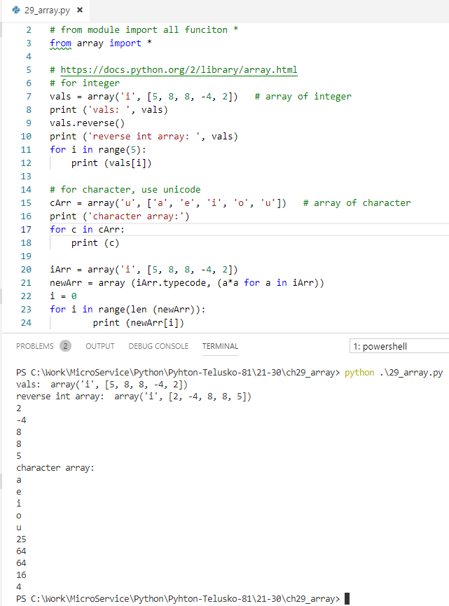
29 Array
https://www.youtube.com/watch?v=6a39OjkCN5I&list=PLsyeobzWxl7poL9JTVyndKe62ieoN-MZ3&index=29
Integer, character, typecode (type code character)

Slide 4
End of Chapter

