Slide 1

34 Matrix
Peter H. Chen

Slide 2
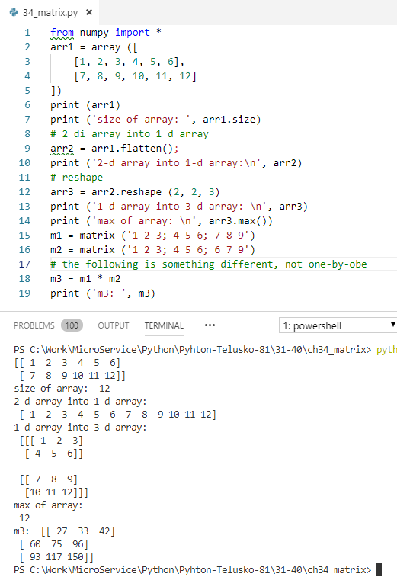
34 Matrix
https://www.youtube.com/watch?v=Blzp9iuhZqo&list=PLsyeobzWxl7poL9JTVyndKe62ieoN-MZ3&index=34
Numpy Matrix: operation

Slide 3
End of Chapter

