Slide 1

21 if
Peter H. Chen

Slide 2
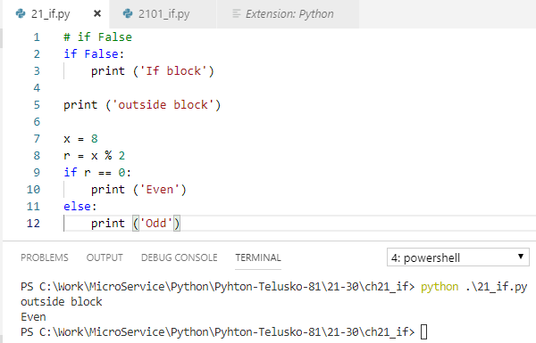
21 Data Type
https://www.youtube.com/watch?v=PqFKRqpHrjw&list=PLsyeobzWxl7poL9JTVyndKe62ieoN-MZ3&index=21
If statement

Slide 3
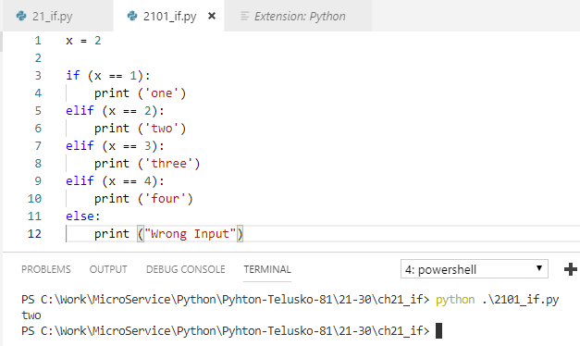
21 Data Type
https://www.youtube.com/watch?v=PqFKRqpHrjw&list=PLsyeobzWxl7poL9JTVyndKe62ieoN-MZ3&index=21
If .. elif .. Else statement

Slide 4
End of Chapter

