Slide 1

61 Duck Type
Peter H. Chen

Slide 2
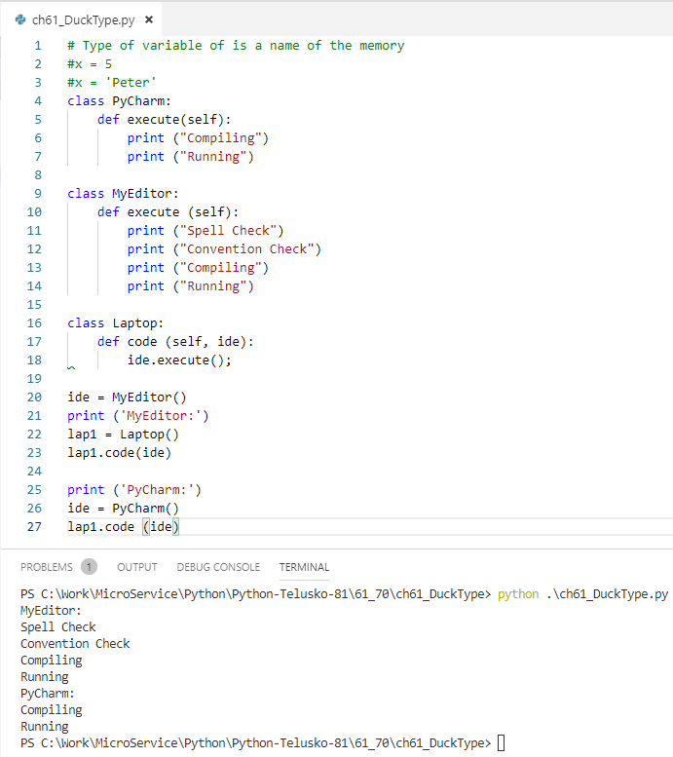
61 Duck Type
https://www.youtube.com/watch?v=CuK0g8OFzwo&list=PLsyeobzWxl7poL9JTVyndKe62ieoN-MZ3&index=61
Duck Type of Polymorphism:
A duck is a bird walking like a duck, quacking like a duck, swimming like a duck. The duck does not matter how it walk, quack, or swim.
Implement duck typing. The ide is PyCharm or MyEditor. It does not matter.

Slide 3
End of Chapter

