Slide 1
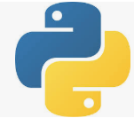
3 Python Setup
Peter H. Chen

Slide 2
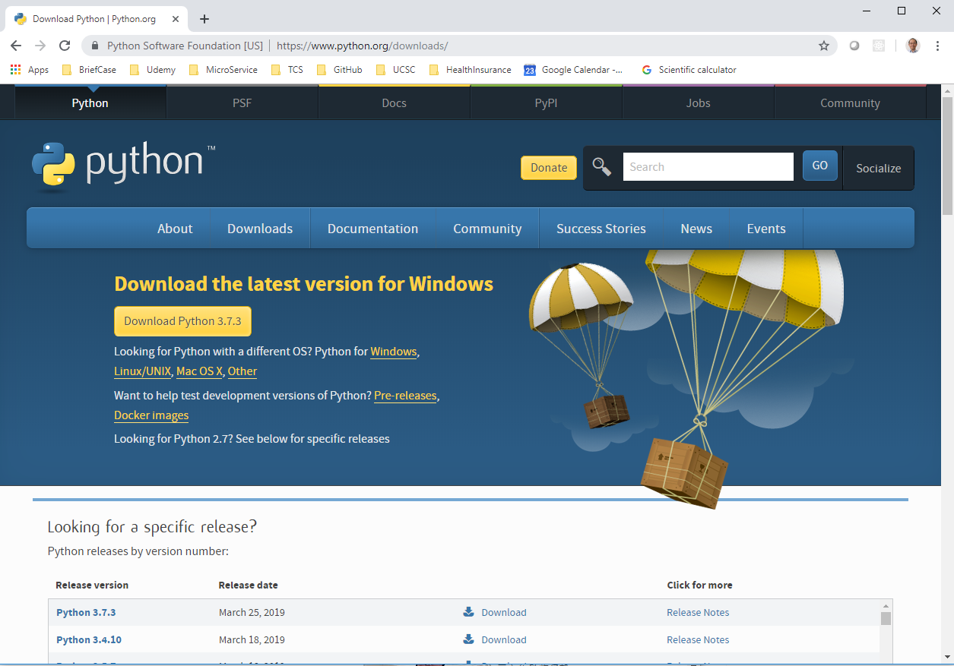
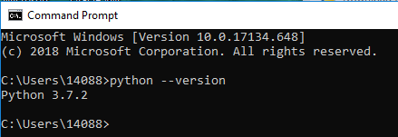
3 Python Setup
https://www.youtube.com/watch?v=IX6mc9l6tY4&index=2&list=PLQVvvaa0QuDe8XSftW-RAxdo6OmaeL85M
Install Python: 3.7.3
> python --version
Python 3.7.3

Slide 3
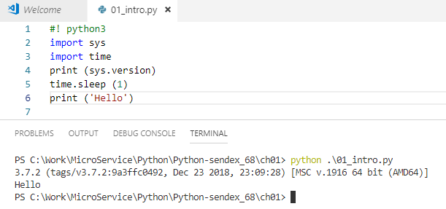
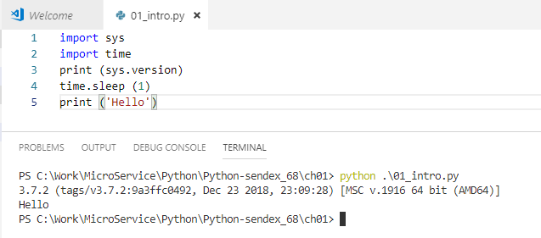
3 Python Setup
https://www.youtube.com/watch?v=IX6mc9l6tY4&index=2&list=PLQVvvaa0QuDe8XSftW-RAxdo6OmaeL85M
Install Python: 3.7.3
“#! Python3” is not required.

Slide 4
End of Chapter

