Slide 1

4 Python CLI
Peter H. Chen

Slide 2
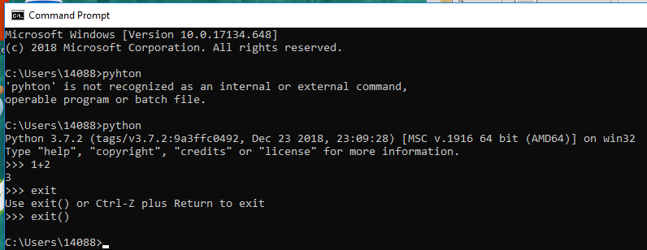
4 Python CLI
https://www.youtube.com/watch?v=IX6mc9l6tY4&index=2&list=PLQVvvaa0QuDe8XSftW-RAxdo6OmaeL85M
Python >> 1 + 2
3
>> exit()

Slide 3
End of Chapter

