Slide 1

3 String Operation and Concatenation
Peter H. Chen

Slide 2
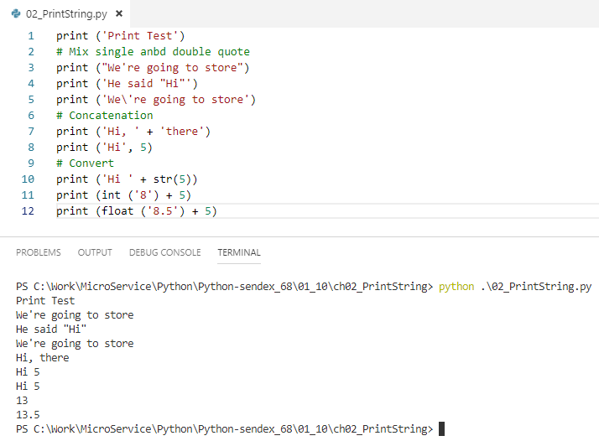
3 String Operation and Concatenation
https://www.youtube.com/watch?v=UsCQXe1OHZk&list=PLQVvvaa0QuDe8XSftW-RAxdo6OmaeL85M&index=3
Mix string operation, string concatenation, conversion.

Slide 3
End of Chapter

