Slide 1

26 Print Pattern
Peter H. Chen

Slide 2
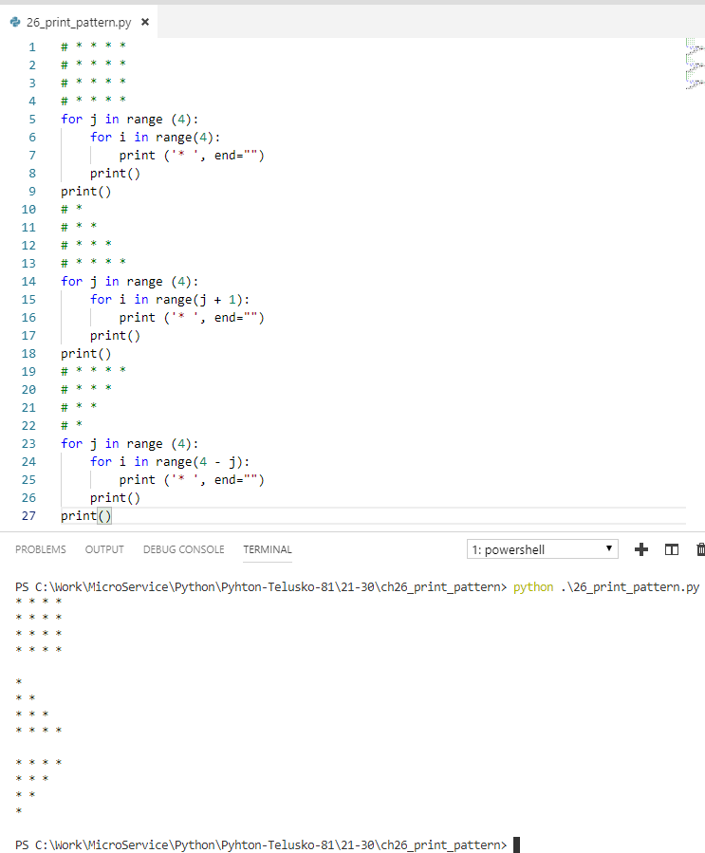
26 Print Pattern
https://www.youtube.com/watch?v=k8SXsT5TLxQ&list=PLsyeobzWxl7poL9JTVyndKe62ieoN-MZ3&index=26
Print pattern
* * * *
* * * *
* * * *
* * * *
Print pattern
*
* *
* * *
* * * *
Print pattern
* * * *
* * *
* *
*

Slide 3
End of Chapter

