Slide 1

17 Bitwise Operator
Peter H. Chen

Slide 2
17 Bitwise Operator
https://www.youtube.com/watch?v=PyfKCvHALj8&list=PLsyeobzWxl7poL9JTVyndKe62ieoN-MZ3&index=17
This section discusses the Bitwise Operator.
~12 = ~00001100 => 11110011 => -13
How to get -13?
There is no negative number in the computer system, for example, -13.
We have to convert -13 into positive number 13 first.
The way to store data for -13 that is called 2’s complement.
To find 2’s complement, first, we have to find 1’s complement + 1.
How to find 1’s complement?
First, take 13 into binary format = 00001101
Second, take 1’s complement of 13 = 11110010
Third, take 2’s complement of 13 = 11110011
11110011 is the -13.

Slide 3
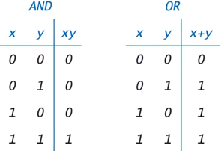
17 Bitwise Operator
https://www.youtube.com/watch?v=PyfKCvHALj8&list=PLsyeobzWxl7poL9JTVyndKe62ieoN-MZ3&index=17
Bitwise AND and OR.
12 & 13 => 12
12 = 00001100
13 = 00001101
00001100 & 00001101 = 00001100 => 12
00001100 | 00001101 = 00001101 => 13
25 & 30 = 24
25 = 00011001
30 = 00011110
25 & 30 = 00011000 => 24
25 ^ 30 = 00000111 => 7
10 = 00001010
10 << 2 = 00101000 => 40

Slide 4
End of Chapter

