Slide 1

76 DB Connection
Peter H. Chen

Slide 2
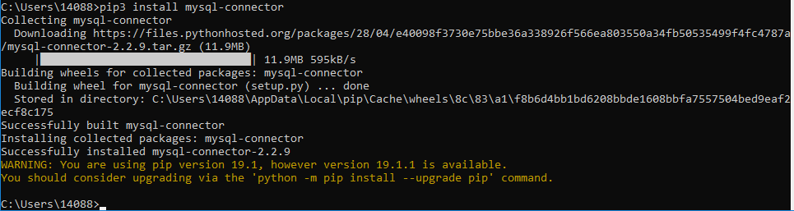
76 DB Connection
https://www.youtube.com/watch?v=vR5utJvN4JY&list=PLsyeobzWxl7poL9JTVyndKe62ieoN-MZ3&index=76
In the last section, we installed the MySQL, start the workbench, create database, create table, and insert the data. At the end, we also see how to fetch the data by the select statement.
The ultimate goal was to connect Python with database.
We need one thing between the Python and database which is MySQL Connector.
If you need to connect MySQL with any languages, we need a MySQL Connector.
Now, how to install the MySQL Connector? We need to install the MySQL Connector with Python.
Open a Command prompt. We have to use package installer.
> pip3 install mysql-connector-python

Slide 3
76 DB Connection
https://www.youtube.com/watch?v=vR5utJvN4JY&list=PLsyeobzWxl7poL9JTVyndKe62ieoN-MZ3&index=76
Now, MySQL Connector is working. We have to work on Python.
Step 1: import mysql.connector
Step 2: mydb = mysql.connector.connect (host=“localhost”, user=“root”, password=“Pcxxxx=xx”)
Step 3: mycursor = mydb.cursor() # data is store in mycurcor
# mycursor.execute(“show database”)
> mycursor.execute(“select * from student”)
> for i in mycursor:
print (i)

Slide 4
76 DB Connection
https://www.youtube.com/watch?v=vR5utJvN4JY&list=PLsyeobzWxl7poL9JTVyndKe62ieoN-MZ3&index=76
If you have "Authentication plugin '{0}' is not supported".format(plugin_name))
mysql.connector.errors.NotSupportedError: Authentication plugin 'caching_sha2_password' is not supported
Note: I tried and very frustrated until I watched the following video:
https://www.youtube.com/watch?v=tGinfzlp0fE
"pip uninstall mysql-connector" work on some computer and it might not work for other computer.
I did the followings:
### The mysql-connector causes problem.
1. pip uninstall mysql-connector
### The following may not need but I removed both connector completely.
2. pip uninstall mysql-connector-python
### re-install mysql-conenct-pyhton connector.
3. pip install mysql-connector-python
and the following python code worked.
# Step 1: import mysql.connector
import mysql.connector
# step 2: connect to database
mydb = mysql.connector.connect (host="localhost", user="root", passwd="Pc1997=ch",
database="mydb", auth_plugin='caching_sha2_password')
mycursor = mydb.cursor()
mycursor.execute ("select * from student")
for i in mycursor:
print (i)

Slide 5
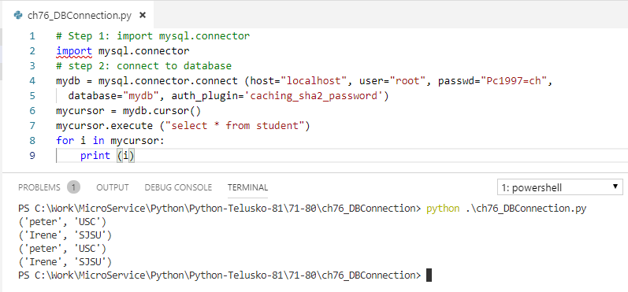
76 DB Connection
https://www.youtube.com/watch?v=vR5utJvN4JY&list=PLsyeobzWxl7poL9JTVyndKe62ieoN-MZ3&index=76
> python DBconnection.py

Slide 6
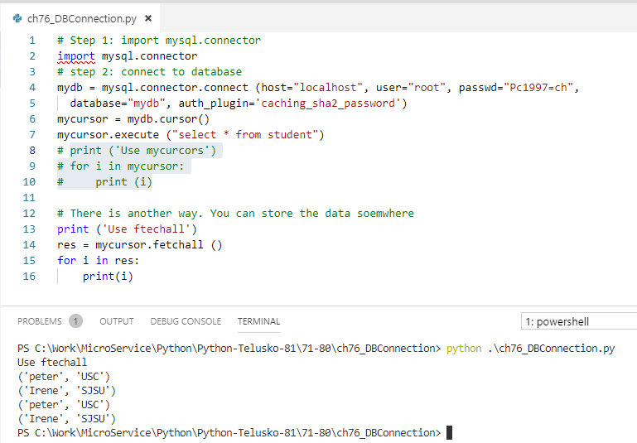
76 DB Connection
https://www.youtube.com/watch?v=vR5utJvN4JY&list=PLsyeobzWxl7poL9JTVyndKe62ieoN-MZ3&index=76
> Cursor can be only used once. You cannot use cursor twice.

Slide 7
End of Chapter

