Slide 1

52 Class and Object
Peter H. Chen

Slide 2
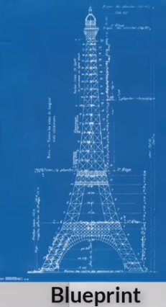
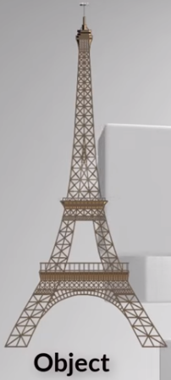
52 Class and Object
https://www.youtube.com/watch?v=8O5kX73OkIY&list=PLsyeobzWxl7poL9JTVyndKe62ieoN-MZ3&index=52
Object Oriented programming:
Blueprint is a Class.
Tower is an Object.

Slide 3
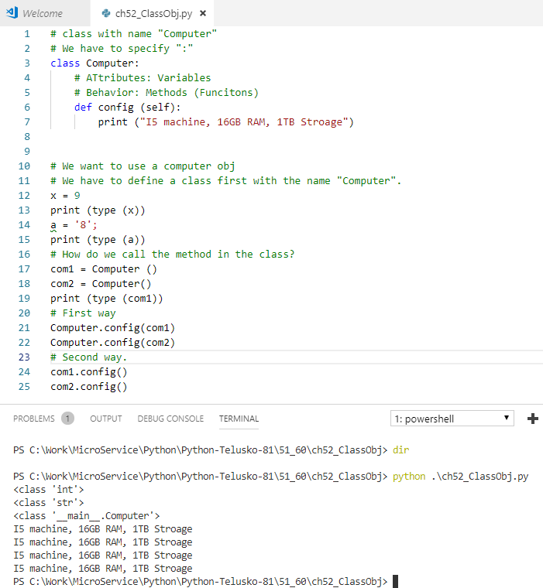
52 Class and Object
https://www.youtube.com/watch?v=8O5kX73OkIY&list=PLsyeobzWxl7poL9JTVyndKe62ieoN-MZ3&index=52
Python OOP.

Slide 4
End of Chapter

