Slide 1

37 Argument Type
Peter H. Chen

Slide 2
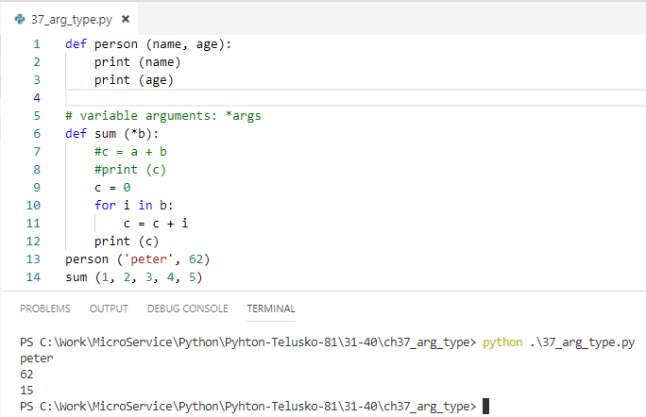
37 Argument Type
https://www.youtube.com/watch?v=eci9iU_s6Ag&list=PLsyeobzWxl7poL9JTVyndKe62ieoN-MZ3&index=37
Argument type: variable argument *args.

Slide 3
End of Chapter

