Slide 1

15 Swap Variable
Peter H. Chen

Slide 2
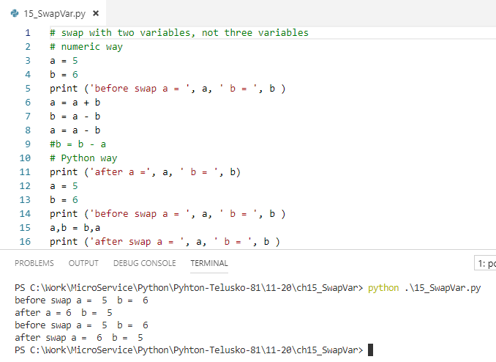
15 Swap Variable
https://www.youtube.com/watch?v=3dpJrMtxYeo&list=PLsyeobzWxl7poL9JTVyndKe62ieoN-MZ3&index=15
This section discusses the swap variables with two variables.
Normally, we swap variables with three variables with one extra temp variable.
Python can swap with two variables.

Slide 3
End of Chapter

