Slide 1

58 Inheritance
Peter H. Chen

Slide 2
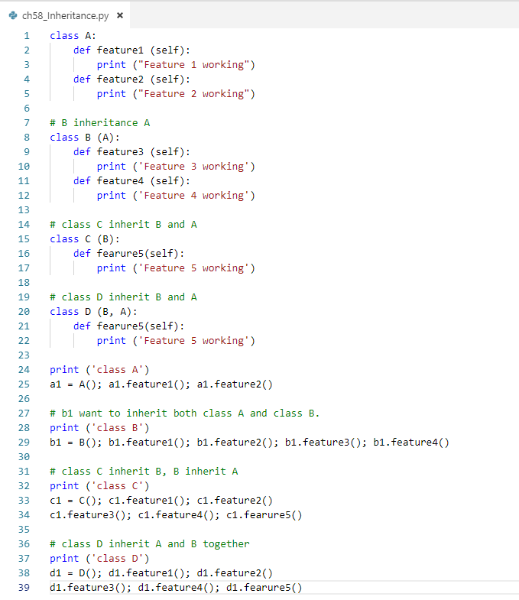
58 Inheritance
https://www.youtube.com/watch?v=Cn7AkDb4pIU&list=PLsyeobzWxl7poL9JTVyndKe62ieoN-MZ3&index=58
Inheritance: Parent and child relationship.
Class A
Class B inherit class A
Class C inherit class B
Class D multiple inherit class A and B

Slide 3
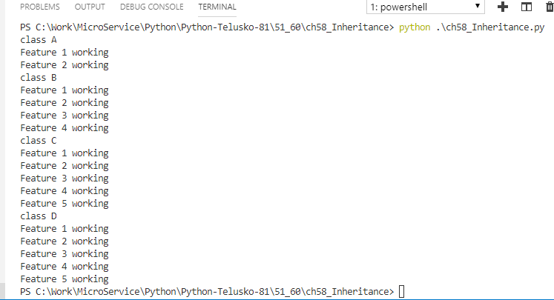
58 Inheritance
https://www.youtube.com/watch?v=Cn7AkDb4pIU&list=PLsyeobzWxl7poL9JTVyndKe62ieoN-MZ3&index=58
Inheritance: Parent and child relationship.
Class A
Class B inherit class A
Class C inherit class B
Class D multiple inherit class A and B

Slide 4
End of Chapter

